Slide 1
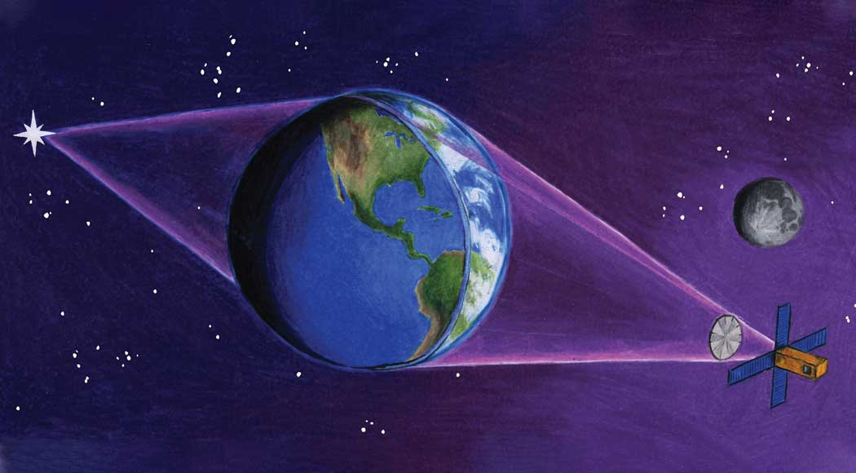

The atmosphere as a telescope: the Terrascope
Shane Alpert
Advisors: Paul M. Visser & Daphne Stam

Slide 2
Outline
Introduction
  Telescopes
  Terrascope
  Research Questions
Geometric Optics
Atmospheric Effects
Thesis research

Slide 3
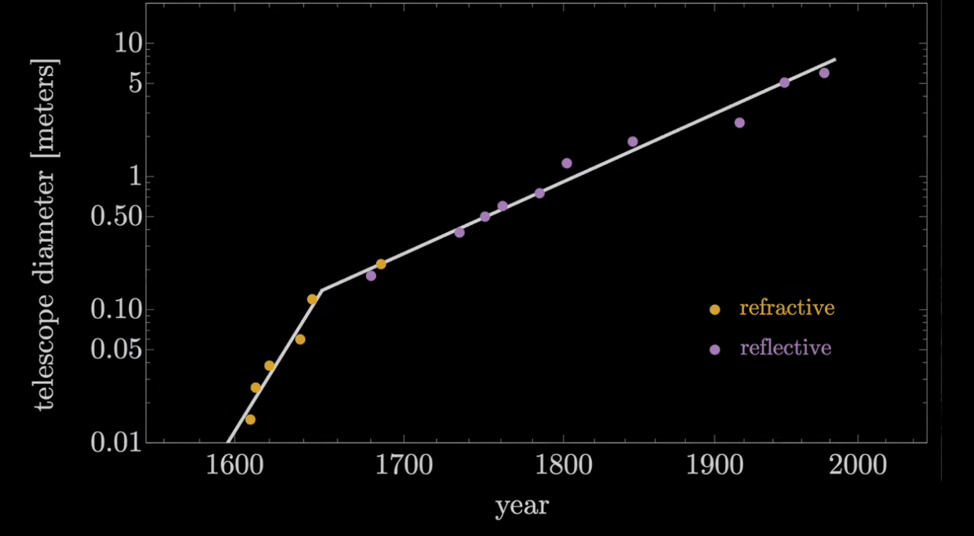
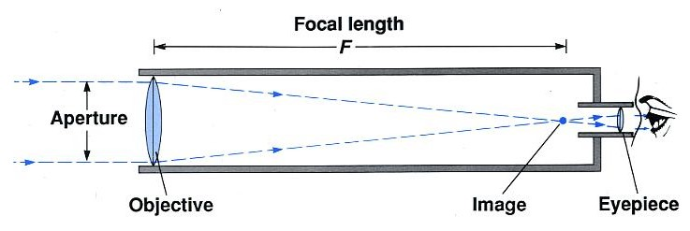
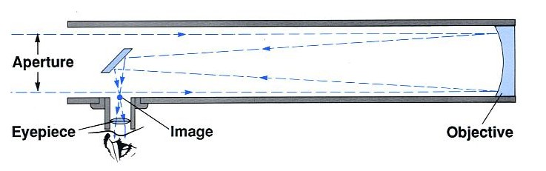

Introduction – Telescopes
“Astronomers crave photons”
$\frac{Signal}{Noise}$ $∝$ $\sqrt{\frac{\# photons}{unit time}}$ $∝$ $\sqrt{telescope area}$ $∝$ $telescope diameter$
Types of Telescopes
  Refractive
  Reflective

Slide 4

Introduction – Telescopes
“Astronomers crave photons” , but increasingly expensive
$\frac{Signal}{Noise}$ $∝$ $\sqrt{\frac{\# photons}{unit time}}$ $∝$ $\sqrt{telescope area}$ $∝$ $telescope diameter$

Slide 5
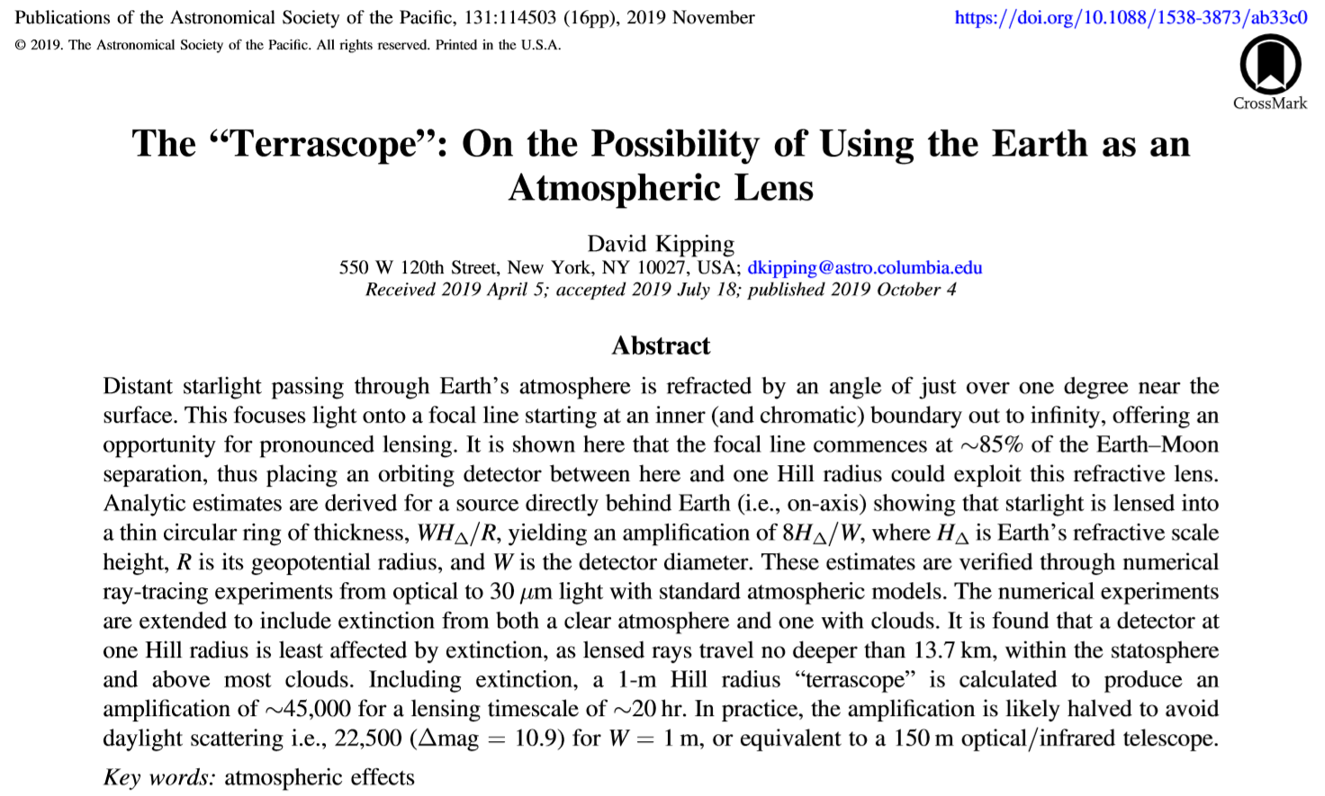
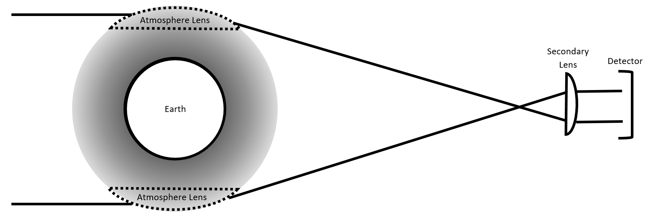

Introduction – Terrascope
Alternative: natural lenses
  Earth’s atmosphere
    Distance?
    Amplification?
    Atmospheric effects?

Slide 6
Introduction – Terrascope
Earth’s atmosphere
    Distance: 1.5 × 10⁶ km
    Amplification: 22,500
    Atmospheric effects: extinction coefficients not too severe and clouds avoided if detector is far enough
The simplified model, the proof of concept, seems to work. But what happens when we incorporate complexities?

Slide 7
Introduction – Research Questions
Can the Terrascope be a useful telescope, and if so, to what extent?
  What assumptions underlie the simplified model of using the Earth’s atmosphere as a telescope?
  What effects will diminish the quality of the Terrascope?

Slide 8
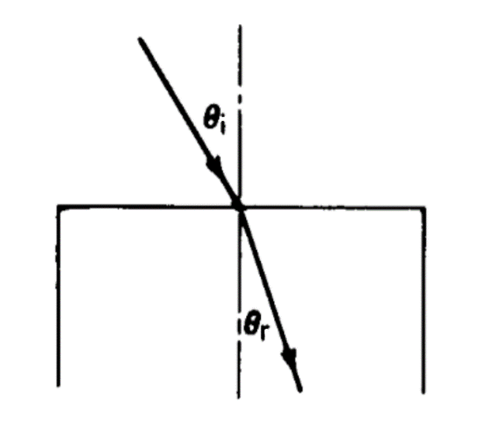
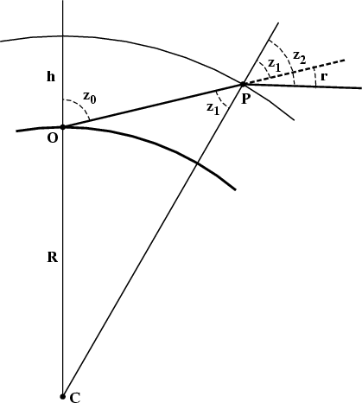
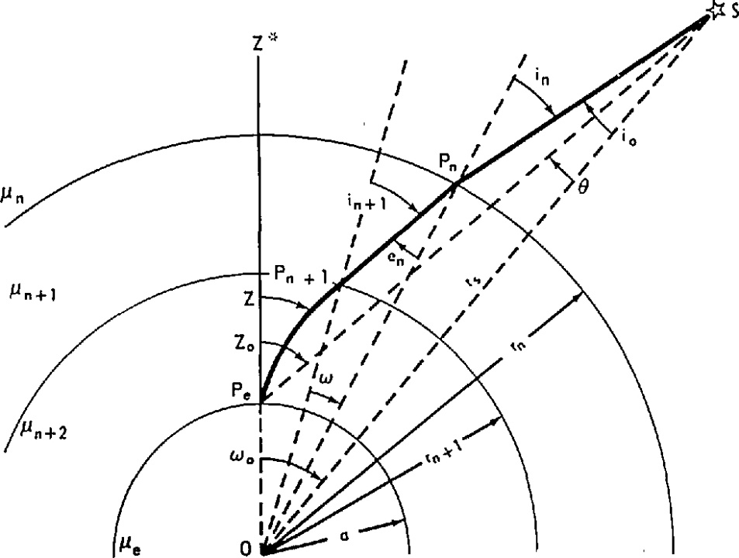
Geometric Optics – Refraction

Slide 9
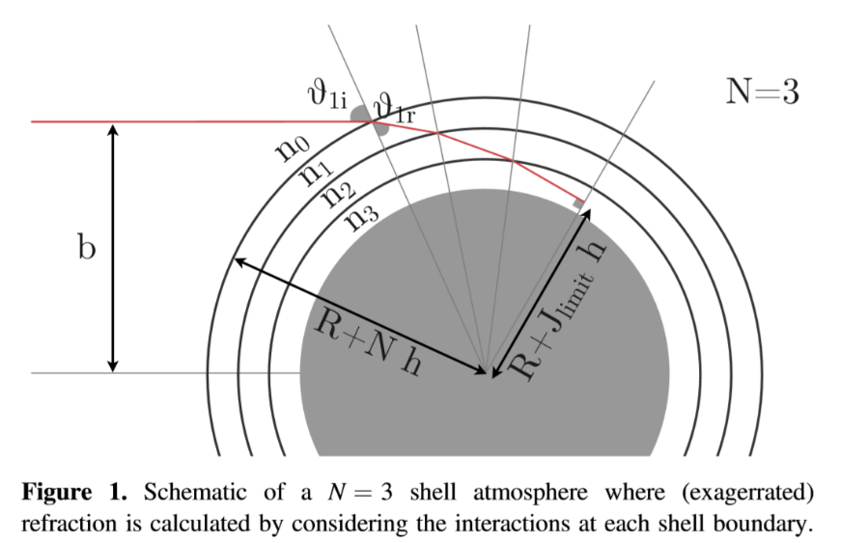








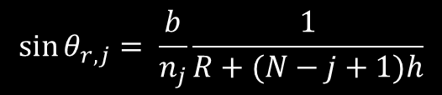



Geometric Optics – Ray-Tracing
$$n_{j−1}\sin{θ_{i,j}}= n_{j}\sin{θ_{r,j}}$$
$$\sin{θ_{i,1}= \frac{b}{1}}\frac{1}{R+Nh}$$
$$\sin{θ_{i,j}= \frac{b}{n_{j−1}}}\frac{1}{R+(N−j+1)h}$$
$$N: number of shells$$
$$n:refractive index$$
$$b: impact parameter$$
$$i: incidence$$
$$r: refraction$$
$$θ_{i/r}: angle of incidence/refraction$$
$$R: radius of Earth$$
$$Z: total altitude of atmosphere$$
$$h=\frac{Z}{N}: shell thickness$$
$$j: shell number (shallow to deep)$$
$$\sin{θ_{r,1}= \frac{b}{n_{1}}}\frac{1}{R+Nh}$$
$$\sin{θ_{r,j}= \frac{b}{n_{j}}}\frac{1}{R+(N−j+1)h}$$
$$α_{j}= θ_{i,j}− θ_{r,j}$$
$$α_{j}: deflection angle of ray$$
$$Δ=2\sum_{j=1}^{J_{limit}}{α_{j}}$$
$$Δ: total deflection angle$$
$$F=b_{crit}\cot{Δ_{crit}}$$
$$F:inner focus$$

Slide 10


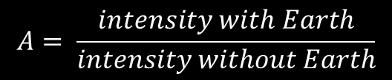

Geometric Optics – Amplification
$$A= \frac{intensity with Earth}{intensity without Earth}$$
$$A=ε\frac{b_{+}^{2}−b_{−}^{2}}{{\left(W/2\right)}^{2}}$$
$$\frac{A}{ε}\sim \frac{55,000}{W}$$
$$A: amplification$$
$$b_{+}: impact parameter to strike top$$
$$b_{−}: impact parameter to strike bottom$$
$$W: aperture (diamter) of detector$$
$$ε: loss parameter due to extinction$$

Slide 11
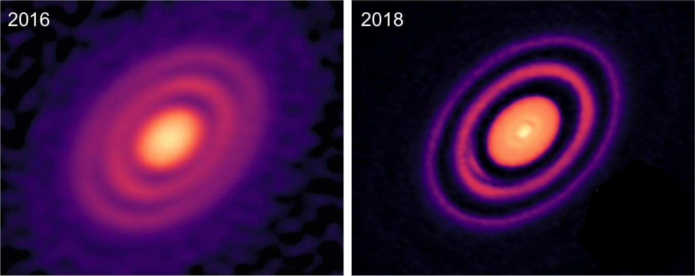
Geometric Optics – Angular Resolution

Slide 12
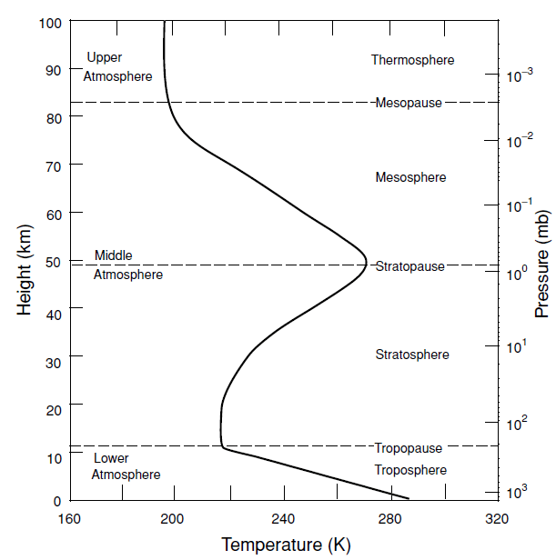
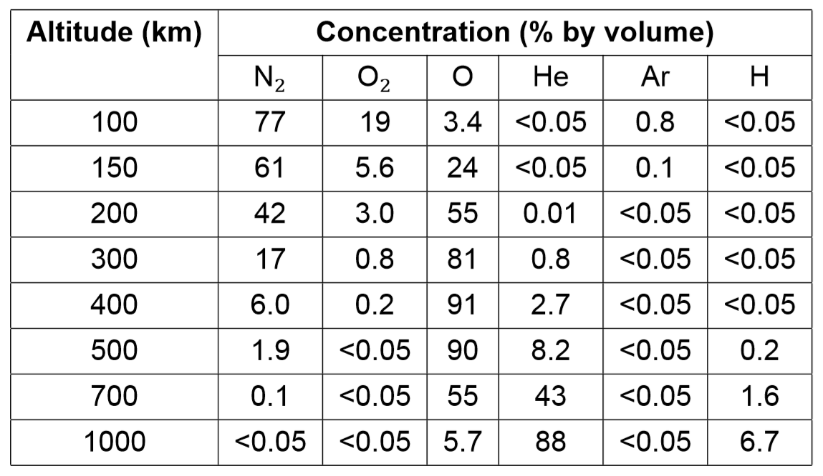
Atmospheric Effects

Slide 13
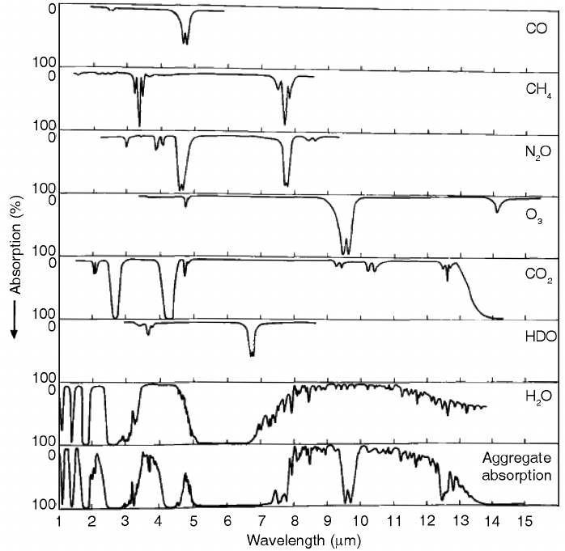
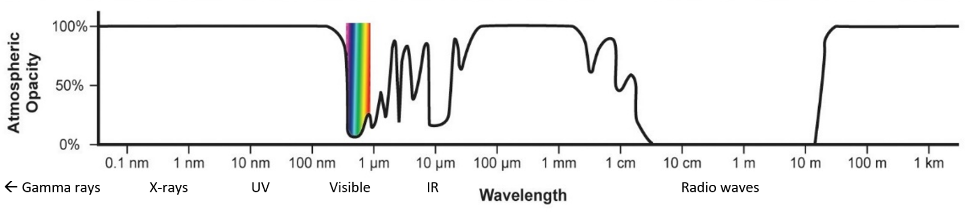
Atmospheric Effects – Absorption

Slide 14
Atmospheric Effects – Absorption
Natural line broadening:
  uncertainty in quantum energy states
Doppler broadening:
  Maxwell velocity distribution of gas
Pressure broadening:
  collisions between particles
Power/saturation broadening:
  increased intensity of light

Slide 15





Atmospheric Effects – Scattering
$$x=\frac{2πr}{λ}$$
$$x:scattering parameter$$
$$r:molecule radius$$
$$λ:light^{′}s wavelength$$
Rayleigh:
  Upper atmosphere, dust/N₂/O₂, intensity inversely proportional to $λ^{4}$
Mie:
  Lower atmosphere, clouds, intensity independent of $λ$ / can depend on $r$
Single vs. multiple scattering
$$x≪1$$
$$x∼1$$

Slide 16
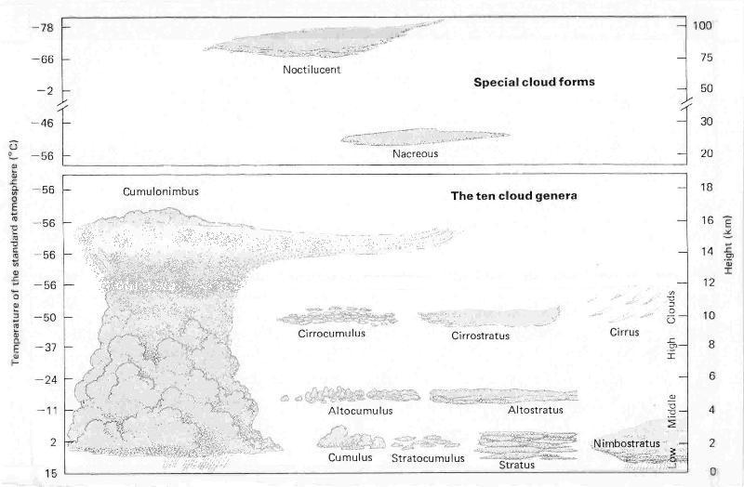
Atmospheric Effects – Clouds
Rising, cooling air → cools to dew point
Condensation nuclei → water vapour and ice crystals
Altitude dependence
Scattering
Turbulence
Notes:
Turbulence due to wet, dense air inside the cloud spread unevenly. Rising warm air and other air from outside hits the uneven dense pockets on the inside

Slide 17
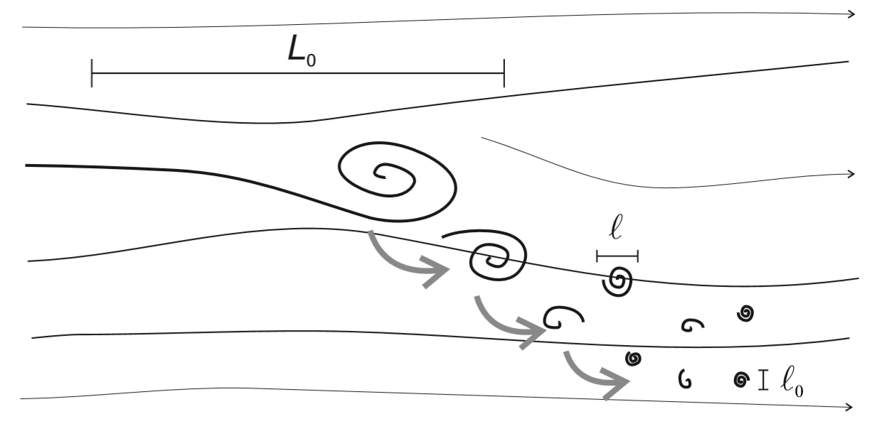
Atmospheric Effects – Turbulence
High Reynold’s number → density to viscosity
Eddies and turbulent cascades
Refractive index fluctuations
Structure constant used to describe turbulence strength
Fried parameter used to describe optical quality

Slide 18
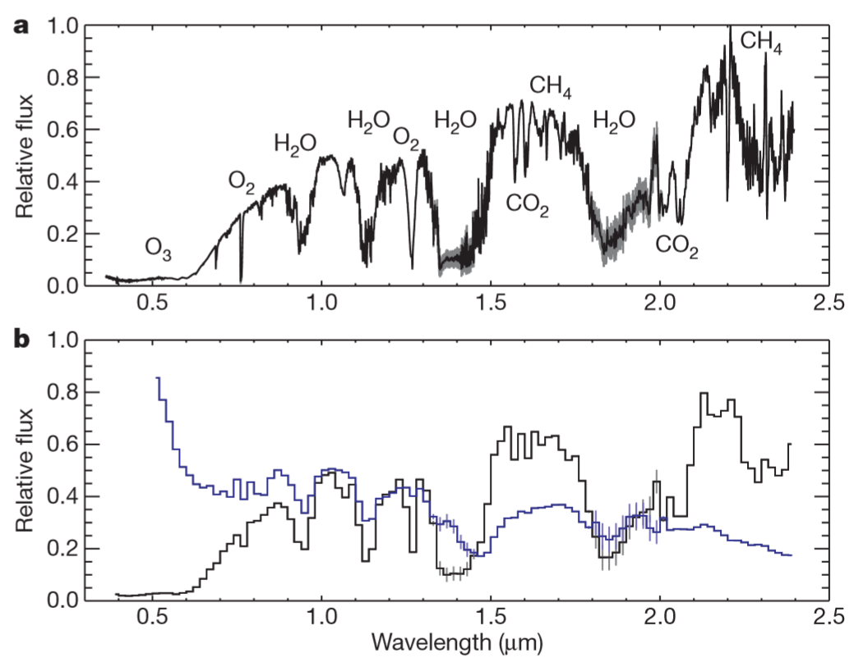
Atmospheric Effects – Transmission, Reflection

Slide 19
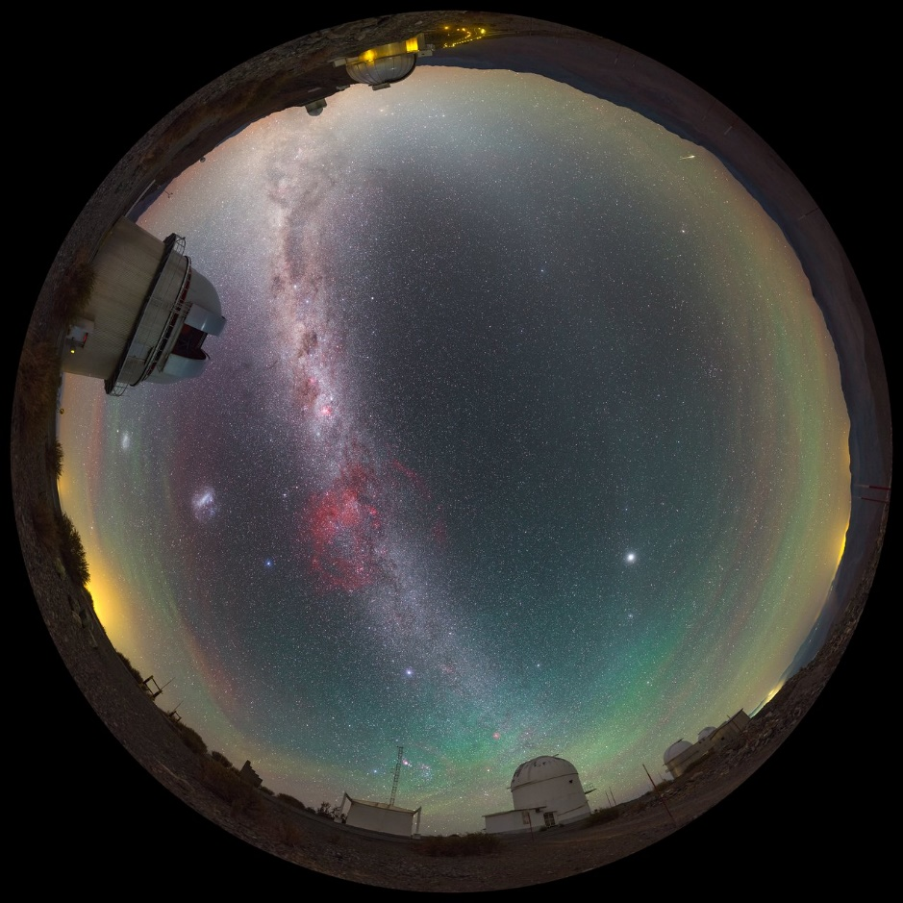
Atmospheric Effects – Airglow

Slide 20
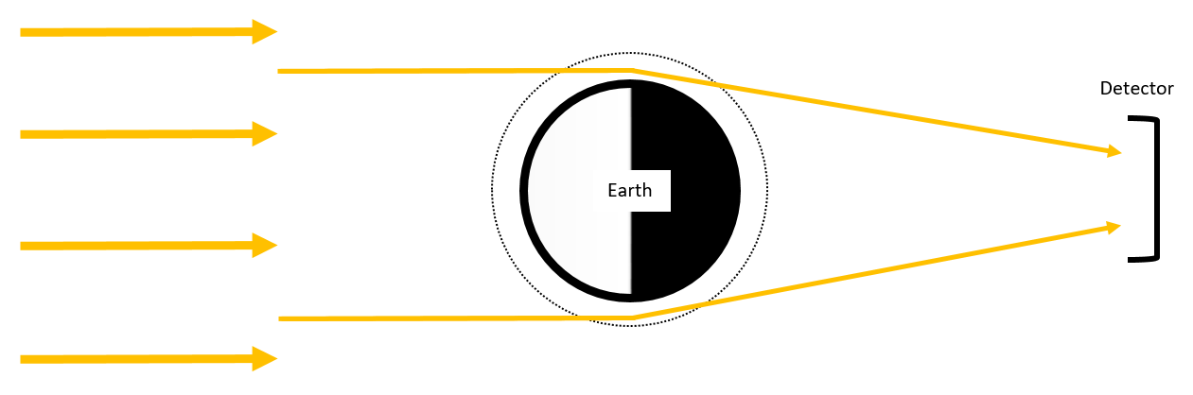
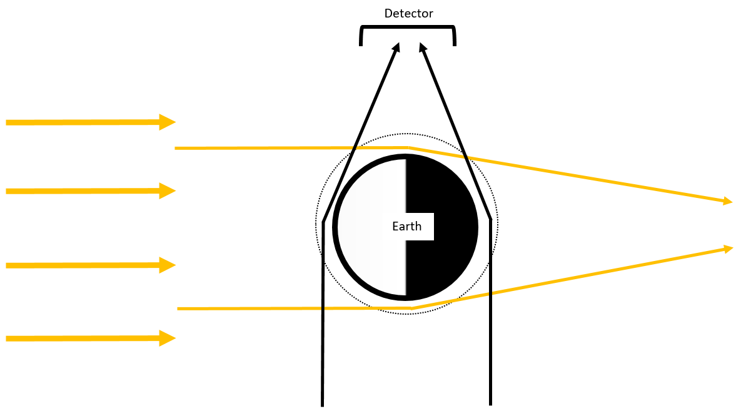
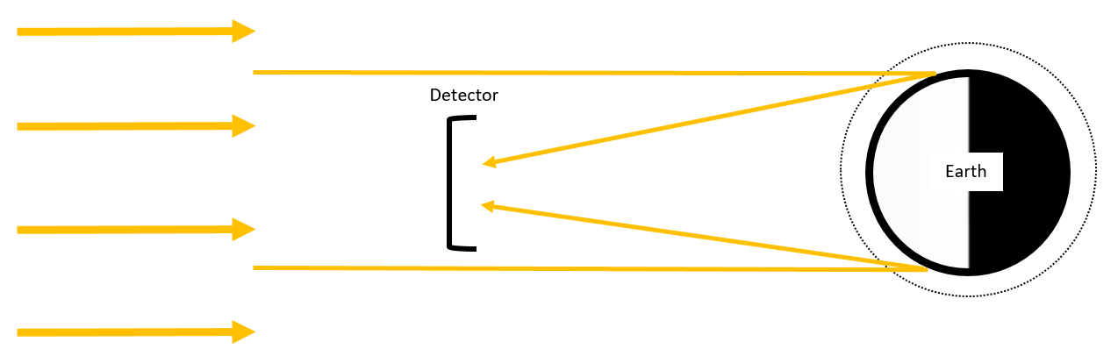
Atmospheric Effects - Variability
Length scales
Time scales
Position

Slide 21
Thesis Research
Starting point
On- and off- axis
Symmetry
Atmospheric TP profiles
Clouds
Turbulence
Airglow
Amplification
Image

Slide 22


$$C_{n}^{2}=\frac{〈{\left(n_{2}−n_{1}\right)}^{2}〉}{r^{2/3}}$$
Refractive index structure constant
r.i. fluctuations inc with eddy size inc
Eddy temp higher than surrounding air have higher r.i.
Murty 1979, Laser beam propagation in atmospheric turbulence
$${〈{\left[δn\left(l\right)\right]}^{2}〉=C}_{n}^{2}l^{2/3}$$

Slide 23
Thesis Research
Kipping | This Thesis
Start with source, end with detector | Start with detector, end with source
On- and off-axis calculated separately | Trace all rays to account for both on- and off-axis
Assume symmetry for on-axis | Don’t assume symmetry
Off-axis denoted by offset distance, Q | Off-axis denoted by offset angle
Atmospheric TP profiles average over global climate | Model local atmospheric TP profiles, not averaged
Accounts for clouds by averaging | Model local affects of clouds (different types of scattering, absorption, and transmission)
Ignored turbulence | Include turbulence
Ignored airglow | Include airglow
Approximate amplification | Numerically calculate amplification from light rays
Calculate shape of lensing | Get picture of different types of sources

