Slide 1
Literature review
Presentation 16/06/2021

Slide 2
Introduction
Renewable energies provide a large part of European electricity, but they pose challenges for network management.
Power-to-gas allows for storing surplus renewable electricity on the short or long term.
Gas and power networks are thus increasingly interdependent.
In order to predict infrastructure needs, the gas and power networks need to be modelled together.

Slide 3
Purpose
Examine the models used for coupled gas and power networks
Take a closer look at the linear models
Discuss practical aspects

Slide 4
Literature review
Power flow models
Gas flow models
Coupling elements
Numerics
Test networks

Slide 5
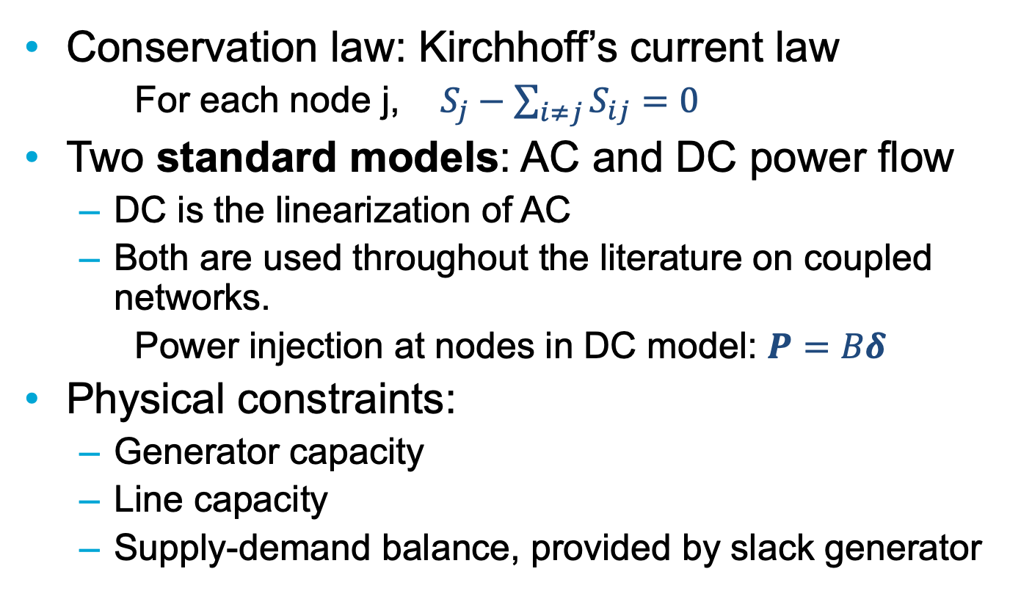
Power network models
Conservation law: Kirchhoff’s current law
  For each node j, $S_{j}−\sum_{i≠j}{S_{ij}=0}$
Two standard models: AC and DC power flow
  DC is the linearization of AC
  Both are used throughout the literature on coupled networks.
  Power injection at nodes in DC model: $P=Bδ$
Physical constraints:
  Generator capacity
  Line capacity
  Supply-demand balance, provided by slack generator

Slide 6
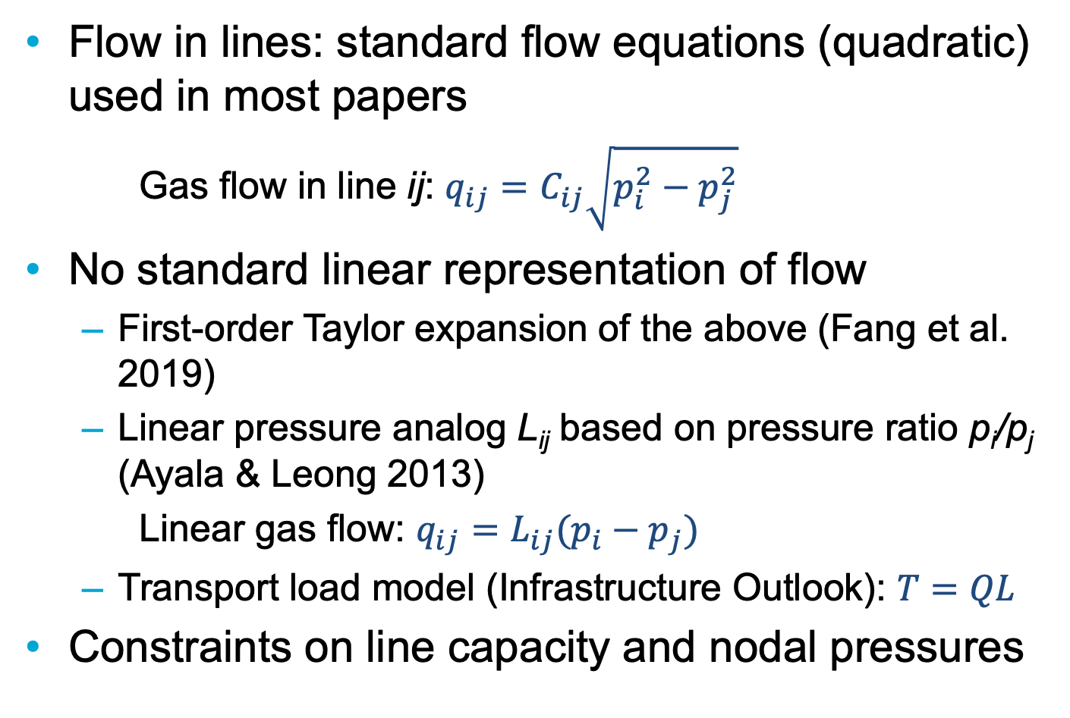
Gas network models: flow in lines
Flow in lines: standard flow equations (quadratic) used in most papers
Gas flow in line ij: $q_{ij}=C_{ij}\sqrt{p_{i}^{2}−p_{j}^{2}}$
No standard linear representation of flow
  First-order Taylor expansion of the above (Fang et al. 2019)
  Linear pressure analog L_{ij} based on pressure ratio p_{i}/p_{j} (Ayala & Leong 2013)
  Linear gas flow: $q_{ij}=L_{ij}(p_{i}−p_{j})$
  Transport load model (Infrastructure Outlook): $T=QL$
Constraints on line capacity and nodal pressures

Slide 7
Gas network models: nodes and storage
At nodes: mass conservation
Long-term, large-scale storage
  Treated as a source or a sink depending on the needs
  Constraints of min/max capacity, and injection/withdrawal rates
Short-term storage: linepack
  Consists of varying the pressure in pipelines to create a small reserve of gas
  Used for immediate adjustments of supply in response to demand fluctuations
The possibility for storage is the major difference between the gas and power networks, along with the reaction time
Storage is not systematically modelled

Slide 8
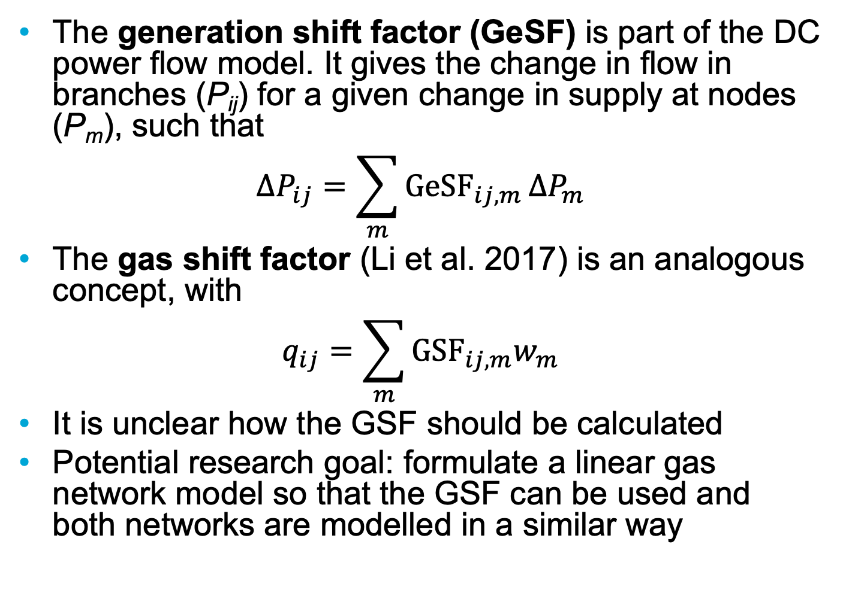
Generation shift factor and gas shift factor
The generation shift factor (GeSF) is part of the DC power flow model. It gives the change in flow in branches (P_{ij}) for a given change in supply at nodes (P_{m}), such that
$${ΔP}_{ij}=\sum_{m}{{GeSF}_{ij, m}}{ΔP}_{m}$$
The gas shift factor (Li et al. 2017) is an analogous concept, with
$$q_{ij}=\sum_{m}{GSF_{ij,m}w_{m}}$$
It is unclear how the GSF should be calculated
Potential research goal: formulate a linear gas network model so that the GSF can be used and both networks are modelled in a similar way

Slide 9
Coupling the networks
Interaction between energy carriers happens at coupling nodes:
  Gas-fired power plants: gas is burned to obtain electricity via turbines.
  Power-to-gas facilities: surplus power is converted to hydrogen or synthetic natural gas (SNG).
  Electric compressors: gas is compressed to compensate for pressure loss in pipelines. This demands energy, which may be provided by a gas turbine or by electricity. Energy demand may be modelled with a linear equation (Geidl & Andersson 2007).
The round-trip conversion efficiency of hydrogen is higher than that of SNG, but hydrogen needs its own infrastructure.

Slide 10
Numerics and optimization
In general, coupled models are large, underdetermined systems of nonlinear equations.
Common strategy: give enough initial data that the system is fully determined and use Newton-Raphson.
  NR’s convergence is sensitive to initial conditions and adequate initial data is difficult to obtain.
Otherwise: try to find an optimal solution
  Nonlinear optimization is tricky: either linearize (piecewise) or use fancy algorithms
Also sometimes used: construct a linear problem
  Linear and nonlinear models may be combined, often one for each energy carrier

Slide 11
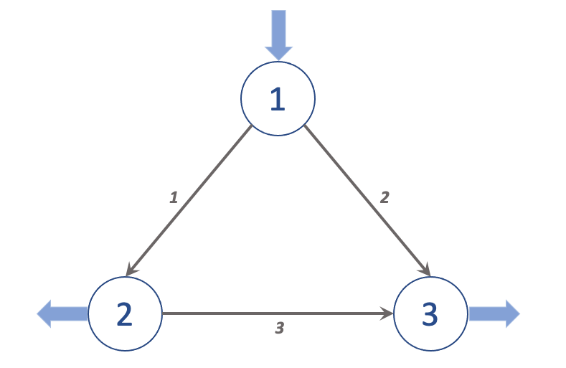
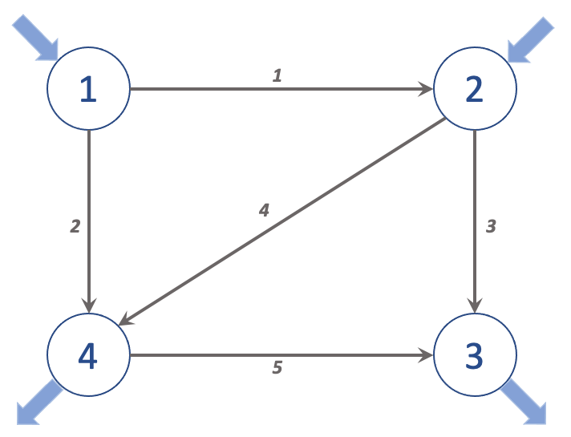
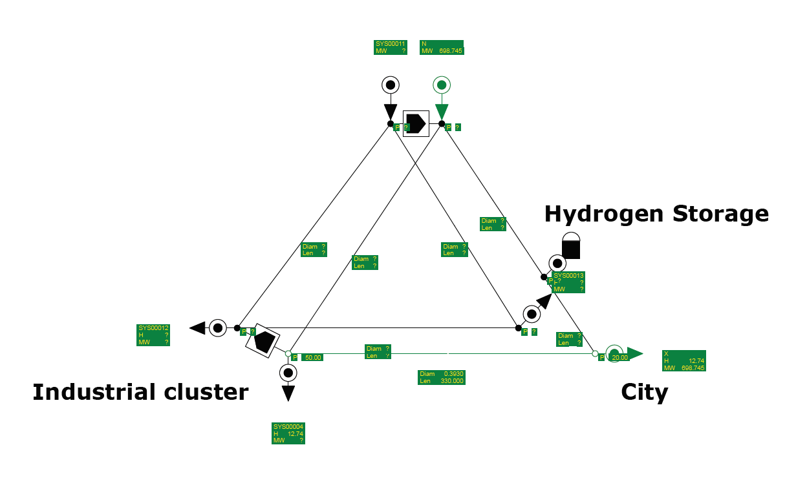
Test networks and software
Standard IEEE test networks for electricity models
No such standard exists for gas, but a library has been assembled for testing purposes (GasLib)
Very small networks to be used for initial testing; can be studied analytically (to an extent)
For implementation of power network analysis: MATPOWER library
Some MATLAB libraries may be usable for gas network analysis

Slide 12
Summary
Modelling of power networks is a well-studied problem; many tools available to help with implementation
Gas networks are trickier:
  No standard linear model, but many ways to simplify
  One library of test networks; not standard yet
Two schools for coupled models:
  Solve for gas flow and power flow separately, with data exchange between the two
  Solve all together
Some constraints (conservation of mass and power, capacity) need to be observed but the physics can be simplified

Slide 13
References
X. Fang, M.T. Craig, and B.-M. Hodge. 2019. ‘Linear Approximation Line Pack Model for Integrated Electricity and Natural Gas Systems OPF’. In 2019 IEEE Power & Energy Society General Meeting (PESGM), 1–5. Atlanta, GA, USA: IEEE.
L.F. Ayala H. and C.Y. Leong. 2013. ‘A Robust Linear-Pressure Analog for the Analysis of Natural Gas Transportation Networks’. Journal of Natural Gas Science and Engineering 14 (September): 174–84.
G. Li, R. Zhang, T. Jiang, H. Chen, L. Bai, and X. Li. 2017. ‘Security-Constrained Bi-Level Economic Dispatch Model for Integrated Natural Gas and Electricity Systems Considering Wind Power and Power-to-Gas Process’. Applied Energy 194 (May): 696–704.
M. Geidl and G. Andersson. 2007. ‘Optimal Power Flow of Multiple Energy Carriers’. IEEE Transactions on Power Systems 22 (1): 145–55.
M. Schmidt, D. Aßmann, R. Burlacu, J. Humpola, I. Joormann, N. Kanelakis, T. Koch, et al. 2017. ‘GasLib—A Library of Gas Network Instances’. Data 2 (December): 40.

Slide 14
Research questions: model construction
How to formulate a unified linear model for the combined network?
  How unified does it need to be?
  How to reflect the different reaction times of gas and power? (Is that necessary, since we compute steady state flow?)
Transport load model for gas: use it?
  Compatible with GSF?
  How to implement communication between gas and power networks?
How does my model compare with the one used in the Infrastructure Outlook?

Slide 15
Research questions: input and output
How much input data is needed?
What constitutes good input data?
  What are the consequences of bad input data?
How accurate are the simulation results?
  How much accuracy is needed?
  How can the accuracy be evaluated?
Which infrastructure and energy generation scenarios are feasible? Desirable?
  How much interaction between gas and power networks? Where and when?
  What are the consequences of network coupling on infrastructure needs?

Slide 16
Upcoming work
Further study linear gas models:
  Decide which formulation is the most appropriate for my work
  Try it on toy networks: analytical study and implementation
Check that I have a functional implementation of power network model
Work out the details of coupling
  Calculate relevant coefficients and constraints
Formulate a combined gas&power model
  Ideally, define gas shift factor so that the gas model looks like the power model

Slide 17


