Slide 1
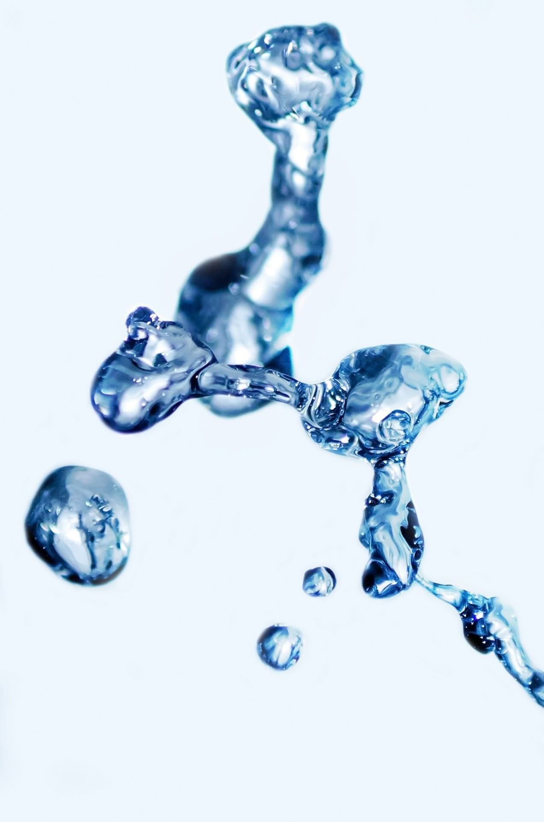
Calibrating the surface tension in SPH independently of the fluid rheology
Made by :
  Kjeld Broekema
Thesis committee:
  Prof. dr. ir. K. Vuik
  Prof. dr. ir. J. T. Padding
  Prof. dr. ir. A. W. Heemink
  Ir. S. Sneijders

Slide 2
Content
Motivation
Research question
SPH: Smoothed Particle Hydrodynamics
Particle Interaction Forces (PIF)
Method calibrating surface tension
Numerical experiments
Results
Conclusion and recommendations

Slide 3
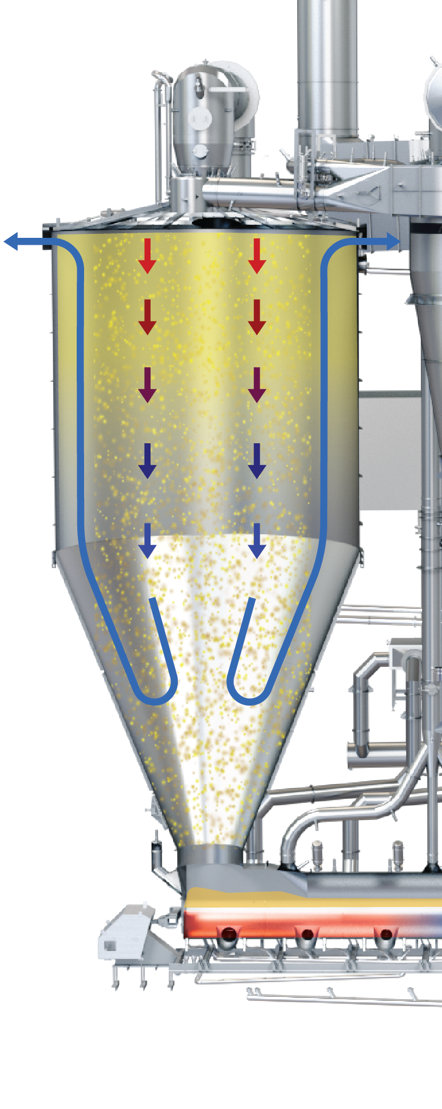
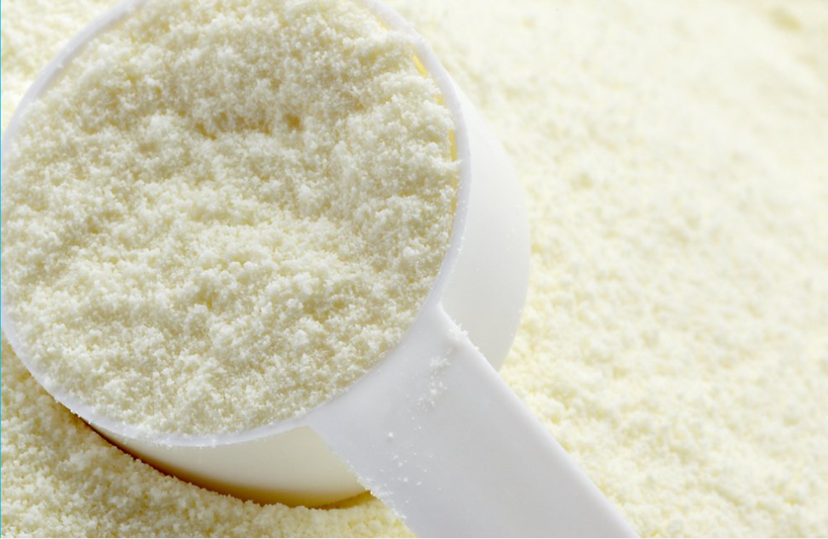

Motivation: spray drying
Extending shelf live:
  milk and yeast extract
Spray drying equipment

Slide 4
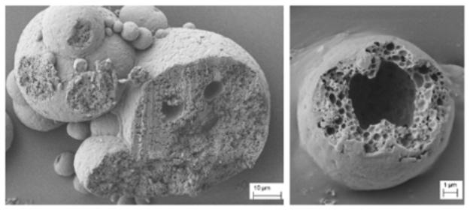
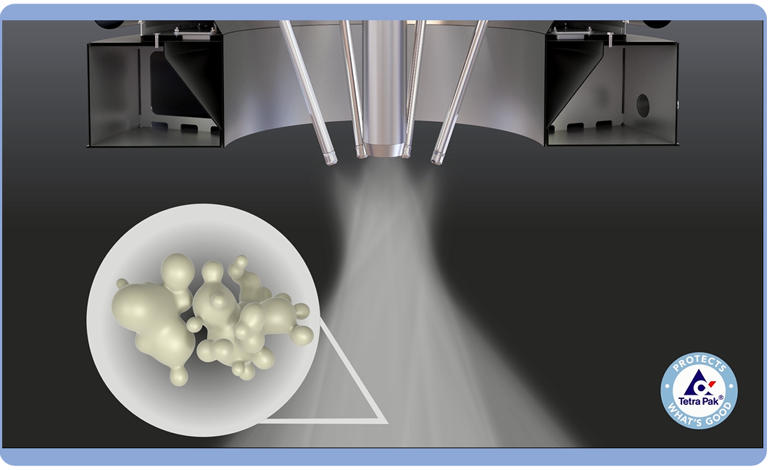
Motivation: quality
Quality end product
  Density
  Particle size
Costly and wasteful production­ trials
Computer models
Incomplete physical foundation
  Viscoelastic properties (rheology)
  Surface tension

Slide 5

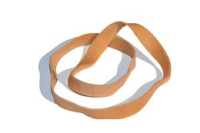
Motivation: rheology
Viscosity, elasticity and viscoelasticity
Constitutive equation
Particle Interaction Forces (PIF)

Slide 6
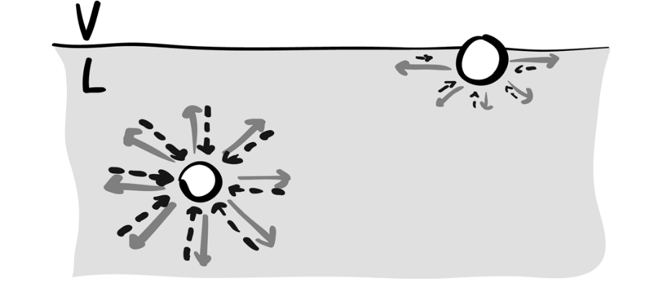
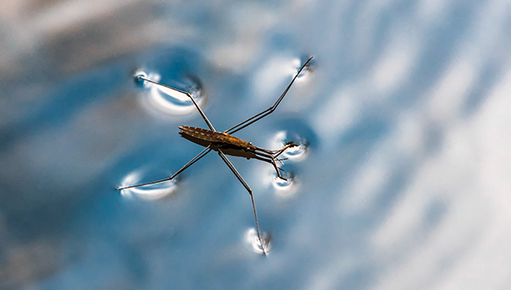
Motivation: surface tension
Missing bonds
Parallel force
PIF affects surface tension

Slide 7
Research question
How can Particle Interaction Forces (PIF) be used to calibrate the fluid rheology while adjusting surface tension independently?

Slide 8
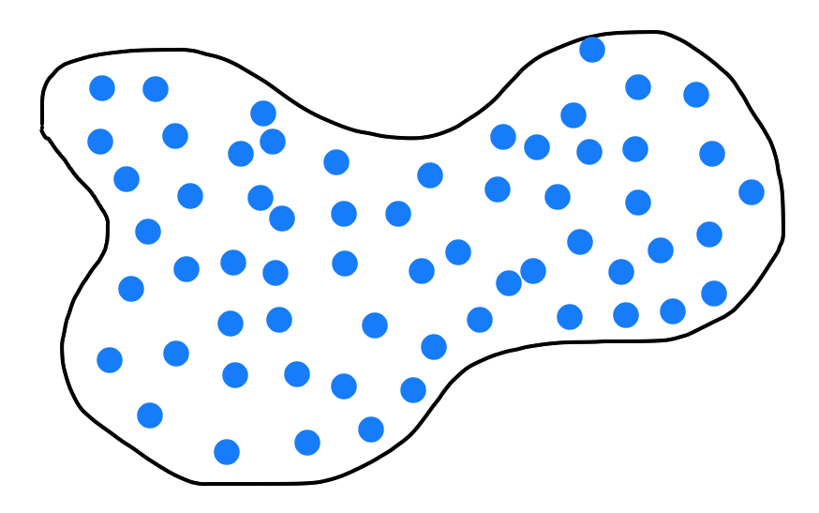
Numerical Method
Smoothed Particle Hydrodynamics (SPH)
  Meshless method
  Fluid discretized in a finite set of particles
  Particles carries field properties
    Density, velocity
Advantages
  Large deformations
  Complex (free) surfaces
Disadvantage
  Convergence

Slide 9
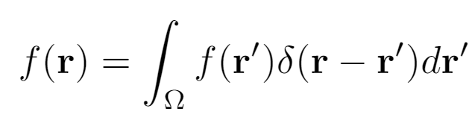
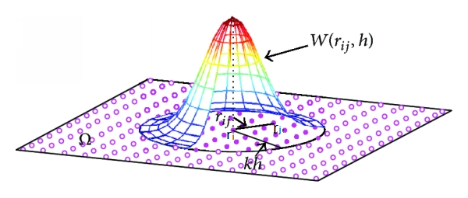
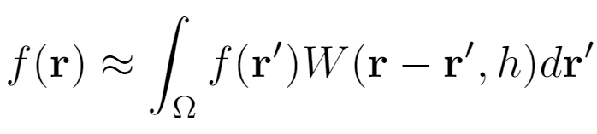
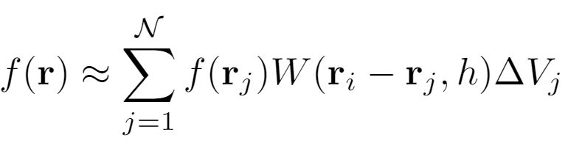

Smoothed Particle Hydrodynamics
Smoothing approximation
Particle approximation

Slide 10
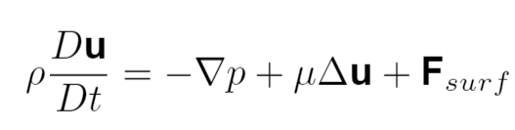

Incompressible fluid (SPH)
Two methods
  Incompressible SPH (ISPH)
    Pressure Poisson equation (PPE)
  Weakly Compressible SPH (WCSPH)
    Equation of state (EOS)
Incompressible Newtonian fluid
Navier-Stokes

Slide 11
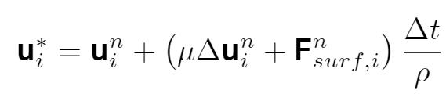
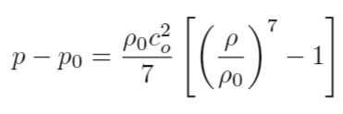
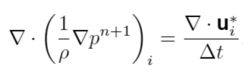
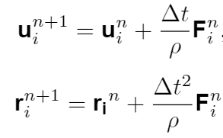
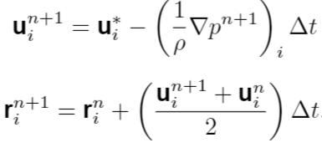
ISPH WCSPH
Predictor step
Tait equation (EOS)
Corrector step (solving the PPE)
Update step
Update step

Slide 12
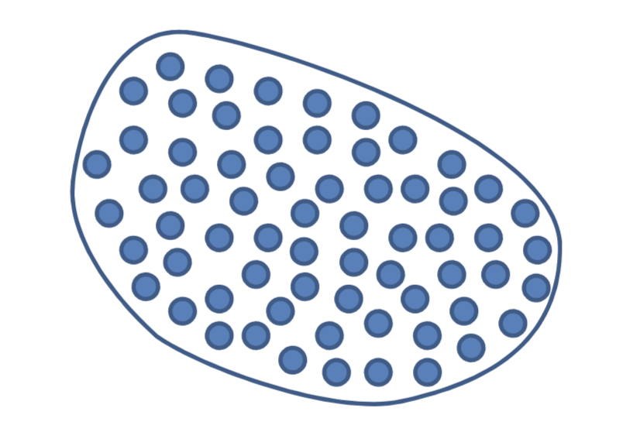
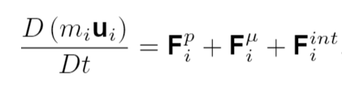
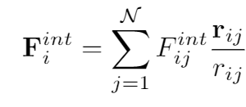
Particle Interaction Forces (PIF)
r_{ij}
r_{ij}
Increasing S_{ij}
(Incompressible) Newtonian fluid
x₁
x₂
PIF for viscoelastic behaviour

Slide 13

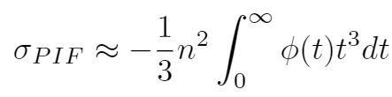
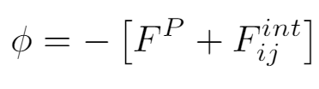
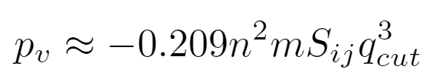
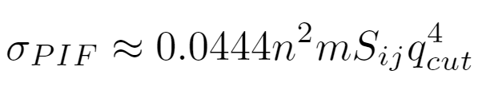


PIF: virial pressure and surface tension
Analytical estimation
$$=$$
$$=$$
$$=$$
$$=$$

Slide 14

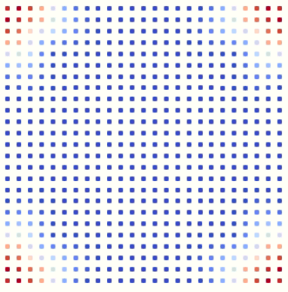




Calibrating surface tension
Continuum Surface Force (CSF)
Unit normal
Color function
Curvature
Surface delta function

Slide 15
Numerical experiments
Static
Dynamic

Slide 16

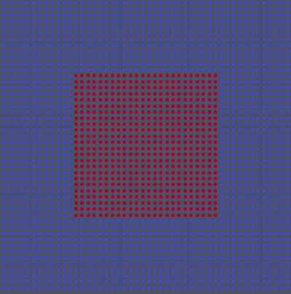
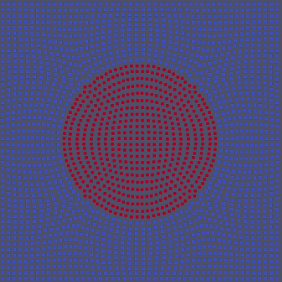
Numerical experiments: static
Droplet deformation
Balance: surface tension and pressure (Young-Laplace)

Slide 17
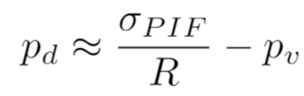
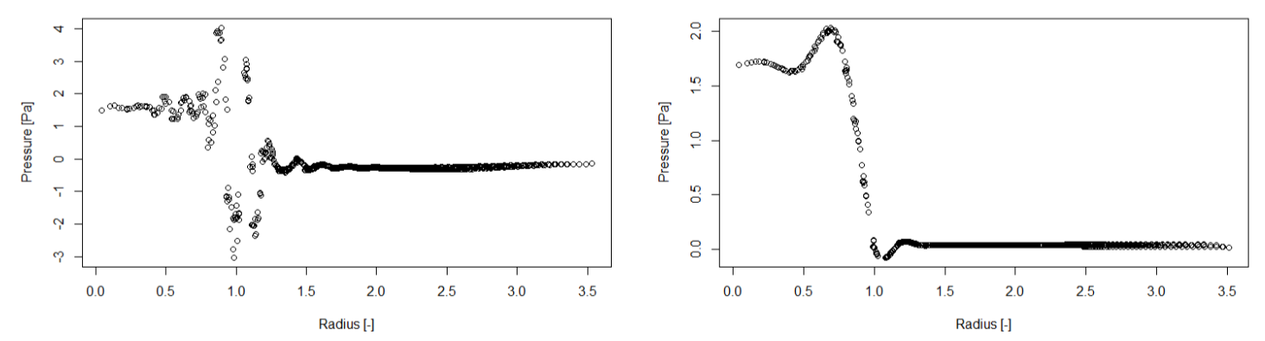
Results: static (PIF)
Estimations
WCSPH ISPH

Slide 18

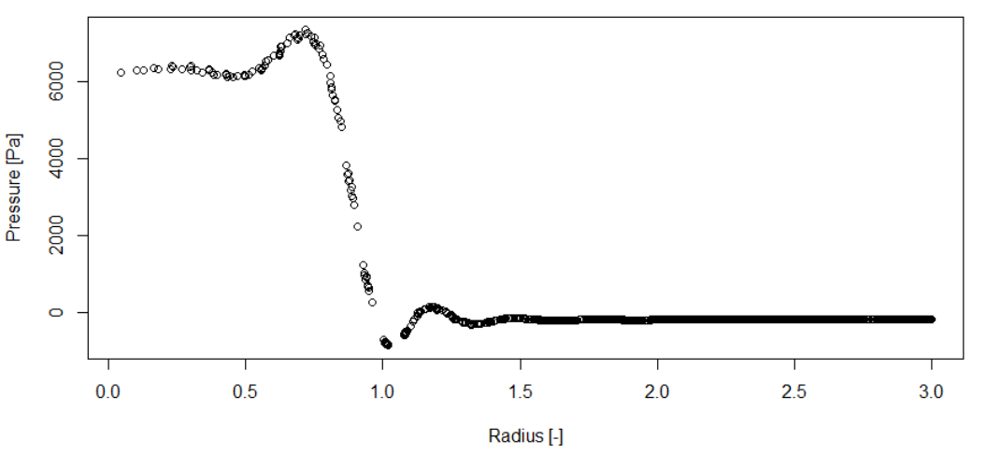
Results: static (PIF and CSF)
Express droplet pressure as (decoupled):
Pressure profile

Slide 19
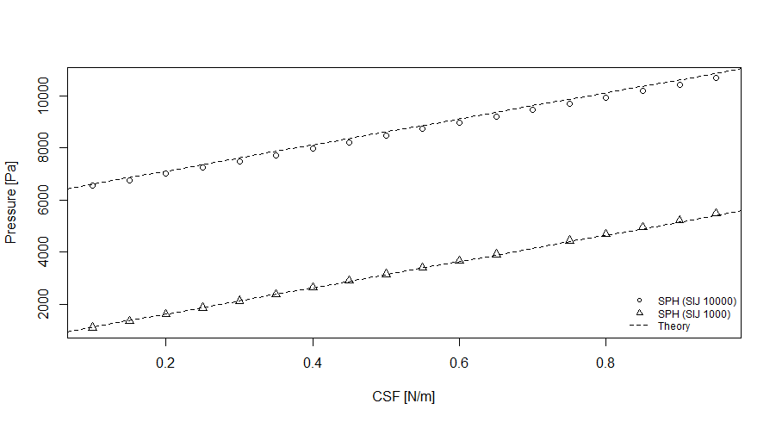
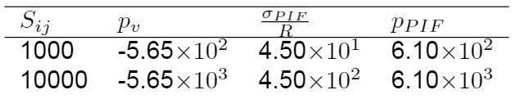
Results: static (PIF and CSF)
Contributions surface tension and virial pressure

Slide 20
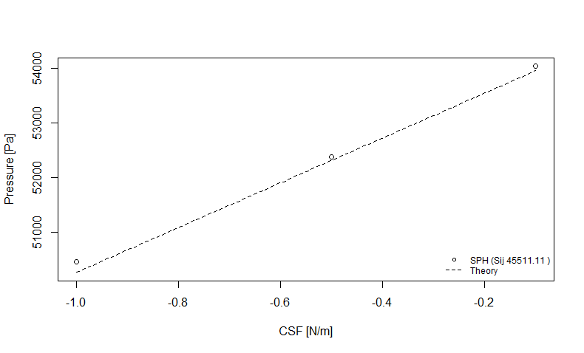
Results: static (PIF and CSF)
Lowering the PIF induced surface tension

Slide 21
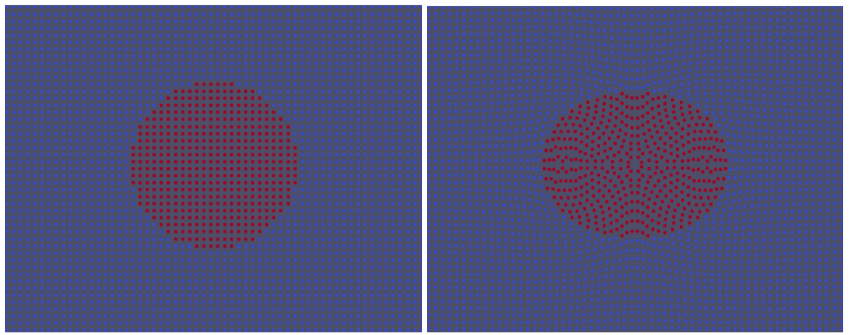
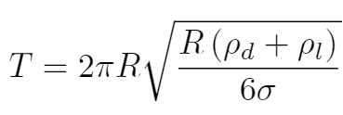
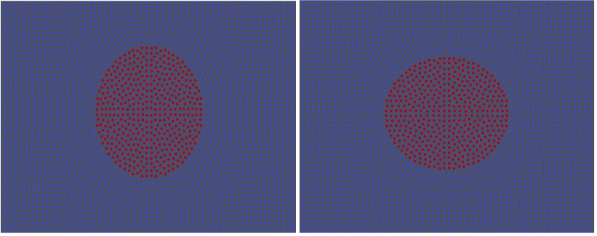
Numerical experiments: dynamic
Oscillating droplet
Dominant surface tension
Newtonian fluid
Theoretical period:

Slide 22
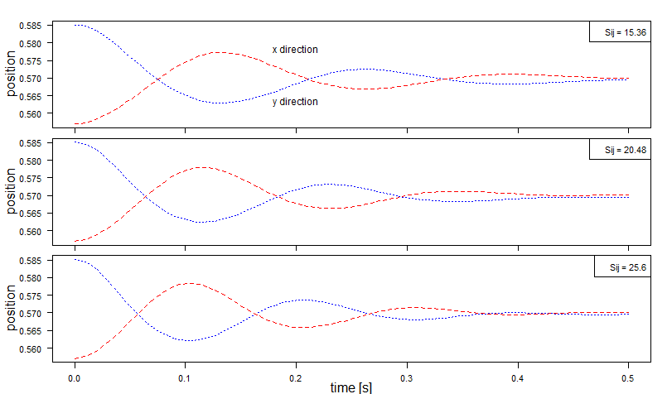
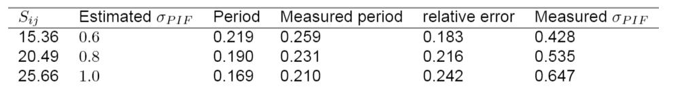
Results: dynamic (PIF)
Compact radius
Underestimation surface tension
Surface tension not dominant

Slide 23
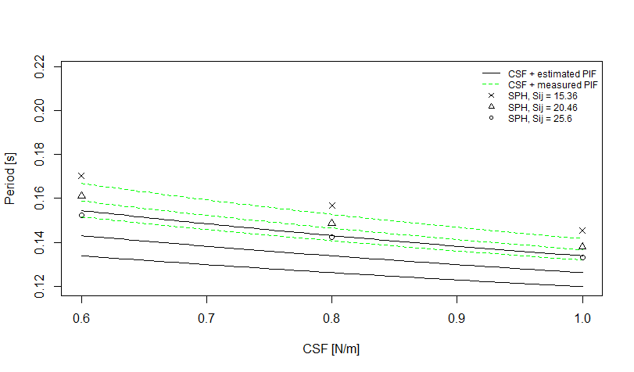
Results: dynamic (PIF and CSF)

Slide 24
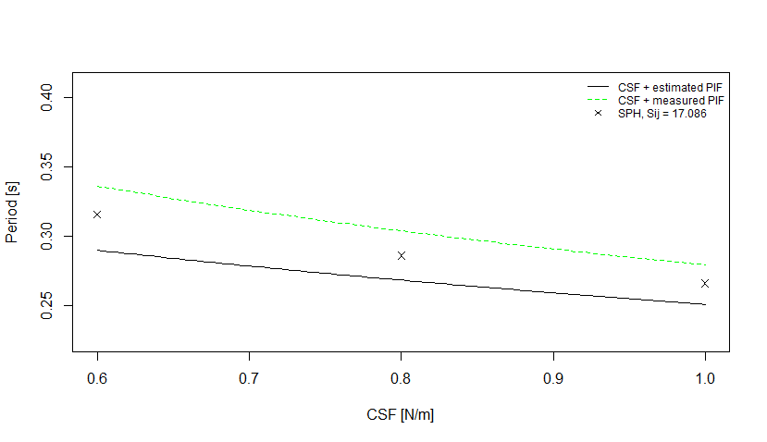
Results: dynamic (PIF and CSF)
Higher resolution

Slide 25
Conclusions
Static case: decoupled
Static case: lowering the PIF surface tension
Dynamic case: inconclusive results

Slide 26
Recommendations
Constitutive equation
Convergence study
Free surface droplet

