Slide 1
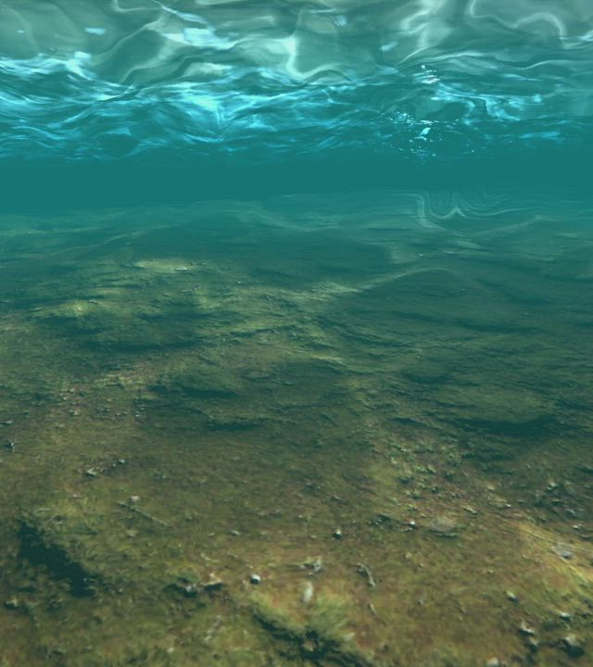

Compressible vs. incompressible pore water in fully-saturated poroelastic soil
Literature report
Femke Klein
18 december

Slide 2
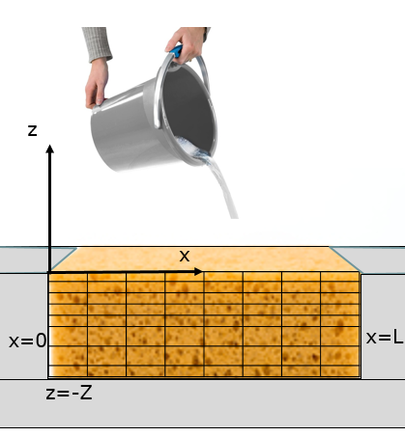
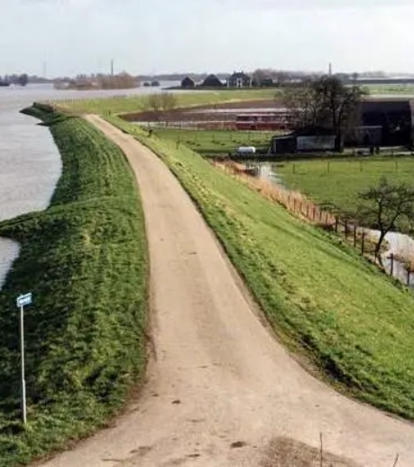
Introduction
Levees are important for the Netherlands.
Oscillations in the seabed due to wave load can have an impact on the levees.
Like a bucket of water being poured on a sponge enclosed by a wall at the sides and bottom.
Aim:
describe the behaviour of the seabed subjected by waves.
  Two models
(Cormont, 1995)
(Van Damme, 2022)

Slide 3
Contents
Resulting physical model in 2D
The model of Biot in 2D
The model of Van Damme and Den Ouden-Van der Horst (new) in 2D
Resulting physical model in 1D
Number of (stationary) solutions
Discretisation in space and time
1D results of Biot’s model for (in)compressible water
1D results of new model for (in)compressible water
Conclusion and discussion
Further research
(Van Damme, 2022)

Slide 4
Assumptions
A fully-saturated poroelastic soil is assumed.
Acceleration terms are ignored.
Computational grid in 2D has length L and depth Z.
Computational grid is enclosed at the sides and bottom. So no flow is assumed to be at the left, bottom and right boundaries.
(Van Damme, 2022)

Slide 5

Assumptions
If the water is assumed to be compressible, the compressibility $β=4.8⋅{10}^{−10}$ is chosen.
If the water is assumed to be incompressible, the compressibility is $β=0.0.$
(Van Damme, 2022)

Slide 6
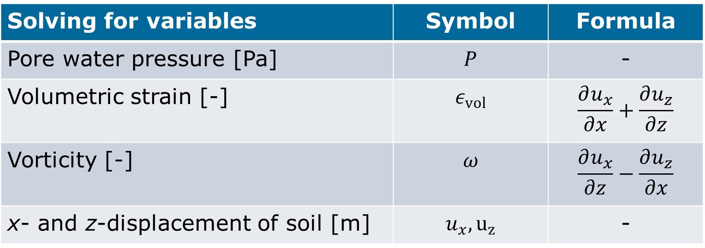
Resulting physical model (2D)
Solving for variables | Symbol | Formula
Pore water pressure [Pa] | $$P$$ | -
Volumetric strain [-] | $$ε_{vol}$$ | $$\frac{∂u_{x}}{∂x}+\frac{∂u_{z}}{∂z}$$
Vorticity [-] | $$ω$$ | $$\frac{∂u_{x}}{∂z}−\frac{∂u_{z}}{∂x}$$
x- and z-displacement of soil [m] | $$u_{x}, u_{z}$$ | -

Slide 7
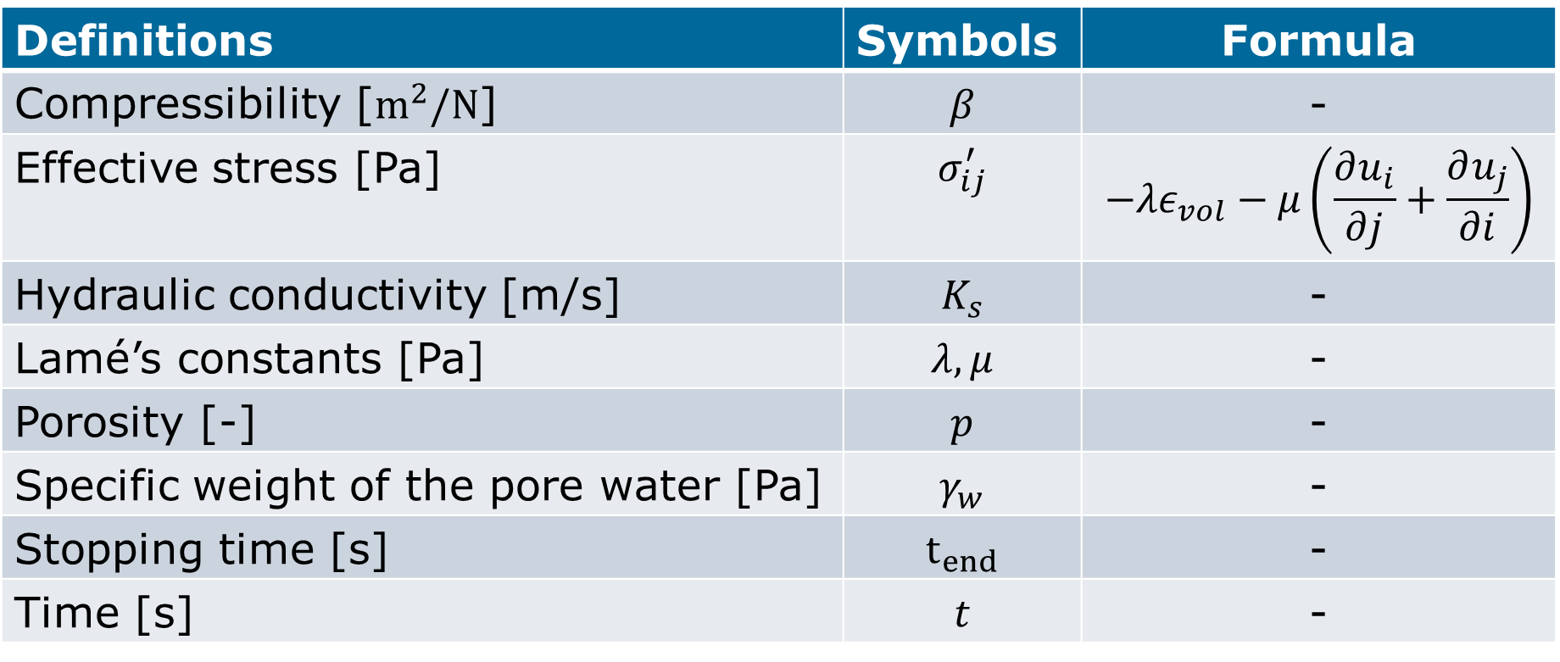
Resulting physical model (2D)
Definitions | Symbols | Formula
Compressibility [$m^{2}/N$] | $$β$$ | -
Effective stress [Pa] | $$σ_{ij}^{′}$$ | $$−λε_{vol}−μ\left(\frac{∂u_{i}}{∂j}+\frac{∂u_{j}}{∂i}\right)$$
Hydraulic conductivity [m/s] | $$K_{s}$$ | -
Lamé’s constants [Pa] | $$λ,μ$$ | -
Porosity [-] | $$p$$ | -
Specific weight of the pore water [Pa] | $$γ_{w}$$ | -
Stopping time [s] | $$t_{end}$$ | -
Time [s] | $$t$$ | -

Slide 8
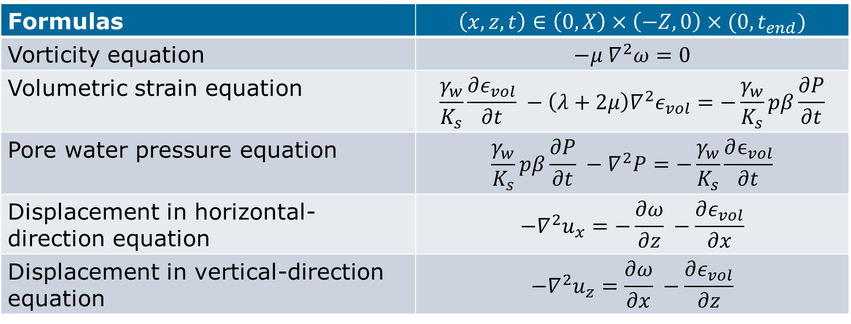
Resulting physical model (2D)
Formulas | $$\left(x,z,t\right)∈\left(0,X\right)×\left(−Z, 0\right)×(0,t_{end})$$
Vorticity equation | $$−μ ∇^{2}ω=0$$
Volumetric strain equation | $$\frac{γ_{w}}{K_{s}}\frac{∂ε_{vol}}{∂t} −\left(λ+2μ\right)∇^{2}ε_{vol}=−\frac{γ_{w}}{K_{s}}pβ\frac{∂P}{∂t}$$
Pore water pressure equation | $$\frac{γ_{w}}{K_{s}}pβ\frac{∂P}{∂t} −∇^{2}P=−\frac{γ_{w}}{K_{s}}\frac{∂ϵ_{vol}}{∂t}$$
Displacement in horizontal-direction equation | $$−∇^{2}u_{x}=−\frac{∂ω}{∂z} −\frac{∂ε_{vol}}{∂x}$$
Displacement in vertical-direction equation | $$−∇^{2}u_{z}=\frac{∂ω}{∂x} −\frac{∂ε_{vol}}{∂z}$$

Slide 9
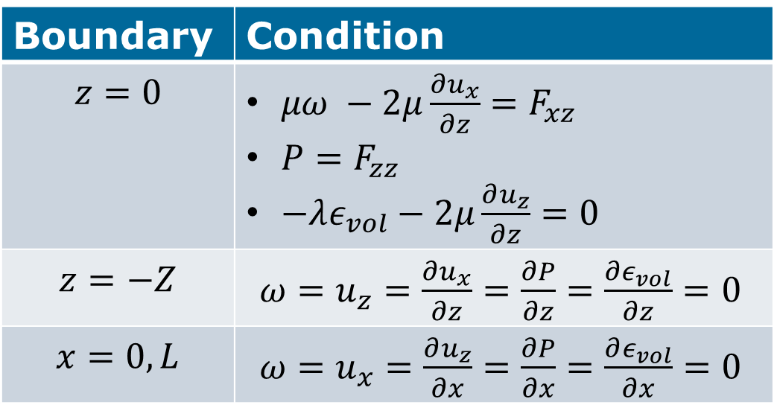
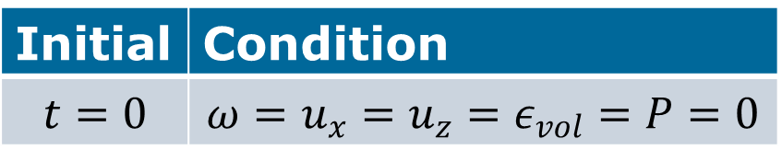
The model of Biot (2D)
Boundary conditions
initial conditions
Boundary | Condition
$$z=0$$ | $μω −2μ\frac{∂u_{x}}{∂z}=F_{xz}$ $P=F_{zz}$ $−λε_{vol}−2μ\frac{∂u_{z}}{∂z}=0$
$$z=−Z$$ | $ω=u_{z}=\frac{∂u_{x}}{∂z}=\frac{∂P}{∂z}=\frac{∂ε_{vol}}{∂z}=0$
$$x=0,L$$ | $ω=u_{x}=\frac{∂u_{z}}{∂x}=\frac{∂P}{∂x}=\frac{∂ε_{vol}}{∂x}=0$
Initial | Condition
$$t=0$$ | $$ω=u_{x}=u_{z}=ε_{vol}=P=0$$
where $F_{xz}, F_{zz}$only depend on time.

Slide 10
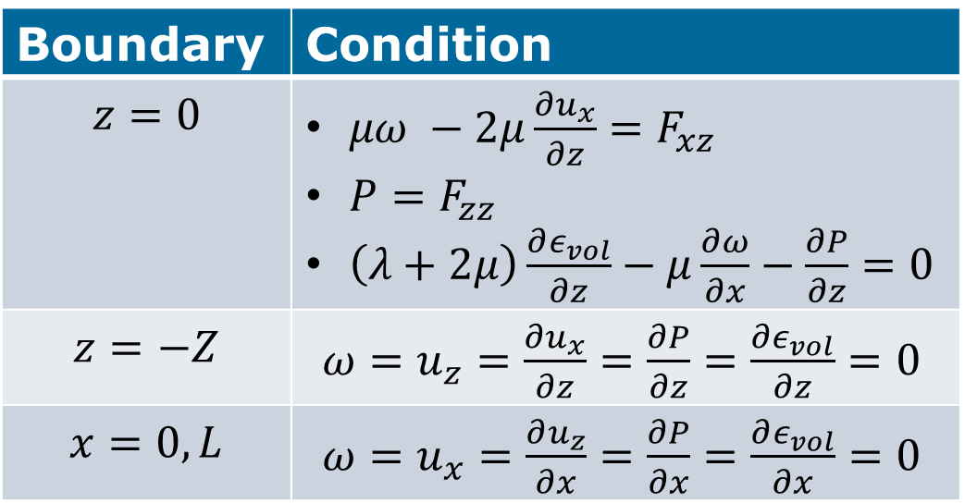
The model of
Van Damme and Den Ouden-Van der Horst (2D)
Boundary conditions
initial conditions
Boundary | Condition
$$z=0$$ | $μω −2μ\frac{∂u_{x}}{∂z}=F_{xz}$ $P=F_{zz}$ $\left(λ+2μ\right)\frac{∂ε_{vol}}{∂z}−μ\frac{∂ω}{∂x}−\frac{∂P}{∂z}=0$
$$z=−Z$$ | $ω=u_{z}=\frac{∂u_{x}}{∂z}=\frac{∂P}{∂z}=\frac{∂ε_{vol}}{∂z}=0$
$$x=0,L$$ | $ω=u_{x}=\frac{∂u_{z}}{∂x}=\frac{∂P}{∂x}=\frac{∂ε_{vol}}{∂x}=0$
Initial | Condition
$$t=0$$ | $$ω=u_{x}=u_{z}=ε_{vol}=P=0$$
where $F_{xz}, F_{zz}$only depend on time.

Slide 11

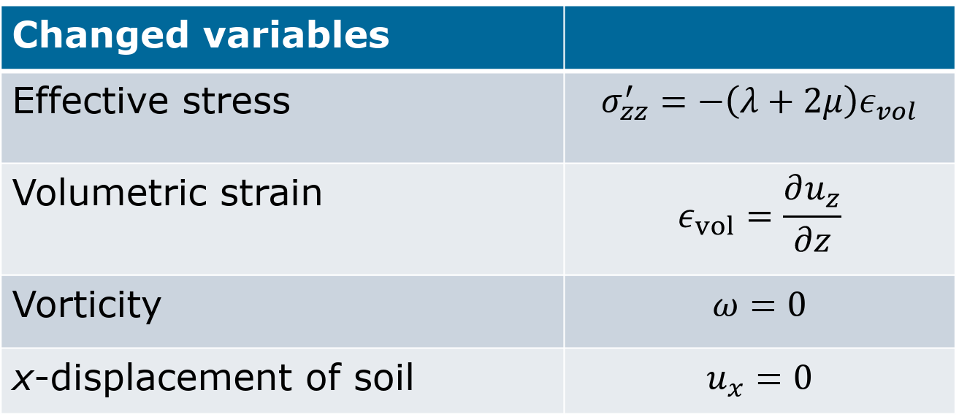
Resulting physical models (1D)
$u_{x}=0, ∇u_{x}=0, \frac{∂u_{z}}{∂x}=0$
Changed variables
Effective stress | $$σ_{zz}^{′}=−\left(λ+2μ\right)ε_{vol}$$
Volumetric strain | $$ε_{vol}=\frac{∂u_{z}}{∂z}$$
Vorticity | $$ω=0$$
x-displacement of soil | $$u_{x}=0$$

Slide 12

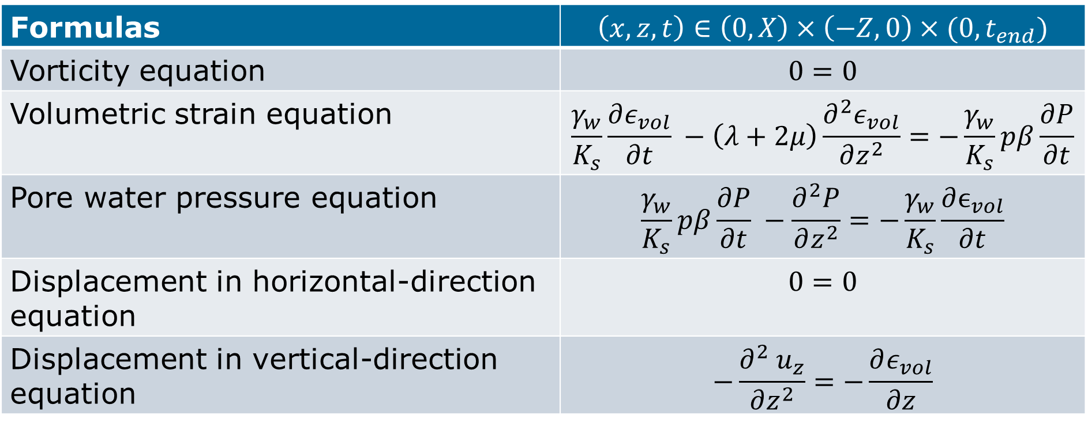
Resulting physical models (1D)
$u_{x}=0, ∇u_{x}=0, \frac{∂u_{z}}{∂x}=0$
Formulas | $$\left(x,z,t\right)∈\left(0,X\right)×\left(−Z, 0\right)×(0,t_{end})$$
Vorticity equation | $$0=0$$
Volumetric strain equation | $$\frac{γ_{w}}{K_{s}}\frac{∂ε_{vol}}{∂t} −\left(λ+2μ\right)\frac{∂^{2}ε_{vol}}{∂z^{2}}=−\frac{γ_{w}}{K_{s}}pβ\frac{∂P}{∂t}$$
Pore water pressure equation | $$\frac{γ_{w}}{K_{s}}pβ\frac{∂P}{∂t} −\frac{∂^{2}P}{∂z^{2}}=−\frac{γ_{w}}{K_{s}}\frac{∂ϵ_{vol}}{∂t}$$
Displacement in horizontal-direction equation | $$0=0$$
Displacement in vertical-direction equation | $$−\frac{∂^{2}{ u}_{z}}{∂z^{2}}=−\frac{∂ε_{vol}}{∂z}$$

Slide 13
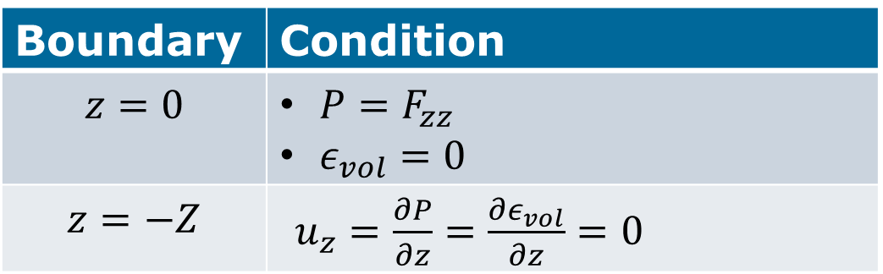
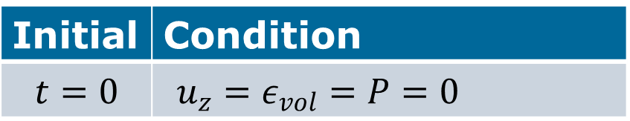
The model of Biot (1D)
Boundary conditions
initial conditions
Boundary | Condition
$$z=0$$ | $P=F_{zz}$ $ε_{vol}=0$
$$z=−Z$$ | $u_{z}=\frac{∂P}{∂z}=\frac{∂ε_{vol}}{∂z}=0$
Initial | Condition
$$t=0$$ | $u_{z}=ε_{vol}=P=0$
Here $F_{zz}(t)=\left\{\left.\begin{aligned} \left(1−β\right)\left(λ+2μ\right)\left(1−\cos\left(t\right)\right), if t≤π \\ \left(1−β\right)\left(λ+2μ\right) 2, else\end{aligned}\right.\right.$(Mersie, 2021)

Slide 14
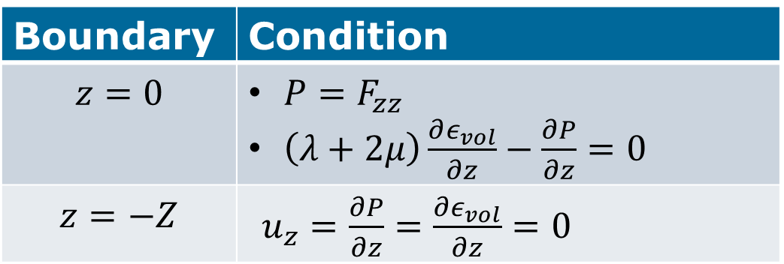
The model of
Van Damme and Den Ouden-Van der Horst (1D)
Boundary conditions
initial conditions
Boundary | Condition
$$z=0$$ | $P=F_{zz}$ $\left(λ+2μ\right)\frac{∂ε_{vol}}{∂z}−\frac{∂P}{∂z}=0$
$$z=−Z$$ | $u_{z}=\frac{∂P}{∂z}=\frac{∂ε_{vol}}{∂z}=0$
Initial | Condition
$$t=0$$ | $u_{z}=ε_{vol}=P=0$
Here $F_{zz}(t)=\left(1−β\right)\left(λ+2μ\right)\left(1−\cos\left(t\right)\right)$(Mersie, 2021)

Slide 15
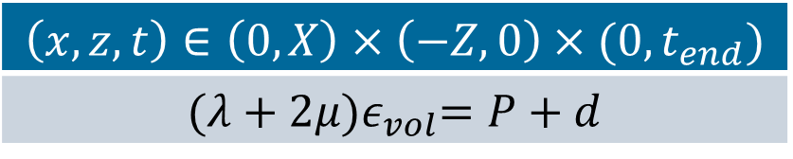
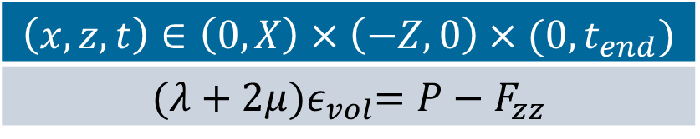


#solutions: Biot’s model and new model (1D)
Volumetric strain equation + Pore water pressure equation $⟺\left(λ+2μ\right)\frac{{{ ∂}^{2}ε}_{vol}}{∂z^{2}}=\frac{∂^{2}P}{∂z^{2}}$
Biot’s model
New model
$$\left(x,z,t\right)∈\left(0,X\right)×\left(−Z, 0\right)×(0,t_{end})$$
$${(λ+2μ)ε}_{vol}=P−F_{zz}$$
$$\left(x,z,t\right)∈\left(0,X\right)×\left(−Z, 0\right)×(0,t_{end})$$
$${(λ+2μ)ε}_{vol}=P+d$$
Unique solution
$$d(t)∈ℝ$$
Infinitely many solutions
Choose
$d=0$
More strict boundary condition
Unique solution

Slide 16
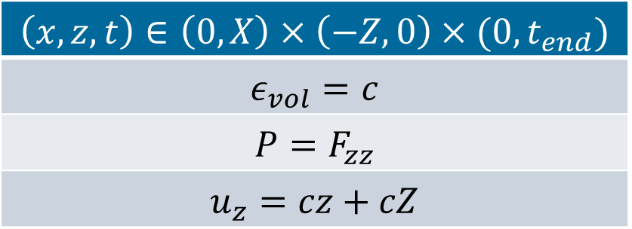
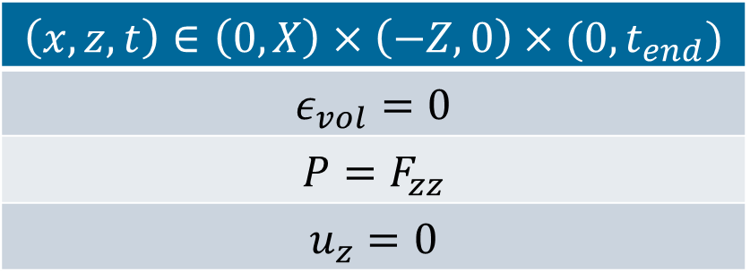


Stationary: Biot’s model and new model (1D)
Stationary model Biot
Stationary model new
$$\left(x,z,t\right)∈\left(0,X\right)×\left(−Z, 0\right)×(0,t_{end})$$
$$ε_{vol}=0$$
$$P=F_{zz}$$
$$u_{z}=0$$
$$\left(x,z,t\right)∈\left(0,X\right)×\left(−Z, 0\right)×(0,t_{end})$$
$$ε_{vol}=c$$
$$P=F_{zz}$$
$$u_{z}=cz+cZ$$
Unique solution
$$c∈ℝ$$
Infinitely many solutions
Choose $d=0$
Then $c=\frac{F_{zz}}{λ+2μ}$
More strict boundary condition
Unique solution
16

Slide 17




FEM: Biot’s model and new model (1D)
0
Finite-Element Method (FEM) used for space-discretisation.
Hat-functions as basis-functions.
2 homogeneous layers, each 1.0 m deep.
  [-2,-1]: Layer of medium sand.
  [-1,0]: Layer of fine sand.
Each kind of soil has different properties.
(800)
$$Δz=0.0025$$
($⋮$)
z-direction
-1
(1)
(0)
-2

Slide 18

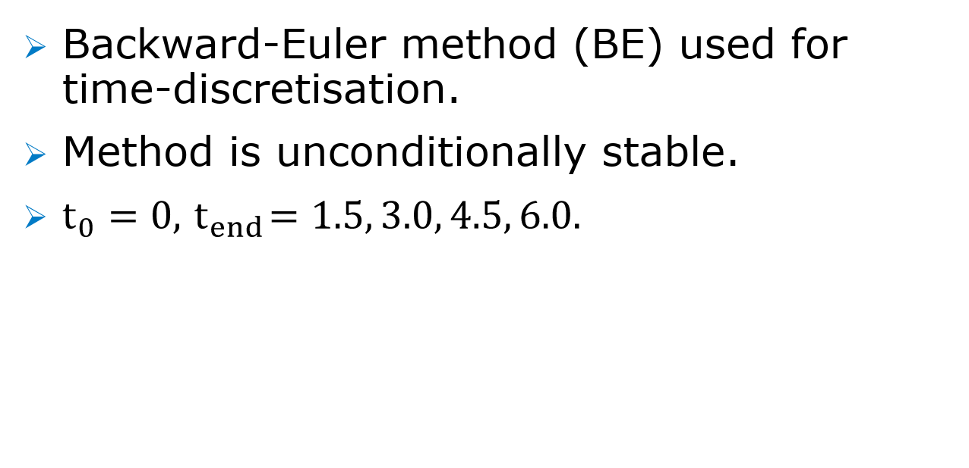


BE: Biot’s model and new model (1D)
$$t^{i}$$
$$Δt=0.0025$$
Backward-Euler method (BE) used for time-discretisation.
Method is unconditionally stable.
$t_{0}=0, { t}_{end}=1.5, 3.0, 4.5, 6.0.$
$$t^{i+1}$$

Slide 19
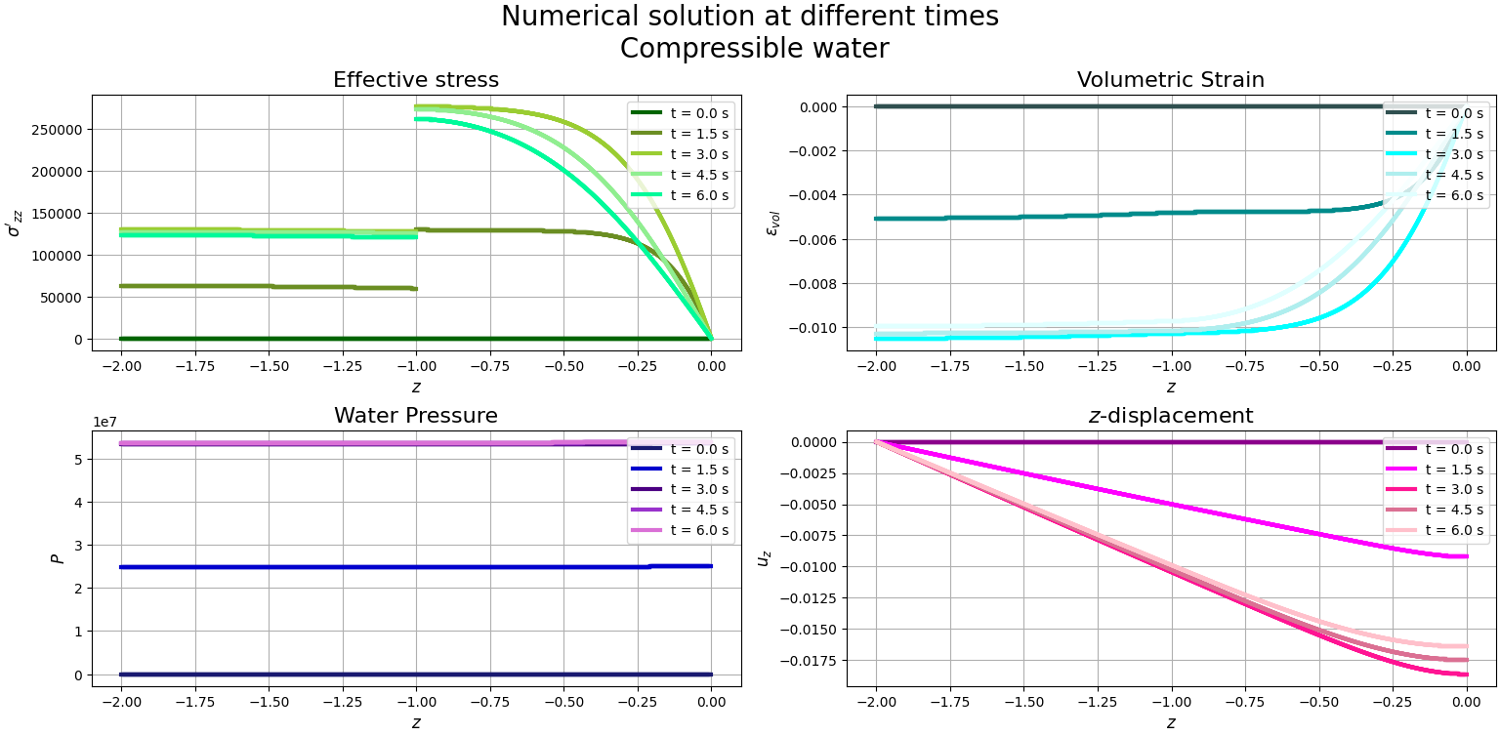
Biot (1D): Results for compressible water

Slide 20
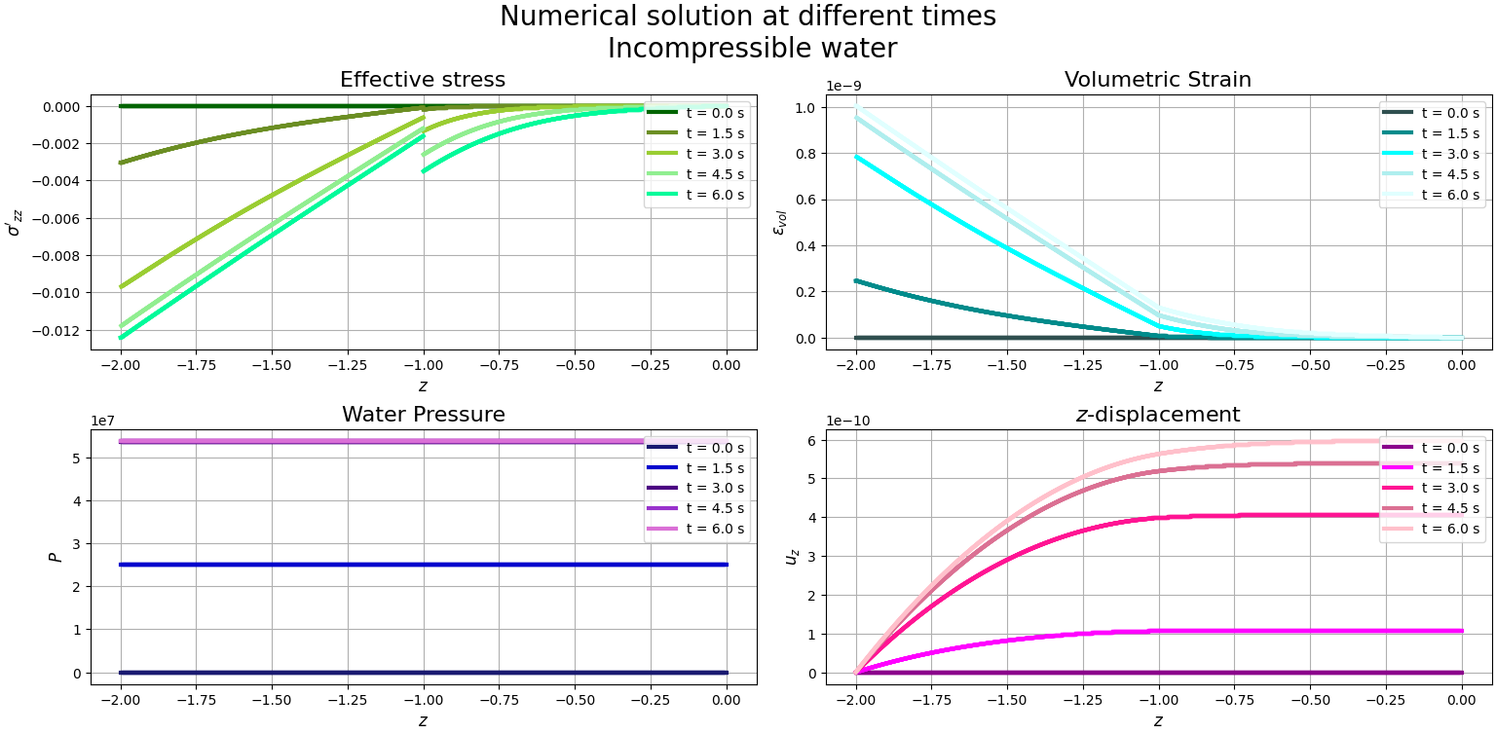
Biot (1D): Results for incompressible water

Slide 21
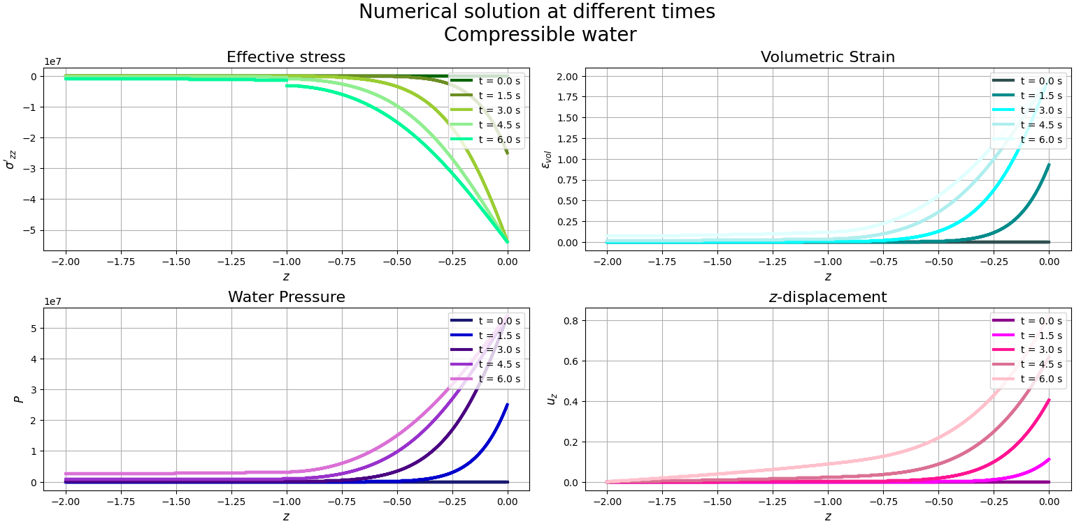
New (1D): Results for compressible water

Slide 22
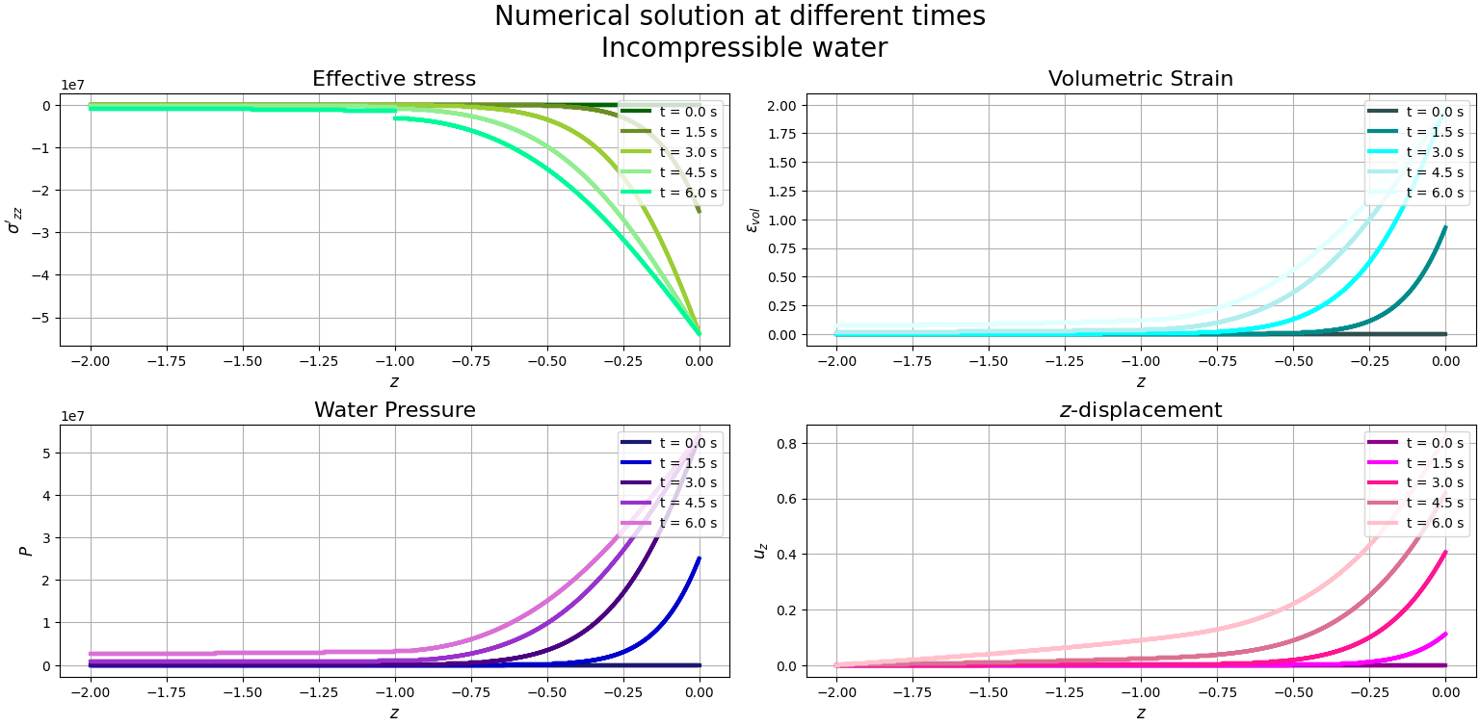
New (1D): Results for incompressible water

Slide 23
Conclusion & Discussion:
The governing equations of Biot’s model and the model of Van Damme and Den Ouden-Van der Horst (new) are the same.
The two models differ in a boundary condition for the surface.
The solutions of both models behave similar for compressible water. The value of compressibility used is of importance.
For incompressible water the results of Biot’s model and the new model differ a lot due to the difference in boundary conditions.

Slide 24
Further research
Implement 2D models.
  Compare results of the 2D-model of Biot and the model Van Damme and Den Ouden-Van der Horst with 1D.
  Compare results of both models with real observations.
  Compare results of both models with eachother more extensively.
Implement 3D model.
  Compare results like for 2D.

Slide 25
Further research
Extend models with acceleration terms. In this literature report we assumed they were negligible, but is this valid?
Derive the amount of energy at surface. Is the amount of energy going in the same as going out after one complete wave? This could validate the difference in boundary conditions at surface.
Make the computational grid more general:
no longer a rectangle, but with a sloping or wavy surface.

Slide 26
Compressible vs. incompressible pore water in fully-saturated poroelastic soil
Literature report
Femke Klein
18 december

Slide 27
Bibliography
Cormont, H. (1995). River dike between Kesteren and Opheusden, the Netherlands, at high water levels of the river Nederrijn in 1995 [photo].
Van Damme, M. (2022). Team Techniek Grondgedrag [Image from Power Point]. Rijkswaterstaat.
Mersie, M. (2021). Overtopping failure in levees. M.S. thesis at TU Delft and Rijkswaterstaat.

Slide 28
Extra slides

Slide 29
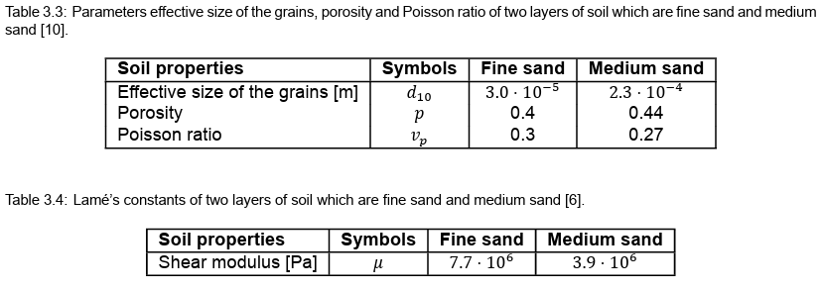
Properties of fine sand and medium sand

Slide 30
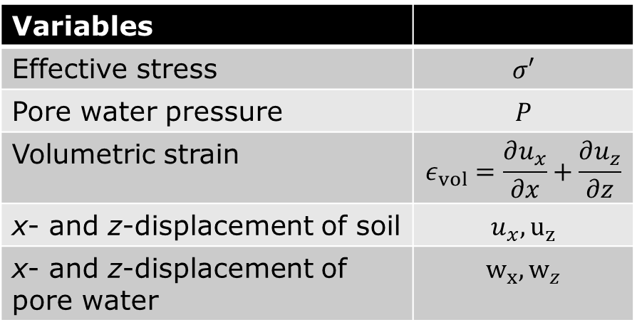
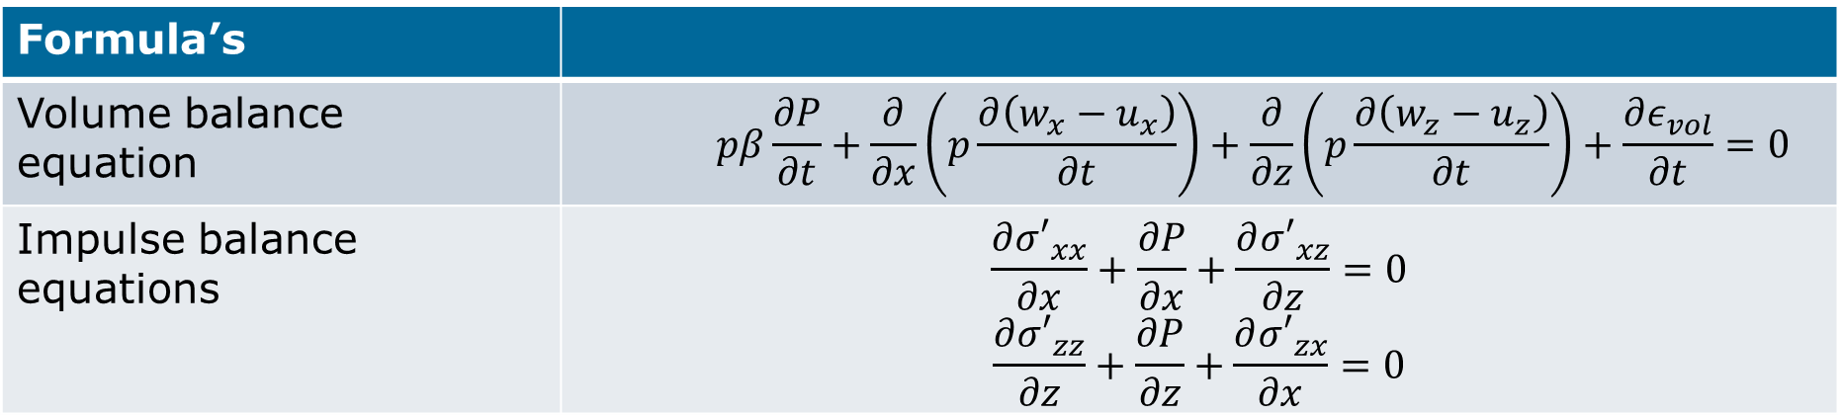
The models in general
(2D)
Variables
Effective stress | $$σ′$$
Pore water pressure | $$P$$
Volumetric strain | $$ε_{vol}=\frac{∂u_{x}}{∂x}+\frac{∂u_{z}}{∂z}$$
x- and z-displacement of soil | $$u_{x}, u_{z}$$
x- and z-displacement of pore water | $${w_{x}, w}_{z}$$
Formula’s
Volume balance equation | $$pβ\frac{∂P}{∂t}+\frac{∂}{∂x}\left(p\frac{∂\left(w_{x}−u_{x}\right)}{∂t}\right)+\frac{∂}{∂z}\left(p\frac{∂\left(w_{z}−u_{z}\right)}{∂t}\right)+\frac{∂ε_{vol}}{∂t}=0$$
Impulse balance equations | $$\frac{∂{σ′}_{xx}}{∂x}+\frac{∂P}{∂x}+\frac{∂{σ′}_{xz}}{∂z}=0$$ $$\frac{∂{σ′}_{zz}}{∂z}+\frac{∂P}{∂z}+\frac{∂{σ′}_{zx}}{∂x}=0$$

Slide 31
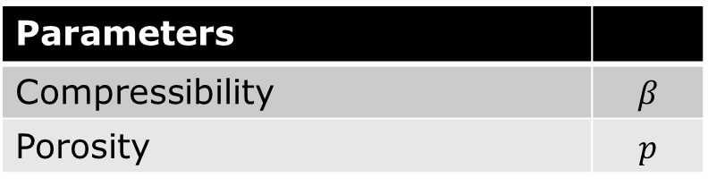
The models in general
(2D)
Parameters
Compressibility | $$β$$
Porosity | $$p$$
Formula’s
Volume balance equation | $$pβ\frac{∂P}{∂t}+\frac{∂}{∂x}\left(p\frac{∂\left(w_{x}−u_{x}\right)}{∂t}\right)+\frac{∂}{∂z}\left(p\frac{∂\left(w_{z}−u_{z}\right)}{∂t}\right)+\frac{∂ε_{vol}}{∂t}=0$$
Impulse balance equations | $$\frac{∂{σ′}_{xx}}{∂x}+\frac{∂P}{∂x}+\frac{∂{σ′}_{xz}}{∂z}=0$$ $$\frac{∂{σ′}_{zz}}{∂z}+\frac{∂P}{∂z}+\frac{∂{σ′}_{zx}}{∂x}=0$$

Slide 32
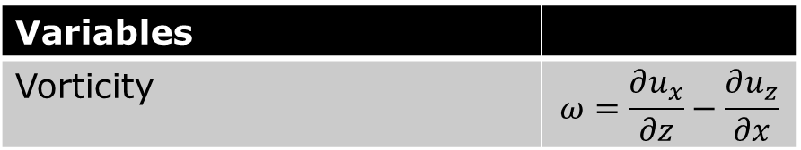
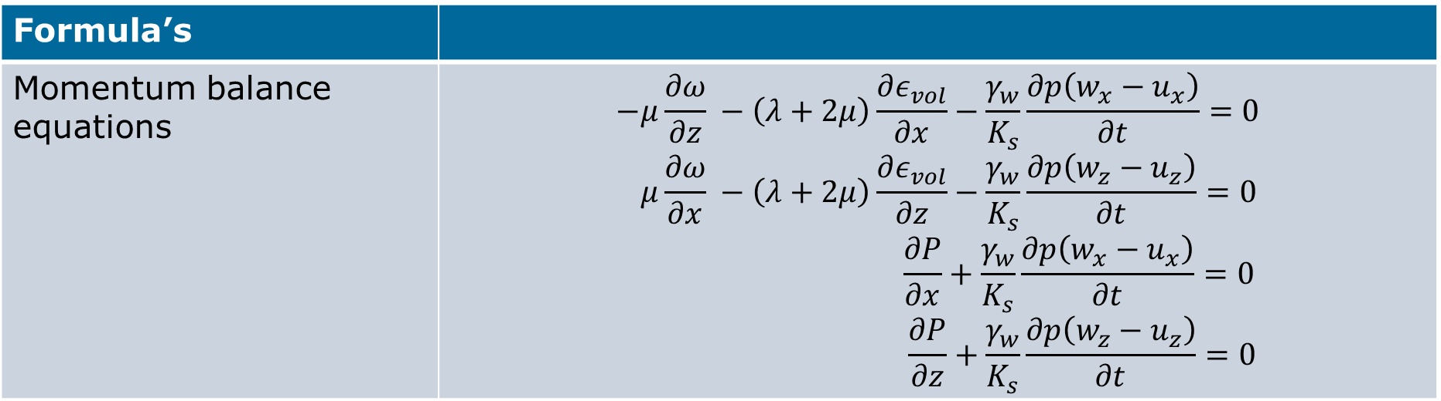
The models in general
(2D)
Variables
Vorticity | $$ω=\frac{∂u_{x}}{∂z}−\frac{∂u_{z}}{∂x}$$
Formula’s
Momentum balance equations | $$−μ\frac{∂ω}{∂z} −\left(λ+2μ\right)\frac{∂ε_{vol}}{∂x}−\frac{γ_{w}}{K_{s}}\frac{∂p\left(w_{x}−u_{x}\right)}{∂t}=0$$ $$μ\frac{∂ω}{∂x} −\left(λ+2μ\right)\frac{∂ε_{vol}}{∂z}−\frac{γ_{w}}{K_{s}}\frac{∂p\left(w_{z}−u_{z}\right)}{∂t}=0$$ $$\frac{∂P}{∂x}+\frac{γ_{w}}{K_{s}}\frac{∂p\left(w_{x}−u_{x}\right)}{∂t}=0$$ $$\frac{∂P}{∂z}+\frac{γ_{w}}{K_{s}}\frac{∂p\left(w_{z}−u_{z}\right)}{∂t}=0$$

Slide 33
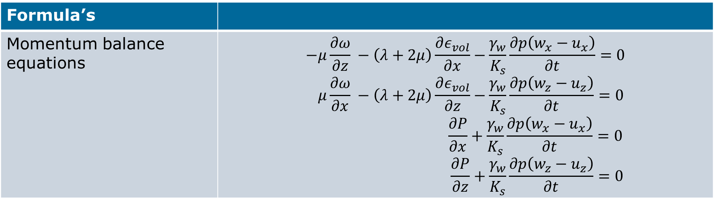
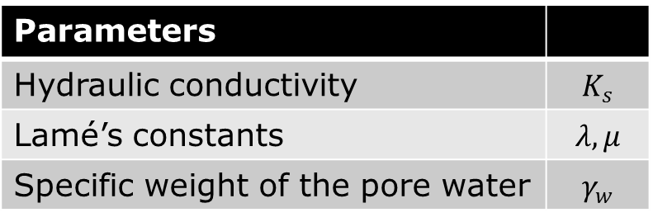
The models in general
(2D)
Parameters
Hydraulic conductivity | $$K_{s}$$
Lamé’s constants | $$λ,μ$$
Specific weight of the pore water | $$γ_{w}$$
Formula’s
Momentum balance equations | $$−μ\frac{∂ω}{∂z} −\left(λ+2μ\right)\frac{∂ε_{vol}}{∂x}−\frac{γ_{w}}{K_{s}}\frac{∂p\left(w_{x}−u_{x}\right)}{∂t}=0$$ $$μ\frac{∂ω}{∂x} −\left(λ+2μ\right)\frac{∂ε_{vol}}{∂z}−\frac{γ_{w}}{K_{s}}\frac{∂p\left(w_{z}−u_{z}\right)}{∂t}=0$$ $$\frac{∂P}{∂x}+\frac{γ_{w}}{K_{s}}\frac{∂p\left(w_{x}−u_{x}\right)}{∂t}=0$$ $$\frac{∂P}{∂z}+\frac{γ_{w}}{K_{s}}\frac{∂p\left(w_{z}−u_{z}\right)}{∂t}=0$$

Slide 34
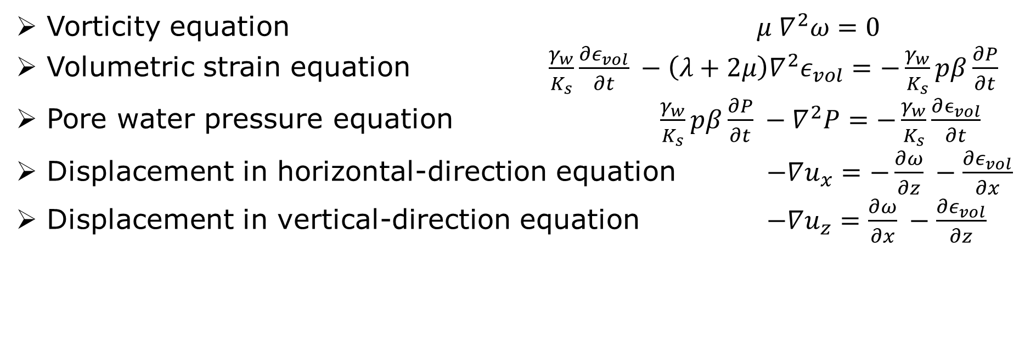
The models in general (2D)
Formula’s
Vorticity equation $μ ∇^{2}ω=0$
Volumetric strain equation $\frac{γ_{w}}{K_{s}}\frac{∂ε_{vol}}{∂t} −\left(λ+2μ\right)∇^{2}ε_{vol}=−\frac{γ_{w}}{K_{s}}pβ\frac{∂P}{∂t}$
Pore water pressure equation $\frac{γ_{w}}{K_{s}}pβ\frac{∂P}{∂t} −∇^{2}P=−\frac{γ_{w}}{K_{s}}\frac{∂ϵ_{vol}}{∂t}$
Displacement in horizontal-direction equation $−∇u_{x}=−\frac{∂ω}{∂z} −\frac{∂ε_{vol}}{∂x}$
Displacement in vertical-direction equation $−∇u_{z}=\frac{∂ω}{∂x} −\frac{∂ε_{vol}}{∂z}$

Slide 35
FEM: Biot’s model and new model (1D)
0
Finite-Element Method (FEM) used for space-discretisation
Hat-functions as basis-functions
1 homogeneous layer, 2.0 m deep
(800)
$$Δz=0.0025$$
($⋮$)
z-direction
(1)
(0)
-2

Slide 36
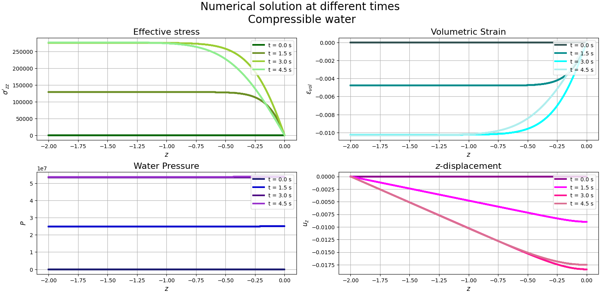
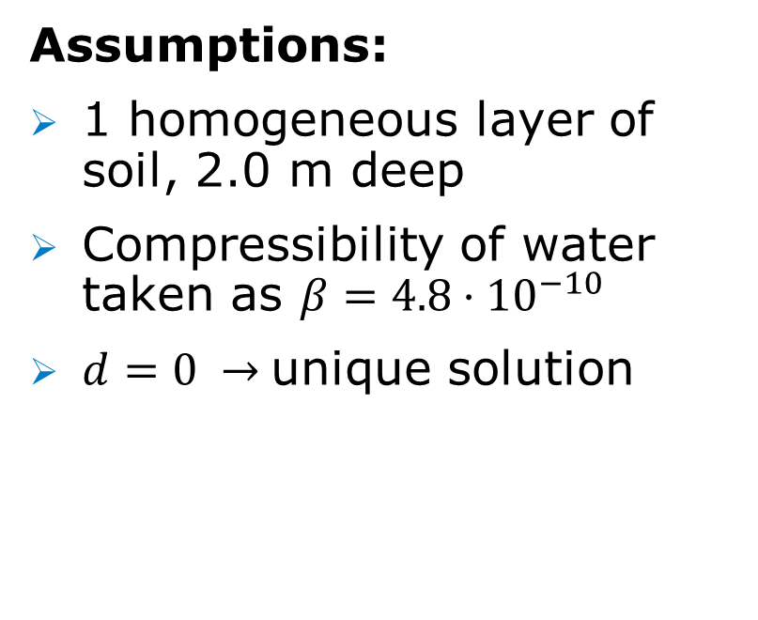
Biot (1D): Results for compressible water
Assumptions:
1 homogeneous layer of soil, 2.0 m deep
Compressibility of water taken as $β=4.8⋅{10}^{−10}$
$d=0 →$unique solution

Slide 37
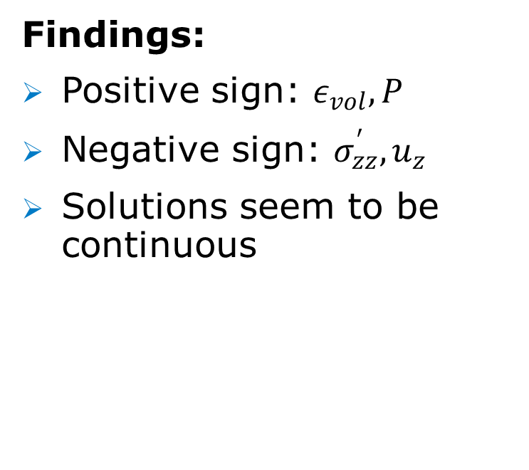
Biot (1D): Results for compressible water
Findings:
Positive sign: $ε_{vol},P$
Negative sign: $σ_{zz}^{′}, u_{z}$
Solutions seem to be continuous

Slide 38
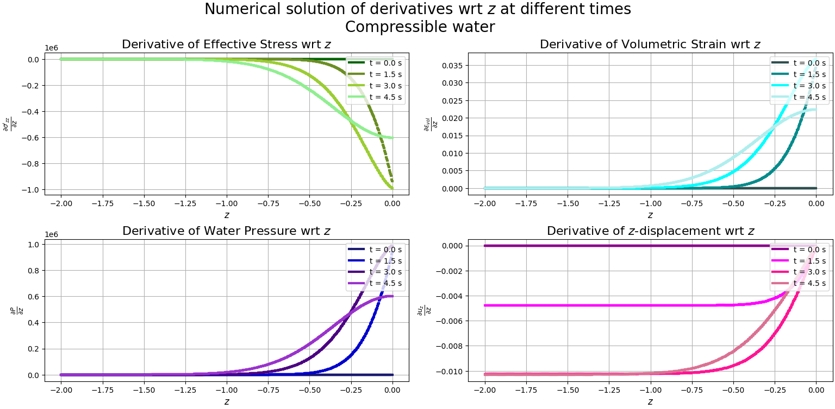
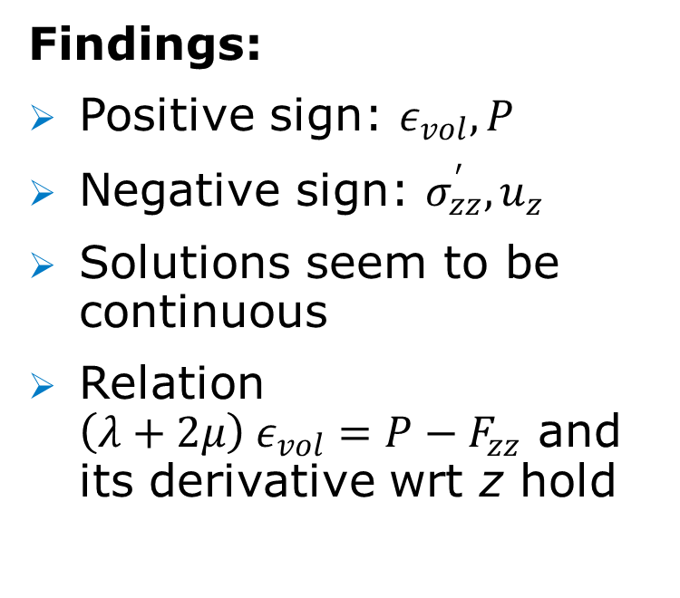
Biot (1D): Results for compressible water
Findings:
Positive sign: $ε_{vol},P$
Negative sign: $σ_{zz}^{′}, u_{z}$
Solutions seem to be continuous
Relation
$\left(λ+2μ\right) ε_{vol}=P−F_{zz}$ and its derivative wrt z hold

Slide 39
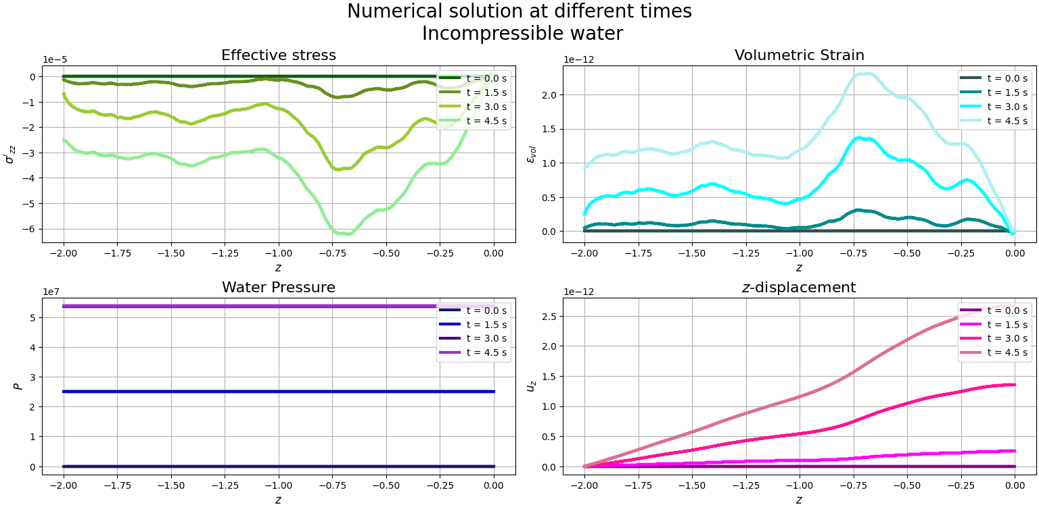
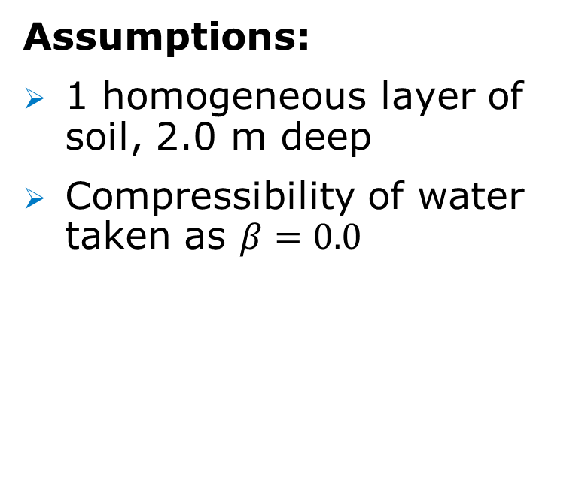
Biot (1D): Results for incompressible water
Assumptions:
1 homogeneous layer of soil, 2.0 m deep
Compressibility of water taken as $β=0.0$

Slide 40
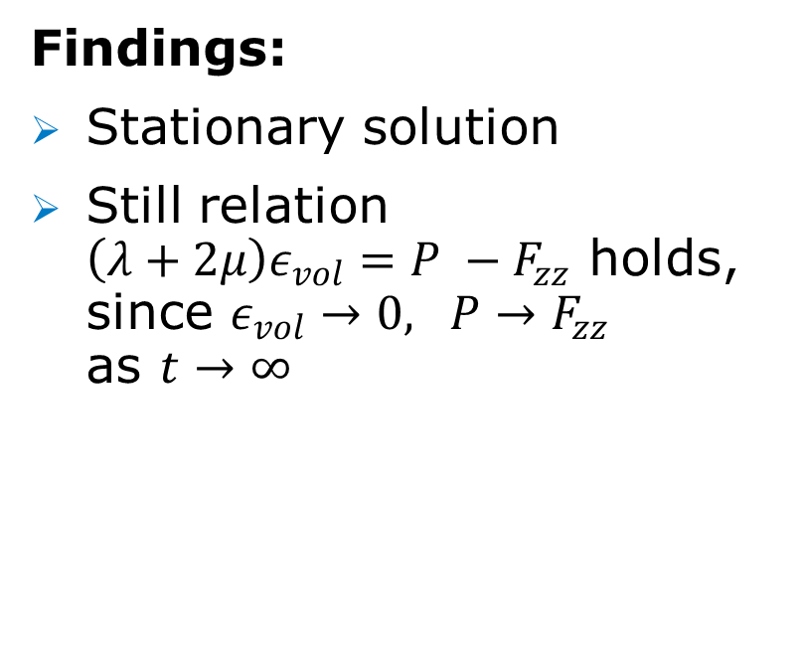
Biot (1D): Results for incompressible water
Findings:
Stationary solution
Still relation
$\left(λ+2μ\right)ε_{vol}=P −F_{zz}$ holds,
since $ε_{vol}→0, P→F_{zz}$
as $t→∞$

Slide 41
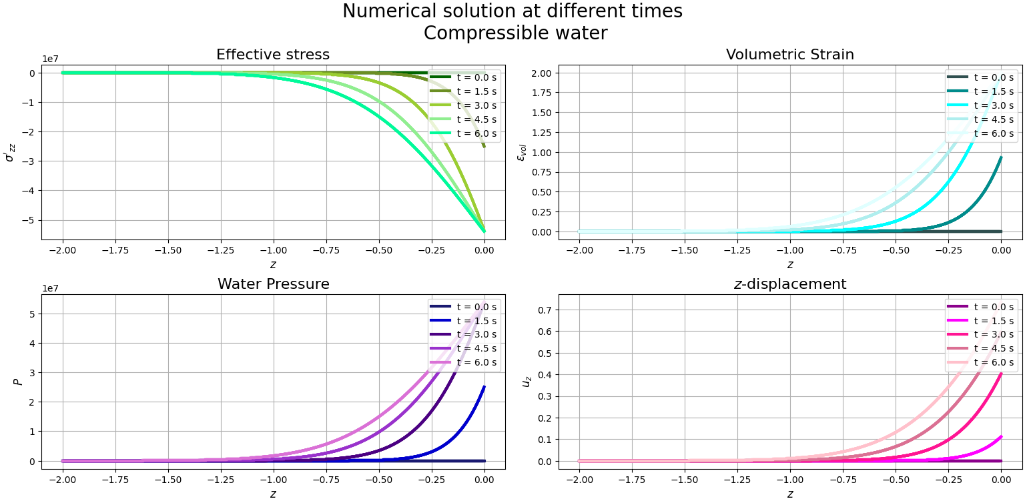

New (1D): Results for compressible water
Assumptions:
1 homogeneous layer of soil, 2.0 m deep
Compressibility of water taken as $β=4.8⋅{10}^{−10}$

Slide 42
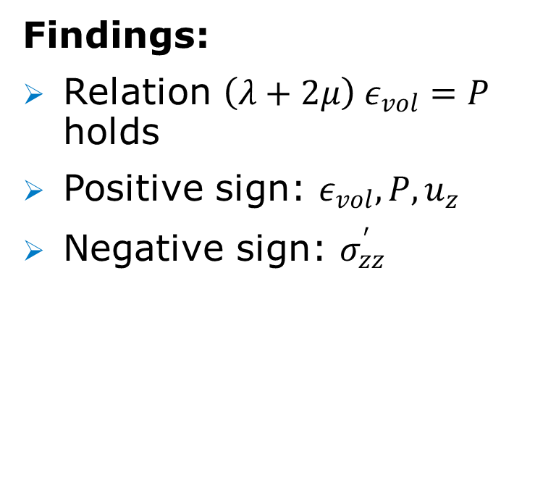
New (1D): Results for compressible water
Findings:
Relation $\left(λ+2μ\right) ε_{vol}=P$ holds
Positive sign: $ε_{vol},P, u_{z}$
Negative sign: $σ_{zz}^{′}$

Slide 43

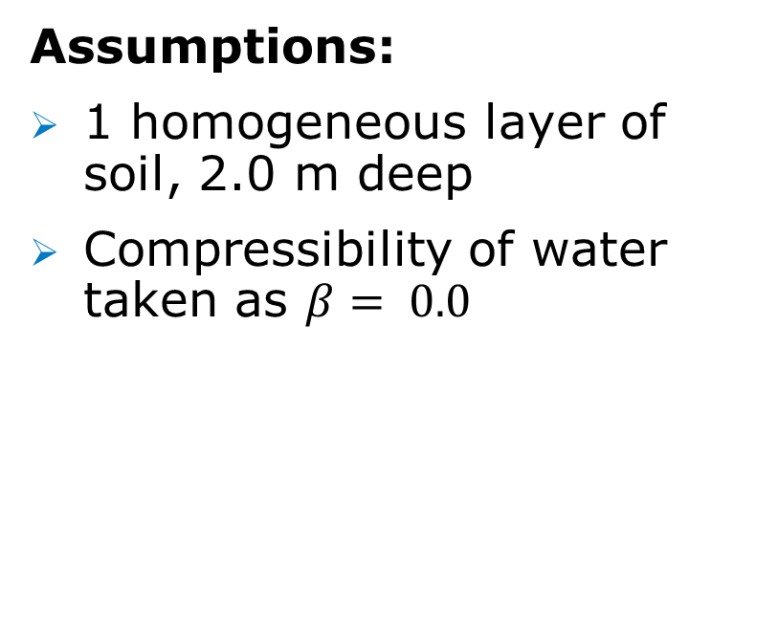
New (1D): Results for incompressible water
Assumptions:
1 homogeneous layer of soil, 2.0 m deep
Compressibility of water taken as $β= 0.0$

Slide 44
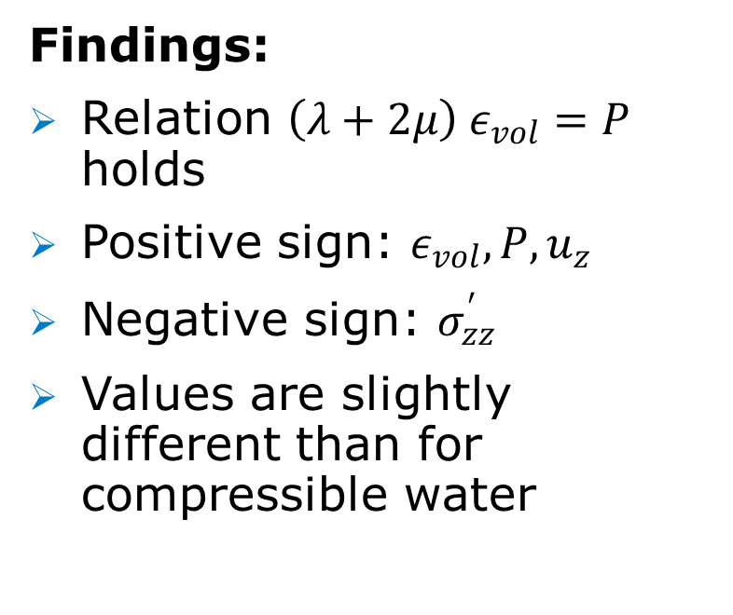
New (1D): Results for incompressible water
Findings:
Relation $\left(λ+2μ\right) ε_{vol}=P$ holds
Positive sign: $ε_{vol},P, u_{z}$
Negative sign: $σ_{zz}^{′}$
Values are slightly different than for compressible water

Slide 45
FEM: Biot’s model and new model (1D)
0
Finite-Element Method (FEM) used for space-discretisation.
Hat-functions as basis-functions.
2 homogeneous layers, each 1.0 m deep.
  [-2,-1]: Layer of medium sand.
  [-1,0]: Layer of fine sand.
Each kind of soil has different properties.
(800)
$$Δz=0.0025$$
($⋮$)
z-direction
-1
(1)
(0)
-2

Slide 46
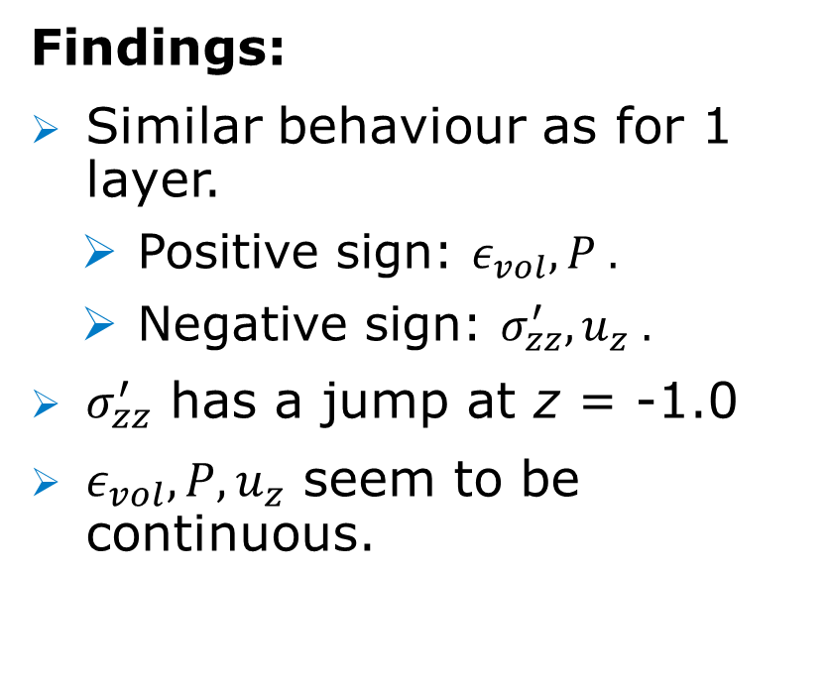
Biot (1D): Results for compressible water
Findings:
Similar behaviour as for 1 layer.
  Positive sign: $ε_{vol},P .$
  Negative sign: $σ_{zz}^{′}, u_{z} .$
$σ_{zz}^{′}$ has a jump at z = -1.0
$ε_{vol},P, u_{z}$ seem to be continuous.

Slide 47
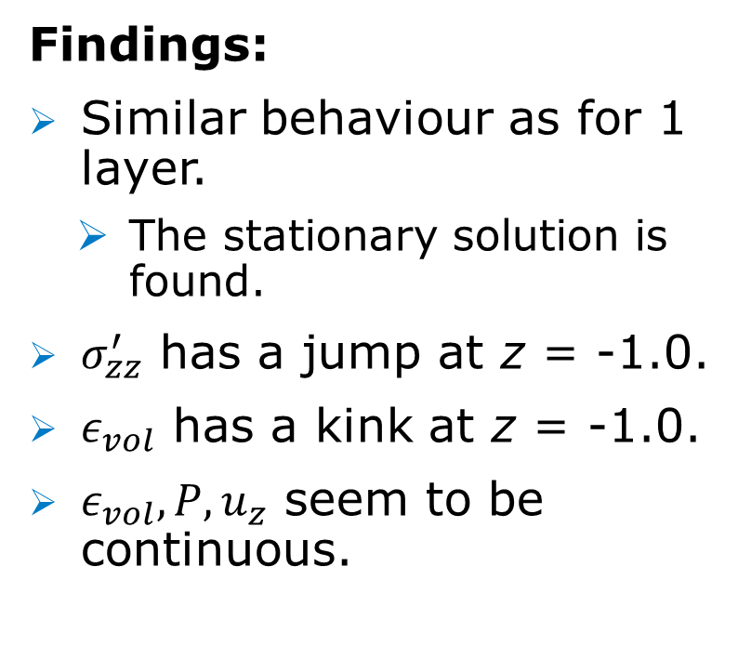
Biot (1D): Results for incompressible water
Findings:
Similar behaviour as for 1 layer.
  The stationary solution is found.
$σ_{zz}^{′}$ has a jump at z = -1.0.
$ε_{vol}$ has a kink at z = -1.0.
$ε_{vol},P, u_{z}$ seem to be continuous.

Slide 48
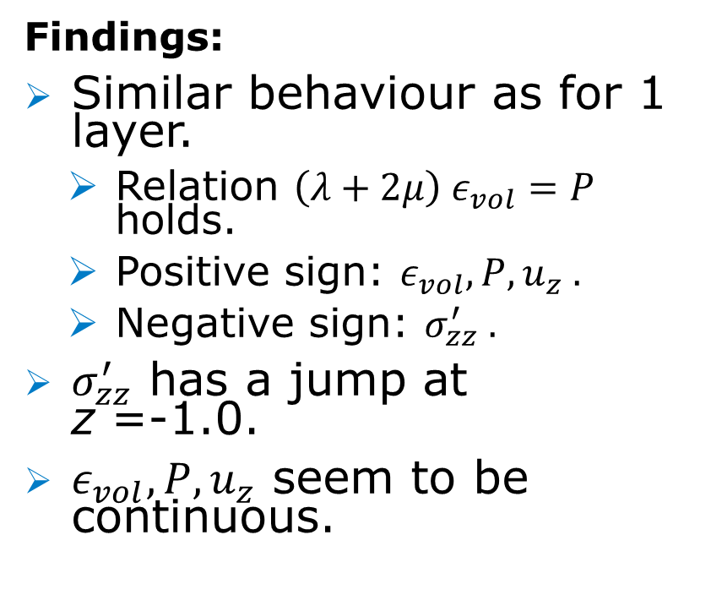
New (1D): Results for compressible water
Findings:
Similar behaviour as for 1 layer.
  Relation $\left(λ+2μ\right) ε_{vol}=P$ holds.
  Positive sign: $ε_{vol},P, u_{z} .$
  Negative sign: $σ_{zz}^{′} .$
$σ_{zz}^{′}$ has a jump at z =-1.0.
$ε_{vol},P, u_{z}$ seem to be continuous.

Slide 49
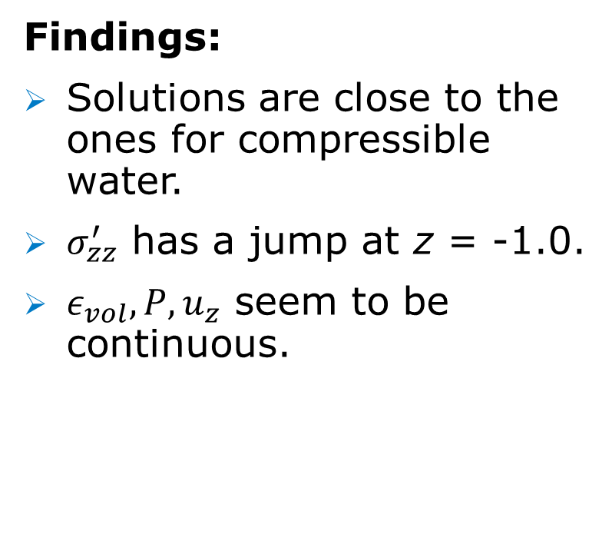
New (1D): Results for incompressible water
Findings:
Solutions are close to the ones for compressible water.
$σ_{zz}^{′}$ has a jump at z = -1.0.
$ε_{vol},P, u_{z}$ seem to be continuous.

Slide 50
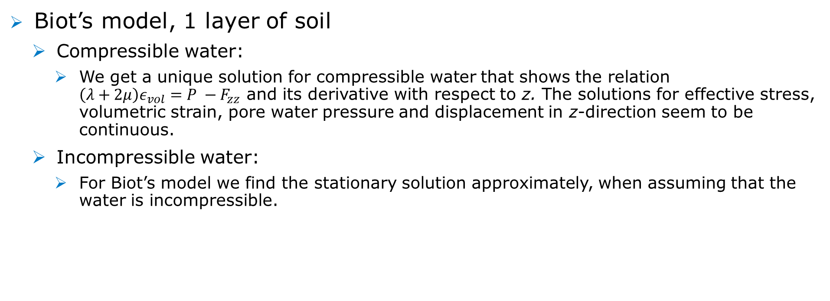
Conclusion & Discussion (Biot’s model, 1 layer):
Biot’s model, 1 layer of soil
  Compressible water:
    We get a unique solution for compressible water that shows the relation
    $\left(λ+2μ\right)ε_{vol}=P −F_{zz}$ and its derivative with respect to z. The solutions for effective stress, volumetric strain, pore water pressure and displacement in z-direction seem to be continuous.
  Incompressible water:
    For Biot’s model we find the stationary solution approximately, when assuming that the water is incompressible.

Slide 51

Conclusion & Discussion (new model, 1 layer):
The model of Van Damme and Den Ouden-Van der Horst, 1 layer of soil
  We get infinitely many solutions and infinitely many stationary solutions. When making the momentum balance equation as boundary condition more strict, we get a model with a unique solution and a unique stationary solution.
  Compressible and incompressible water:
    The solutions for compressible water and for compressible water ($4.8⋅{10}^{−10}m^{2}/N)$ are approximately the same.
    The relation $\left(λ+2μ\right)ε_{vol}=P −F_{zz}$ and its derivative with respect to z holds. The solutions for effective stress, volumetric strain, pore water pressure and displacement in z-direction seem to be continuous.
    Again the solutions for effective stress, volumetric strain, pore water pressure and displacement in z-direction seem to be continuous.

Slide 52
Conclusion & Discussion (2 layers of soil)
In general, 2 layers of different kinds of soil
  There may be a jump or kink in the solution because of some parameters depending on the type of soil.
  Volumetric strain, pore water pressure and displacement in z-direction seem continuous for compressible and incompressible pore water and for 1 and 2 layers of soil. For 1 layer of soil, also the volumetric strain is continuous.

Slide 53
Conclusion & Discussion (Biot’s model, 2 layers)
Biot’s model, 2 layers of different kinds of soil
  Compressible pore water
    2 layers of different kind of soils has similar behaviour as for 1 layer. However, the values do differ a bit due to the different properties of the two different kinds of soil.
  Incompressible water
    The behaviour looks a bit different than for 1 layer, since now the stationary solution is reached a little bit later. However, approximately it is still the stationary solution which is found immediately.

Slide 54
Conclusion & Discussion (new model, 2 layers)
The model of Van Damme and Den Ouden-Van der Horst,
2 layers of different kinds of soil
  Compressible and incompressible pore water
    2 layers of different kind of soils has similar behaviour as for 1 layer.
    However, the values do differ slightly.

