Slide 1
Localizing the Chaotic Strange Attractors of Multiparameter Nonlinear Dynamical Systems using Competitive Modes
A Literary Analysis

Slide 2
Table of Contents
Introduction
Strange Attractors and Chaos
Localization through Competitive Modes
  Lorenz Attractor Example
Conclusions

Slide 3
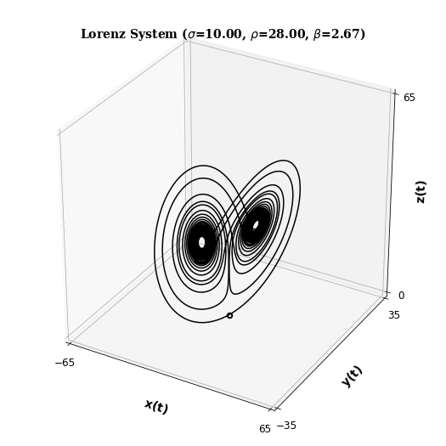

Dynamical Systems
Introduction
Strange Attractors
Competitive Modes
Conclusions
$$\left\{\begin{aligned}\dot{x}=σ(y−x) \\ \dot{y}=x\left(ρ−z\right)−y \\ \dot{z}=xy−βz\end{aligned}\right.$$

Slide 4
Strange Attractors
Introduction
Strange Attractors
Competitive Modes
Conclusions
Definition: The strange attractor A of a n-dimensional system of differential equations is an attractor that is fractal in nature.

Slide 5

Chaos
Introduction
Strange Attractors
Competitive Modes
Conclusions
Definition: Chaos is the phenomenon where a dynamical system is extremely sensitive to initial conditions in some set $C⊆ℝ^{n}$.

Slide 6
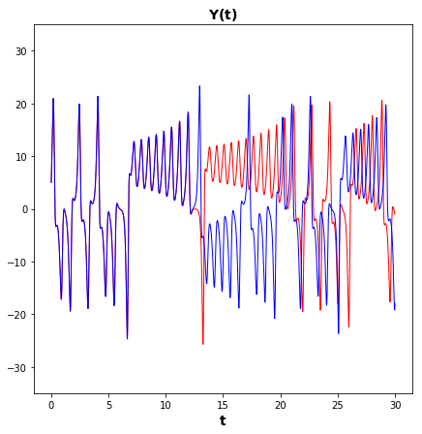
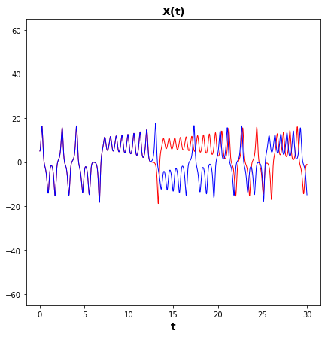
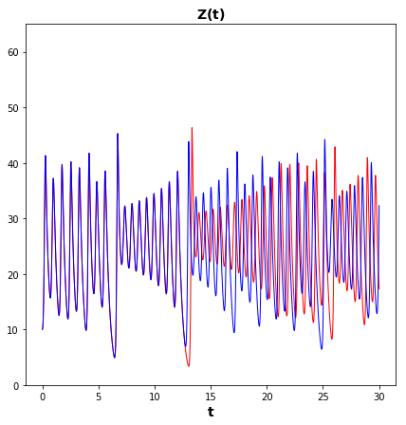
Chaos: Lorenz
Introduction
Strange Attractors
Competitive Modes
Conclusions

Slide 7
Localization
Through
Competitive Modes

Slide 8
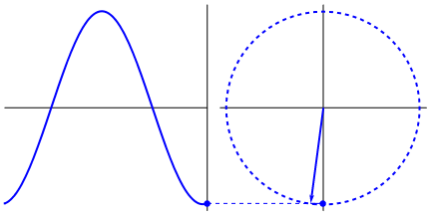

Oscillators
Introduction
Strange Attractors
Competitive Modes
Conclusions
$\ddot{x}+αx=0$ with $α≥0$

Slide 9
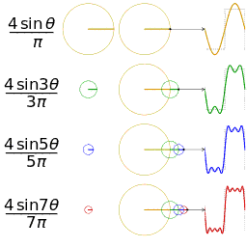
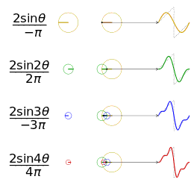
Oscillators
Introduction
Strange Attractors
Competitive Modes
Conclusions

Slide 10

Oscillators to Competitive Modes
Introduction
Strange Attractors
Competitive Modes
Conclusions
$$\left\{\begin{aligned}{\dot{x}}_{1}=F_{1}\left(x_{1},…x_{n}\right) \\ … \\ {\dot{x}}_{n}=F_{n}\left(x_{1},…x_{n}\right)\end{aligned}\right.$$

Slide 11

Oscillators to Competitive Modes
Introduction
Strange Attractors
Competitive Modes
Conclusions
$$\left\{\begin{aligned}{\ddot{x}}_{1}+x_{1}g_{1}\left(x_{1},…x_{n}\right)=h_{1}\left(x_{2},…x_{n}\right) \\ … \\ {\ddot{x}}_{n}+x_{n}g_{n}\left(x_{1},…x_{n}\right)=h_{n}\left(x_{1},…x_{n−1}\right)\end{aligned}\right.$$

Slide 12
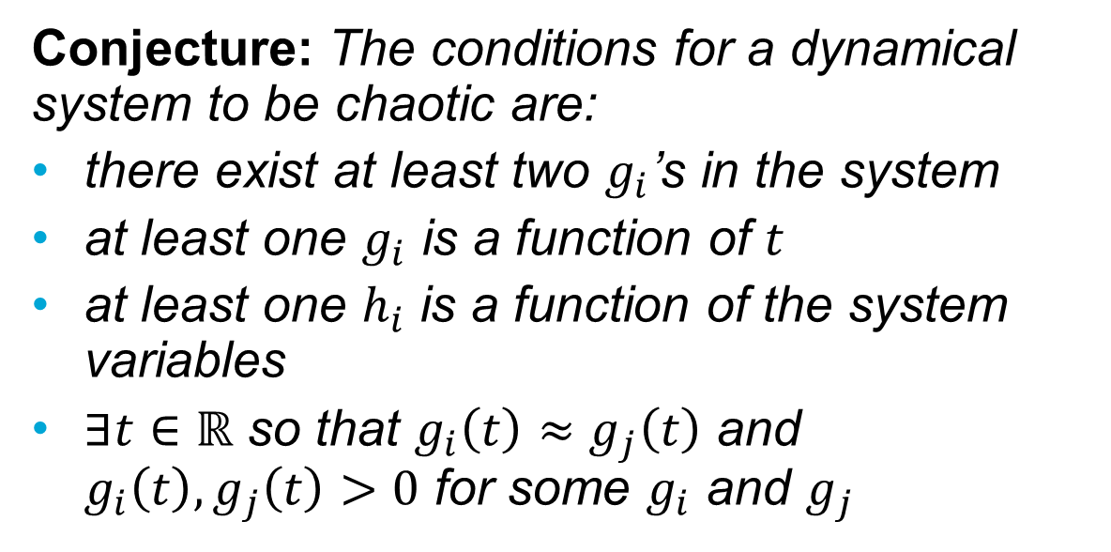
Competitive Mode Conjecture
Introduction
Strange Attractors
Competitive Modes
Conclusions
Conjecture: The conditions for a dynamical system to be chaotic are:
there exist at least two $g_{i}$’s in the system
at least one $g_{i}$ is a function of $t$
at least one $h_{i}$ is a function of the system variables
$∃t∈ℝ$ so that $g_{i}\left(t\right)≈g_{j}\left(t\right)$ and $g_{i}\left(t\right), g_{j}\left(t\right)>0$ for some $g_{i}$ and $g_{j}$

Slide 13
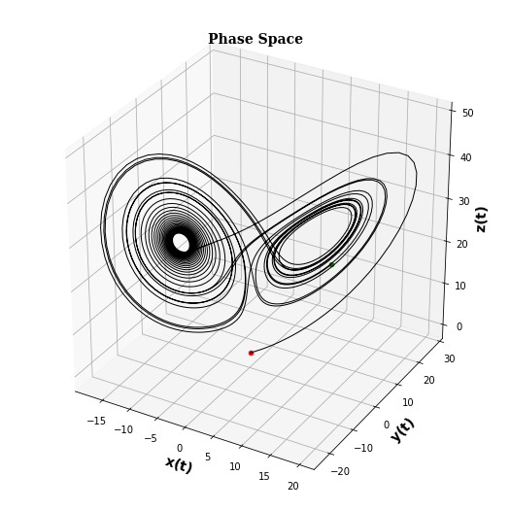
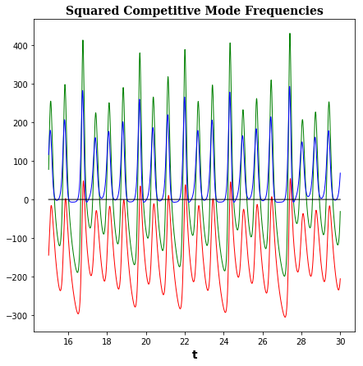
Competitive Modes: Lorenz
Introduction
Strange Attractors
Competitive Modes
Conclusions

Slide 14

Competitive Modes: Lorenz
Introduction
Strange Attractors
Competitive Modes
Conclusions
$g_{1}=g_{2}$:
$$x^{2}=1−σ^{2}$$
$g_{1}=g_{3}$:
$$σz=x^{2}+\left(σ\left(σ+ρ\right)−β^{2}\right)$$
$g_{2}=g_{3}:$
$$σz=σρ+1−β^{2}$$

Slide 15
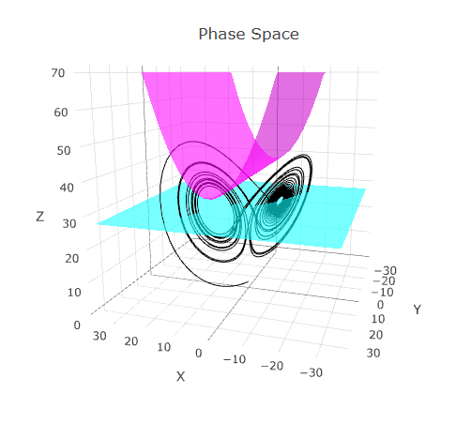
Competitive Modes: Lorenz
Introduction
Strange Attractors
Competitive Modes
Conclusions

Slide 16
Conclusions and Research Questions
Introduction
Strange Attractors
Competitive Modes
Conclusions
Localization techniques do already exist, but are not necessarily simple.
Is the Competitive Mode Conjecture true?
  Which systems fulfill the competitive mode conjecture?
  Does it also apply to discrete systems?

Slide 17
Questions?
Introduction
Strange Attractors
Competitive Modes
Conclusions

Slide 18
Localization through Trajectories
Introduction
Strange Attractors
Trajectories
Nambu Mechanics
Competitive Modes
Conclusions

Slide 19
Localization through Trajectories
Introduction
Strange Attractors
Trajectories
Nambu Mechanics
Competitive Modes
Conclusions
Self-Excited Attractors
Hidden Attractors

Slide 20
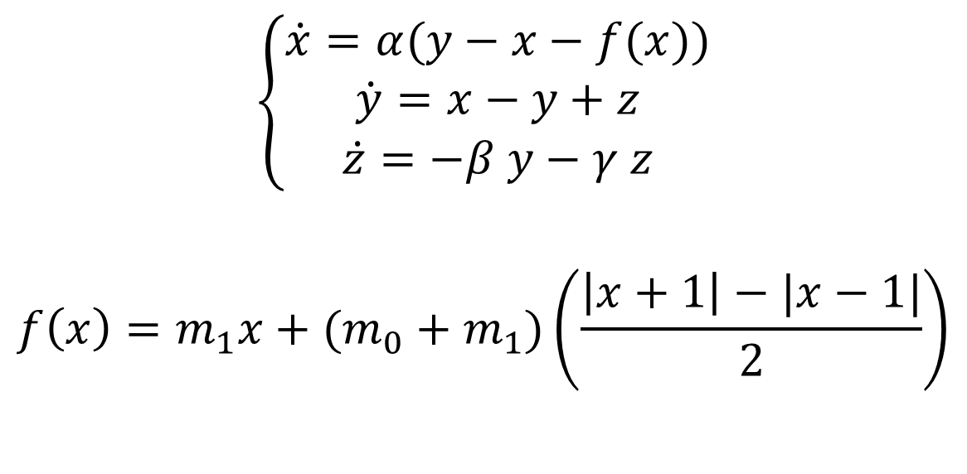
Localization of Chua Hidden Attractor
Introduction
Strange Attractors
Trajectories
Nambu Mechanics
Competitive Modes
Conclusions
$$\left\{\begin{aligned}\dot{x}=α(y−x−f(x)) \\ \dot{y}=x−y+z \\ \dot{z}=−β y−γ z\end{aligned}\right.$$
$$f\left(x\right)=m_{1}x+(m_{0}+m_{1})\left(\frac{\left|x+1\right|−|x−1|}{2}\right)$$

Slide 21
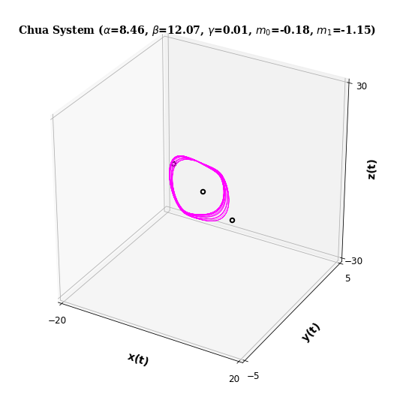
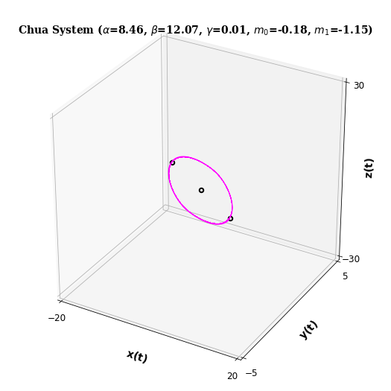
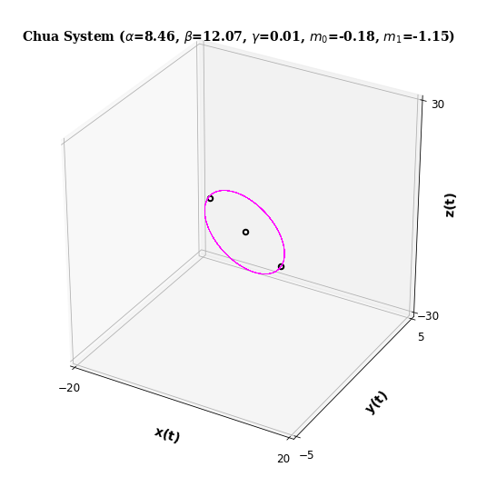



Localization of Chua Hidden Attractor
Introduction
Strange Attractors
Trajectories
Nambu Mechanics
Competitive Modes
Conclusions

Slide 22
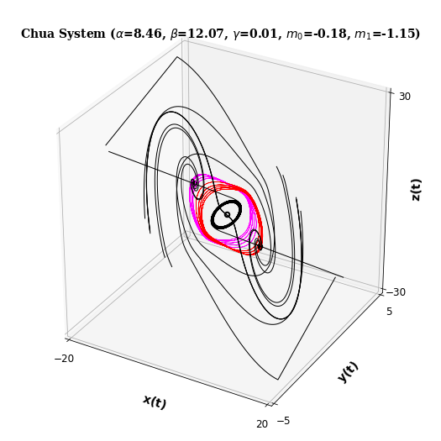
Localization of Chua Hidden Attractor
Introduction
Strange Attractors
Trajectories
Nambu Mechanics
Competitive Modes
Conclusions

Slide 23

Nambu Systems
Introduction
Strange Attractors
Trajectories
Nambu Mechanics
Competitive Modes
Conclusions
$$\left\{\begin{aligned}\dot{x}=\frac{∂H_{1}}{∂y}\frac{∂H_{2}}{∂z}−\frac{∂H_{1}}{∂z}\frac{∂H_{2}}{∂y} \\ \dot{y}=\frac{∂H_{1}}{∂z}\frac{∂H_{2}}{∂x}−\frac{∂H_{1}}{∂x}\frac{∂H_{2}}{∂z} \\ \dot{z}=\frac{∂H_{1}}{∂x}\frac{∂H_{2}}{∂y}−\frac{∂H_{1}}{∂y}\frac{∂H_{2}}{∂x}\end{aligned}\right.$$

Slide 24

Nambu Systems
Introduction
Strange Attractors
Trajectories
Nambu Mechanics
Competitive Modes
Conclusions
$$\text{Then} {\dot{H}}_{1}=0 \text{and} {\dot{H}}_{2}=0$$
Meaning
$$H_{1}\left(x\left(t\right),y\left(t\right),z\left(t\right)\right)=H_{1}\left(x\left(0\right),y\left(0\right),z\left(0\right)\right)$$
$$H_{2}\left(x\left(t\right),y\left(t\right),z\left(t\right)\right)=H_{2}\left(x\left(0\right),y\left(0\right),z\left(0\right)\right)$$

Slide 25
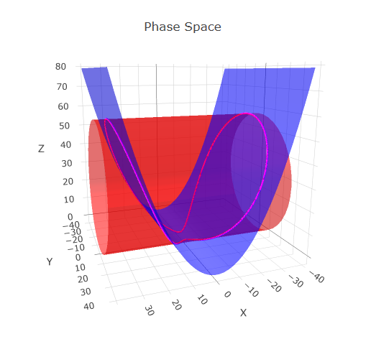
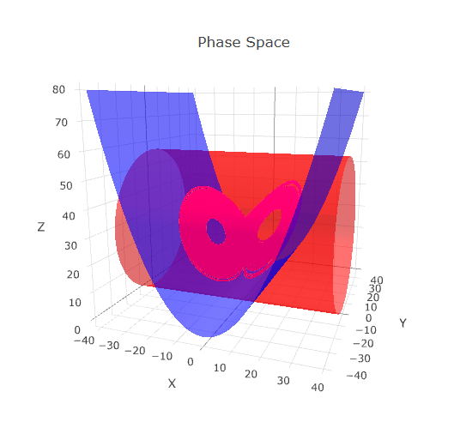
Nambu Hamiltonian Localization
Introduction
Strange Attractors
Trajectories
Nambu Mechanics
Competitive Modes
Conclusions

