Slide 1
MSc Thesis Defense:
Impact of static sea surface topography variations on ocean surface waves
Student:
YING, Yik Keung (EM-COSSE)
Supervisors:
Prof C. Vuik (Delft), Prof L.R. Maas (NIOZ)

Slide 2
Content Page
1. Background - Gravitational Fields and Surface Waves
2. Waves in Shallow Water
  a. Standard Shallow Water Model
  b. Adapted Shallow Water Model
    i. One-Dimensional Waves
    ii. Two-Dimensional Waves
3. Airy’s Linear Wave Theory
  a. Standard Airy’s Linear Wave Theory
  b. Generalised Airy’s Linear Wave Theory
4. Discussions
5. Conclusions

Slide 3
Content Page
1. Background - Gravitational Fields and Surface Waves
2. Waves in Shallow Water
  a. Standard Shallow Water Model
  b. Adapted Shallow Water Model
    i. One-Dimensional Waves
    ii. Two-Dimensional Waves
3. Airy’s Linear Wave Theory
  a. Standard Airy’s Linear Wave Theory
  b. Generalised Airy’s Linear Wave Theory
4. Discussions
5. Conclusions

Slide 4
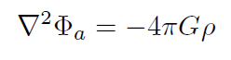

Background – Gravitational Field, Theory
Poisson’s Equation (or Laplace Equation)
Equipotential Surface
  collection of points (x,y,z) such that
Φ_{a}: Attractive Potential
ρ: Density distribution
G: Universal Constant
Φ: Conservative Potential
Φ₀: Constant

Slide 5
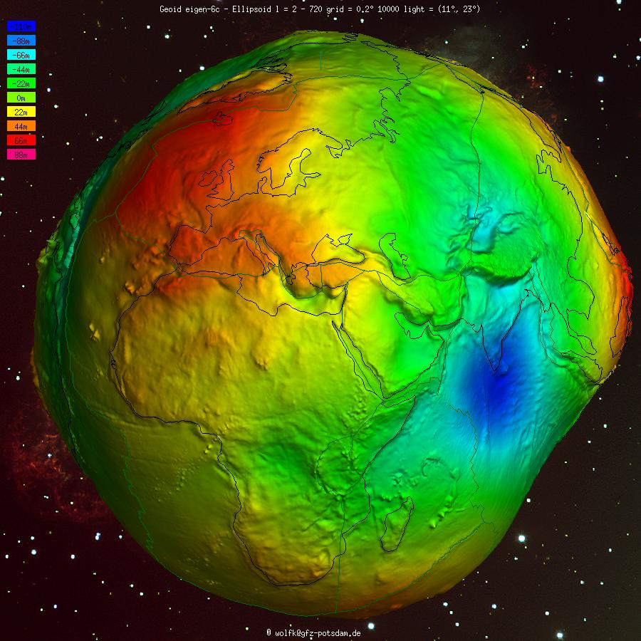
Background – Mean-Sea Level
Shape of Earth:
  The Mean-Sea Level as an Equipotential Surface
Notes:
The Earth surface is never smooth!

Slide 6
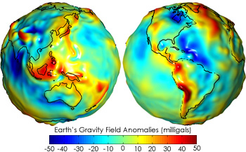
Background – Gravitational Field on Earth
The gravity is never uniform!
1 milligal = 1 cm/s^2

Slide 7
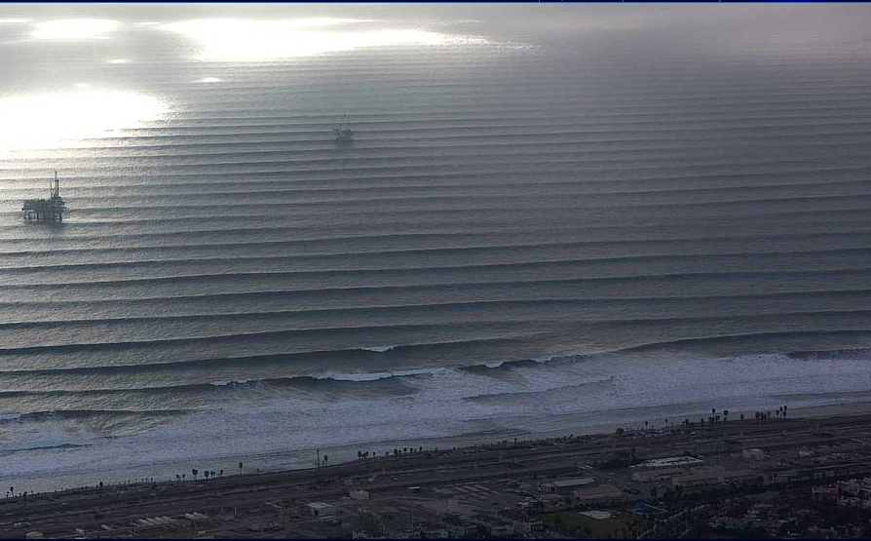
Background – Ocean Surface Waves
Example: Swells

Slide 8
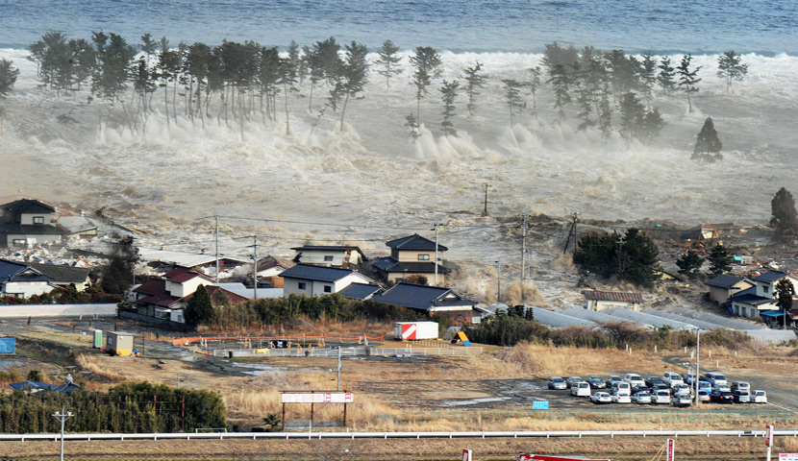
Background – Ocean Surface Waves
Example: Tsunami waves

Slide 9
Content Page
1. Background - Gravitational Fields and Surface Fluid Waves
2. Waves in Shallow Water
  a. Standard Shallow Water Model
  b. Adapted Shallow Water Model
    i. One-Dimensional Waves
    ii. Two-Dimensional Waves
3. Airy’s Linear Wave Theory
  a. Standard Airy’s Linear Wave Theory
  b. Generalised Airy’s Linear Wave Theory
4. Further Discussions
5. Conclusions

Slide 10
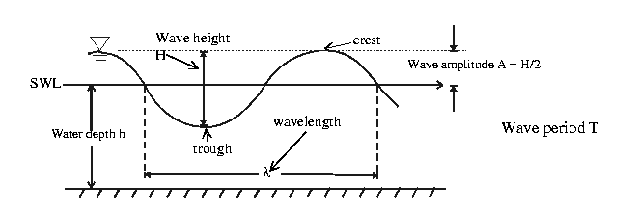
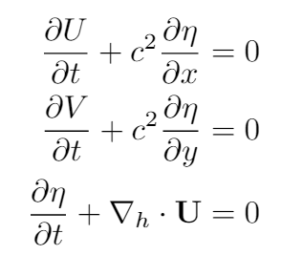
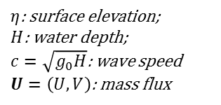
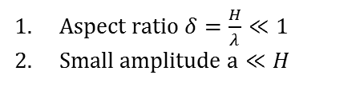
Shallow Water Model: Standard
Wave Height 2a
Crest
Fluid surface
z=0
Water amplitude a
Water Depth H
Wavelength
z
x
Aspect ratio $δ=\frac{H}{λ}≪1$
Small amplitude $a≪H$
Shallowness:
Governing equations for shallow water waves
$η$: surface elevation;
$H$: water depth;
$c=\sqrt{g_{0}H}$: wave speed
$U=\left(U,V\right)$: mass flux

Slide 11

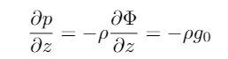

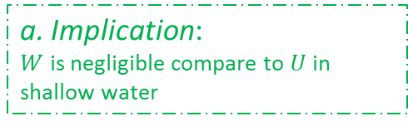

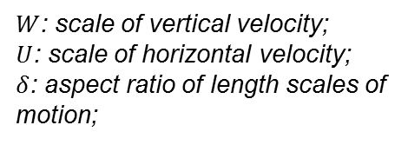
Shallow Water Model: Standard
Assumptions:
  1. Ideal fluid
  2. Uniform Gravity
  3. Shallowness:
    a. 2.5D formalism
    b. Hydrostatic approximation
a. Implication:
$W$ is negligible compare to $U$ in shallow water
$W$: scale of vertical velocity;
$U$: scale of horizontal velocity;
$δ$: aspect ratio of length scales of motion;
$p$: pressure;
$h$: surface elevation;
$p_{a}$: atmo. pressure (const.)
$g$: gravity (const.)
$ρ$: density of fluid (const.)
b. Implication:
Horizontal pressure gradient is determined by surface elevation

Slide 12
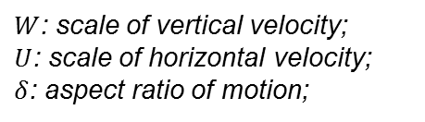
Shallow Water Model: Adapted
Assumptions:
  1. Ideal fluid
  2. Conservative Gravity
  3. Shallowness:
    a. 2.5D formalism
    b. Hydrostatic approximation
$W$: scale of vertical velocity;
$U$: scale of horizontal velocity;
$δ$: aspect ratio of motion;
Question:
How to deal with the hydrostatic approximation when gravity is non-uniform?

Slide 13
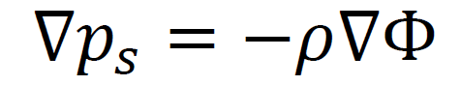
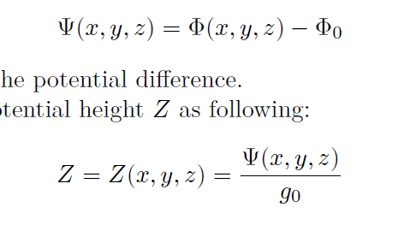
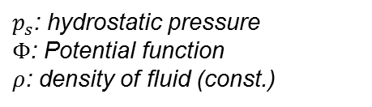
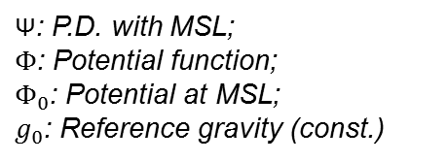
Shallow Water Model: Adapted
How does the hydrostatic condition work?
Recast the vertical coordinates via the conservative potential
Z-Transformation on vertical coordinates
$p_{s}$: hydrostatic pressure
$Φ$: Potential function
$ρ$: density of fluid (const.)
Potential Difference Ψ with MSL
$\text{Ψ}$: P.D. with MSL;
$Φ$: Potential function;
$Φ_{0}$: Potential at MSL;
$g_{0}$: Reference gravity (const.)
Z-coordinate function

Slide 14
Shallow Water Waves: Adapted Model
Visualisation of the (x, Z) coordinates
0
Horizontal Coordinate, x
Equipotential Lines, Z
Re-definition of ‘depth’!

Slide 15

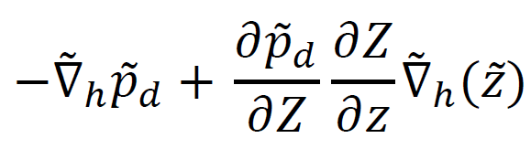
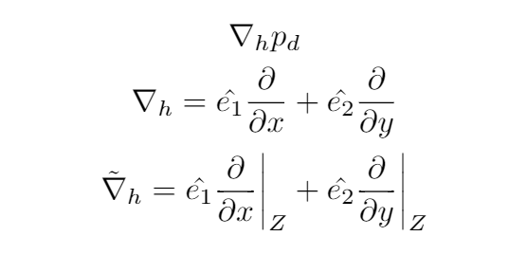
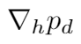
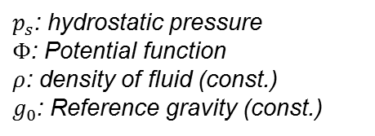

Shallow Water Model: Adapted
Hydrostatic condition in (x, y, Z) coordinates
After hydrostatic approximation in (x, y, Z) coordinates…
$p_{s}$: hydrostatic pressure
$Φ$: Potential function
$ρ$: density of fluid (const.)
$g_{0}$: Reference gravity (const.)
Analogous to classical case
$p_{d}$: dynamic pressure
$\tilde{z}=\tilde{z}(x,y,Z)$: coordinates function
Horizontal pressure gradient:
Horizontal gradient

Slide 16

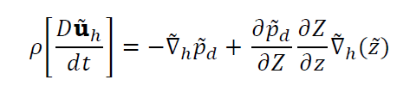

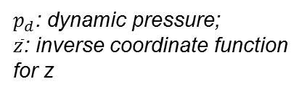

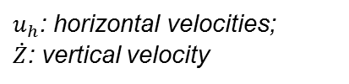

Shallow Water Waves: Adapted Model
Transformed governing equations
Additional assumptions:
  1. Shallowness: Kills nonlinear Jacobian term in momentum
  2. During depth-averaging: Gravity variation only at surface
Jacobian terms after coordinates transformation
Continuity
$u_{h}$: horizontal velocities;
$\dot{Z}$: vertical velocity
Momentum
$p_{d}$: dynamic pressure;
$\overline{z}$: inverse coordinate function for z
Scale $=O(δ ρ\frac{D{\tilde{u}}_{h}}{dt})$
$δ$: aspect ratio of motion length scales

Slide 17


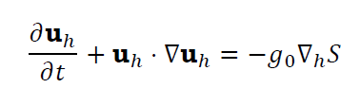

Shallow Water Waves: Adapted Model
Depth-averaging + Zero Normal Flow B.C.
Continuity
Momentum
Depth Averaging
Depth-averaged Continuity
Depth-averaged
Momentum
$S=S(x,y,t)$: Surface elevation;
$\tilde{D}=\tilde{D}(x,y)$: Hydrostatic depth;
$u_{h}={\tilde{u}}_{h}$: Horizontal velocity
Difference with standard shallow water model:
Adapting term in depth-averaged continuity equation

Slide 18
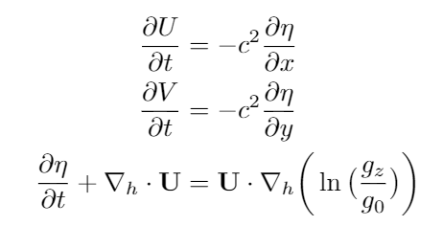


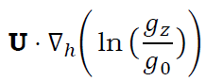
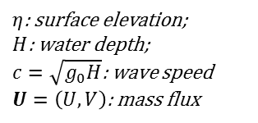
Shallow Water Waves: Adapted Model
Consider a small perturbation to quiescent fluid
  Adapted Shallow Water Wave Equations
1. Wave speed:
2. Adapting term:
$η$: surface elevation;
$H$: water depth;
$c=\sqrt{g_{0}H}$: wave speed
$U=\left(U,V\right)$: mass flux
Difference with standard shallow water waves:
Adapting term in perturbed depth-averaged continuity equation

Slide 19
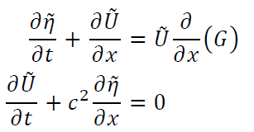




Adapted Shallow Water Waves:
One-Dimensional
One-Dimensional Wave Equations
  Consider the time-harmonic ansatz:
Recasting variables:
$\tilde{η}$: surface elevation;
$D_{0}$: water depth;
$c=\sqrt{g_{z}D_{0}}$: wave speed
$\tilde{U}=\left(\tilde{U},\tilde{V}\right)$: mass flux
$G=\ln\left(\frac{g_{z}}{g_{0}}\right)$: redefined variable
$ω$: angular speed;
${\tilde{η}}_{0}$: amplitude field

Slide 20

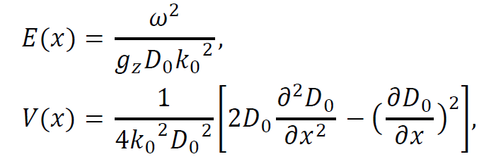
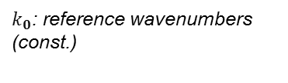
Adapted Shallow Water Waves:
One-Dimensional Diagnostic Formalism
Gives:
  with diagnostic variables: ‘Kinetic Energy’ and ‘Potential’
  Not physical quantities!
Solution: WKBJ-Approximation
$k_{0}$: reference wavenumbers (const.)
Mild-slope: V(x) << E(x)

Slide 21
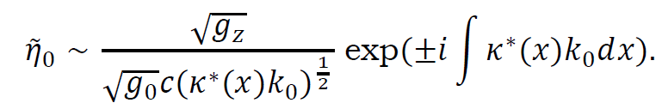


Adapted Shallow Water Waves:
One-Dimensional Diagnostic Formalism
Solution by WKBJ-Approximation
Time-harmonic ansatz
Wavenumber field
where
Amplitude field:
Dependent on g_{z};
Different from standard case
Short concluding remark:
Gravity: affect both amplitude and wavenumber of waves!

Slide 22
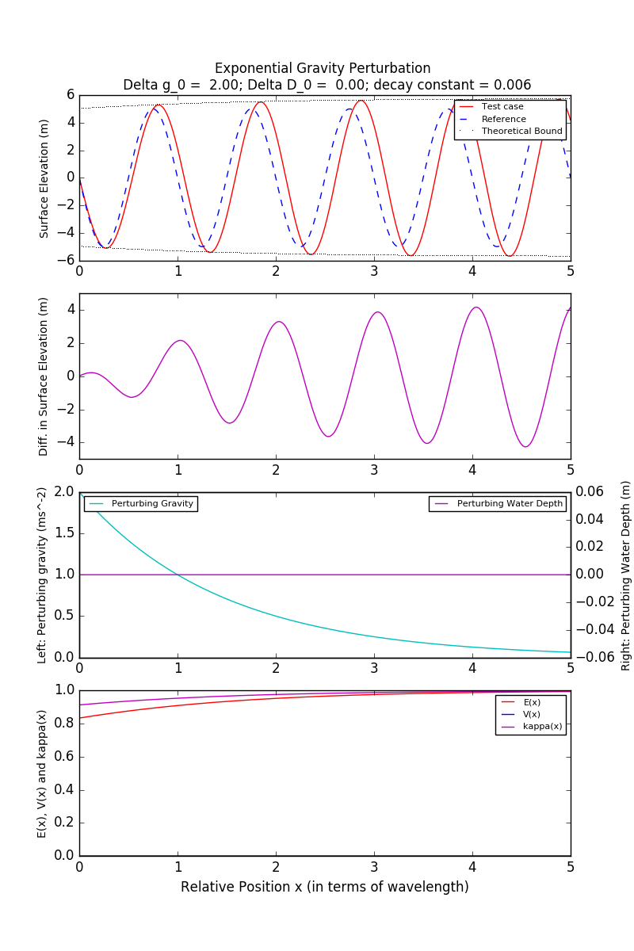
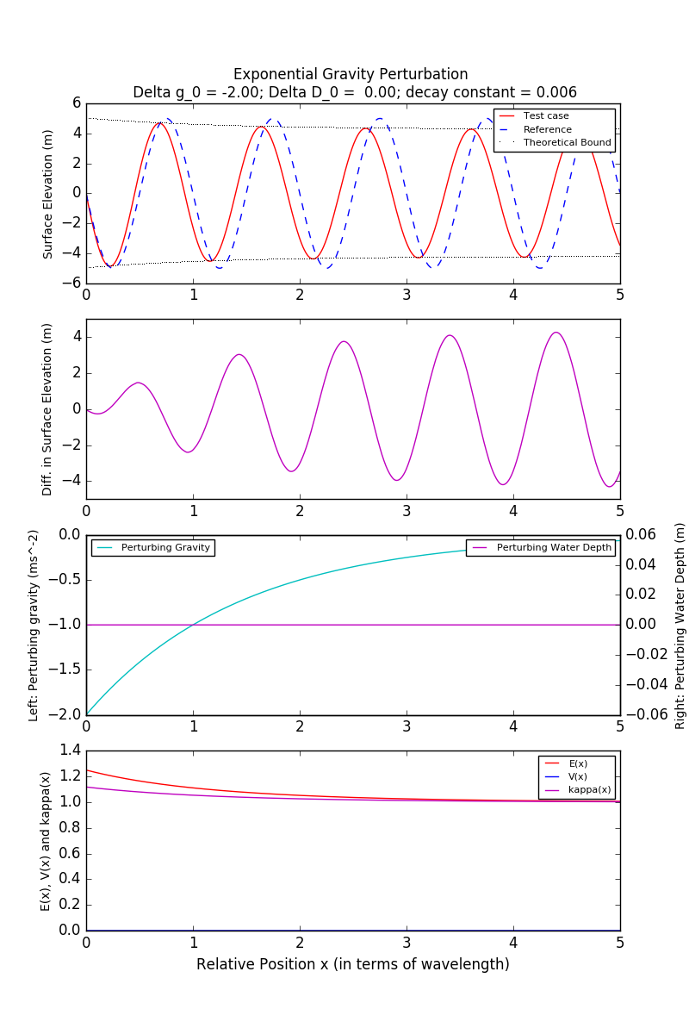


Adapted Shallow Water Waves:
Numerical Solutions (1A)
Target: Validation of the WKBJ-Approximation
Test case: Hypothetical – Exponential Gravity Perturbation, blown-up
Left: Hypothetical waves, $+Δg$
Right: Hypothetical waves, $−Δg$

Slide 23
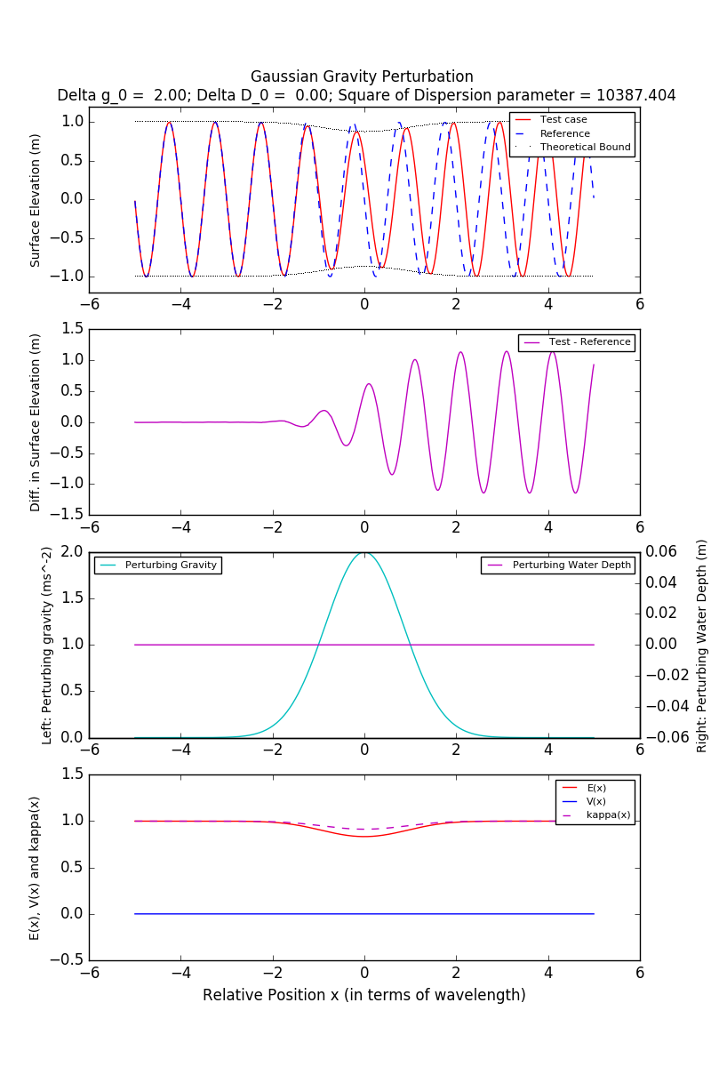
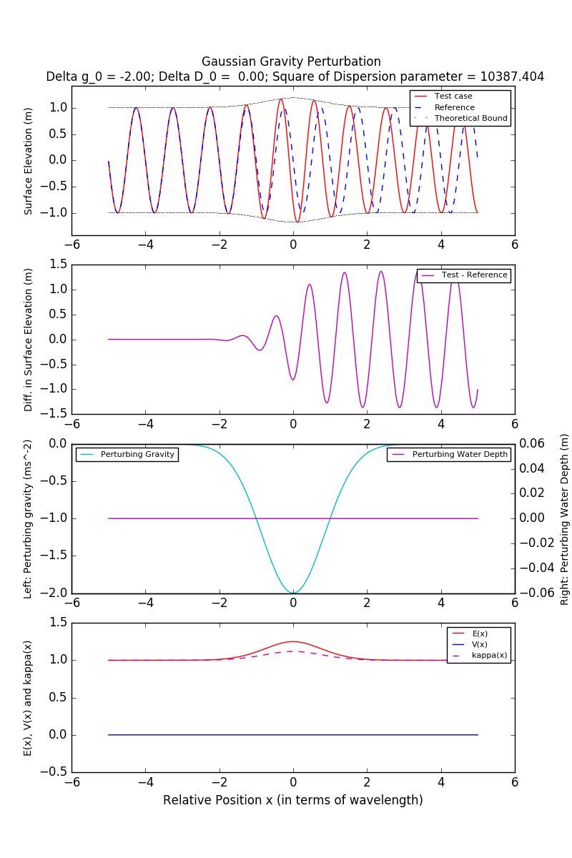
Adapted Shallow Water Waves:
Numerical Solutions (1B)
Target: Validation of the WKBJ-Approximation
Test case: Hypothetical – Gaussian Gravity Perturbation, blown-up
Left: Hypothetical waves, $+Δg$
Right: Hypothetical waves, $−Δg$

Slide 24
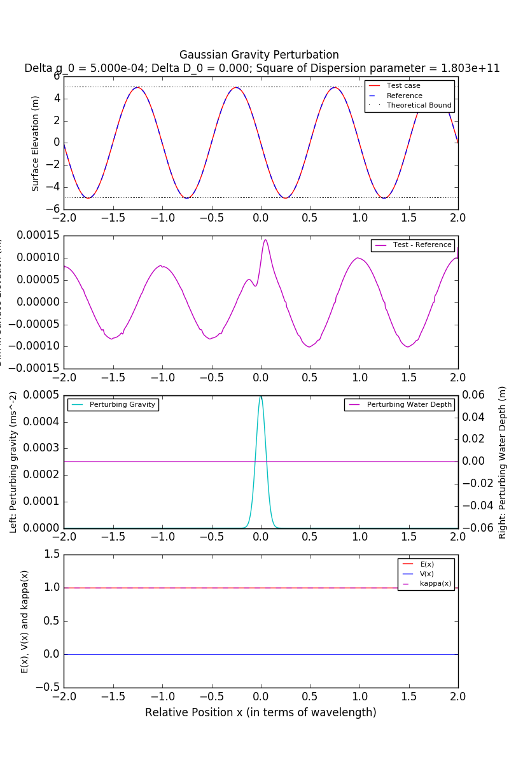
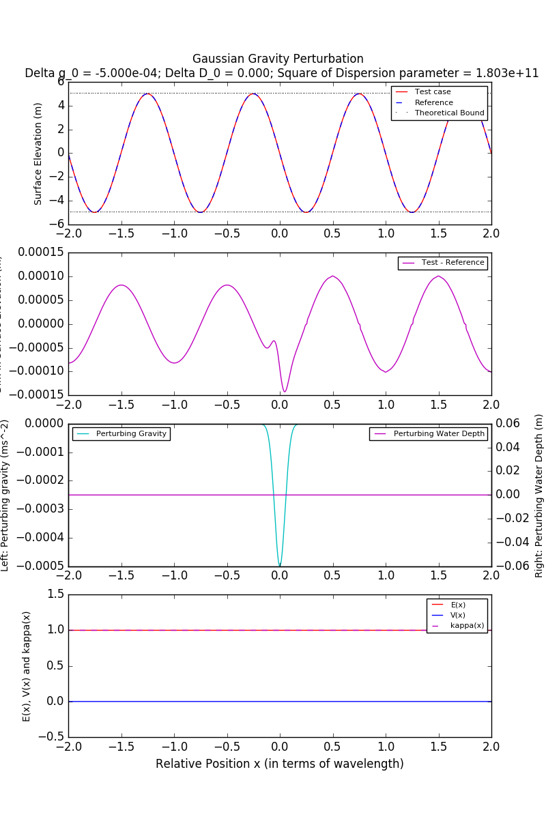
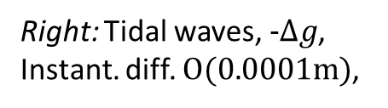
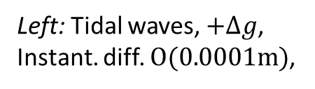
Adapted Shallow Water Waves:
Numerical Solutions (2A)
Target: Waves on the Ocean
Test case: Physical – Gaussian Gravity Perturbation, Tidal
Left: Tidal waves, $+Δg$,
Instant. diff. $O(0.0001m)$,
Right: Tidal waves, $−Δg$,
Instant. diff. $O(0.0001m)$,

Slide 25
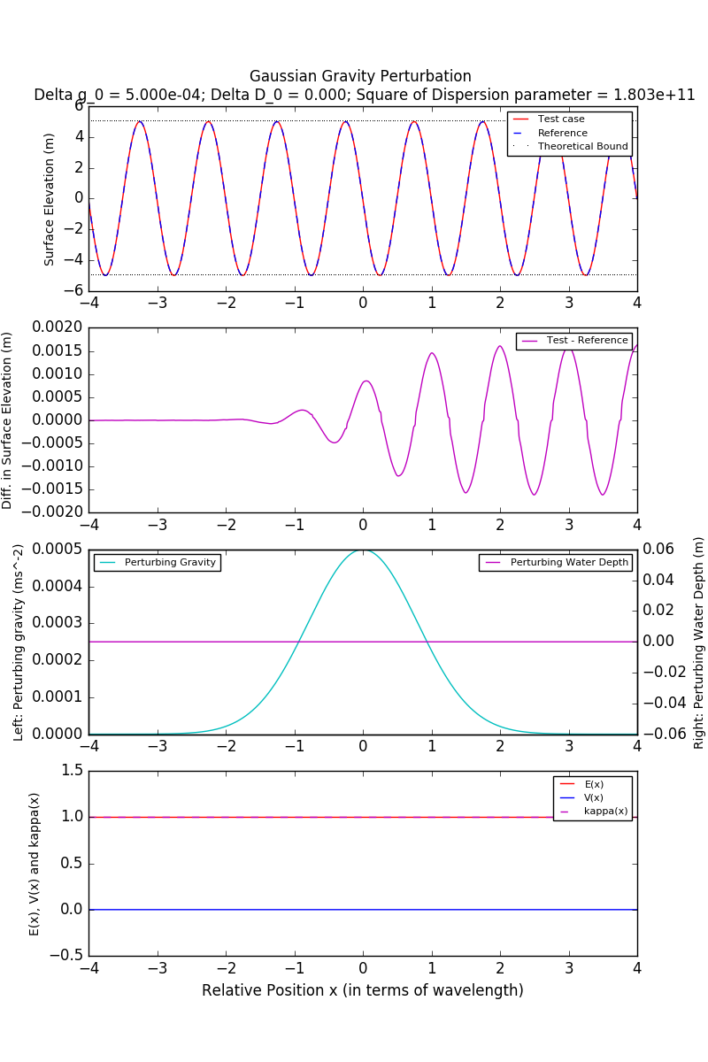
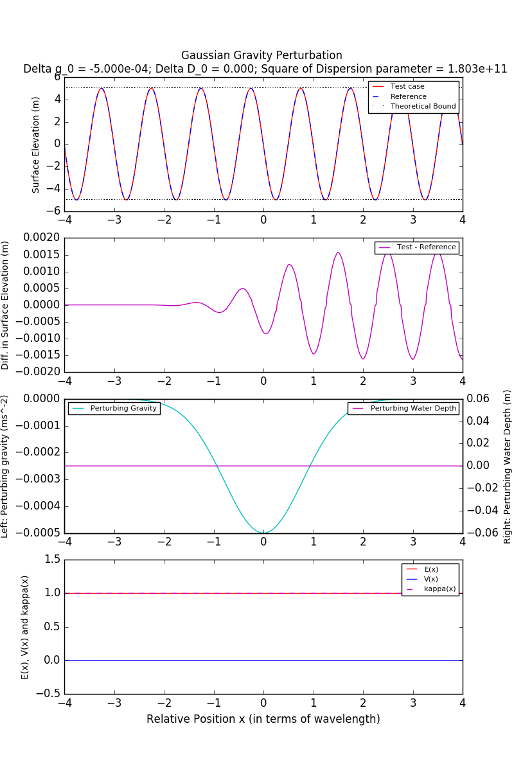
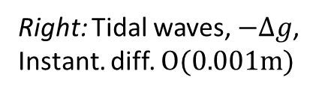
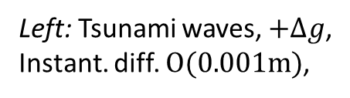
Adapted Shallow Water Waves:
Numerical Solutions (2B)
Target: Waves on the Ocean
Test case: Physical – Gaussian Gravity Perturbation, Tsunami
Left: Tsunami waves, $+Δg$,
Instant. diff. $O(0.001m)$,
Right: Tidal waves, $−Δg$,
Instant. diff. $O(0.001m)$

Slide 26
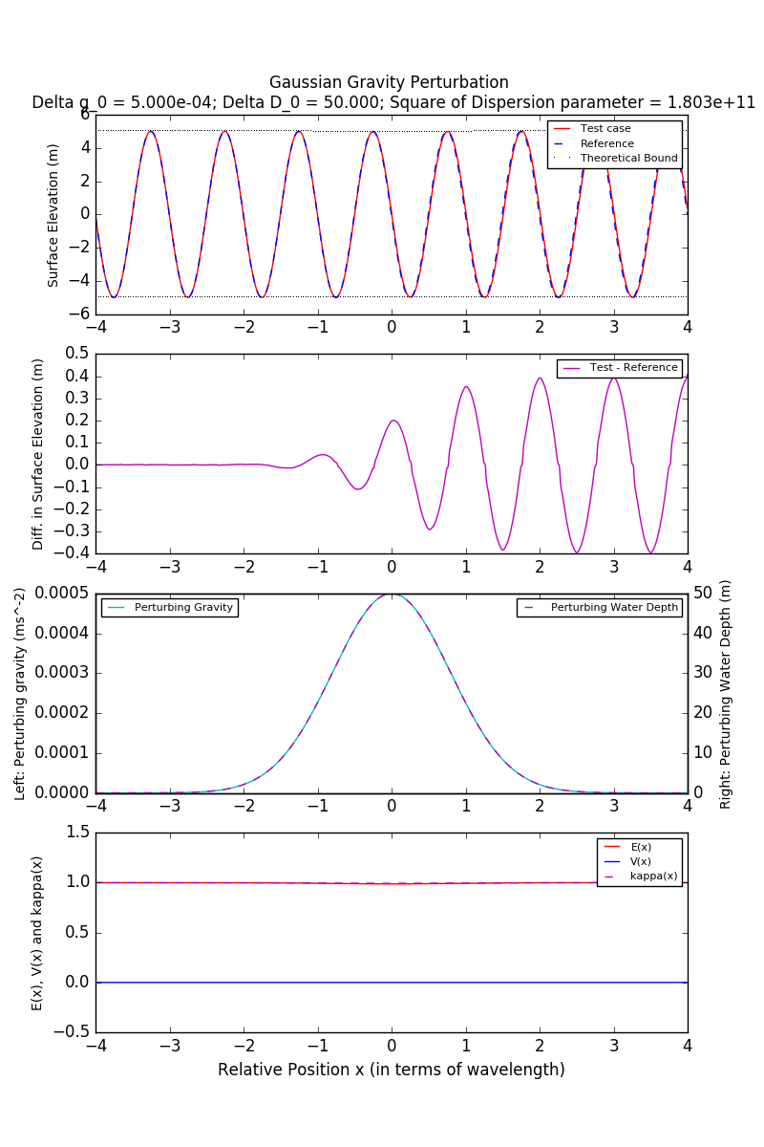
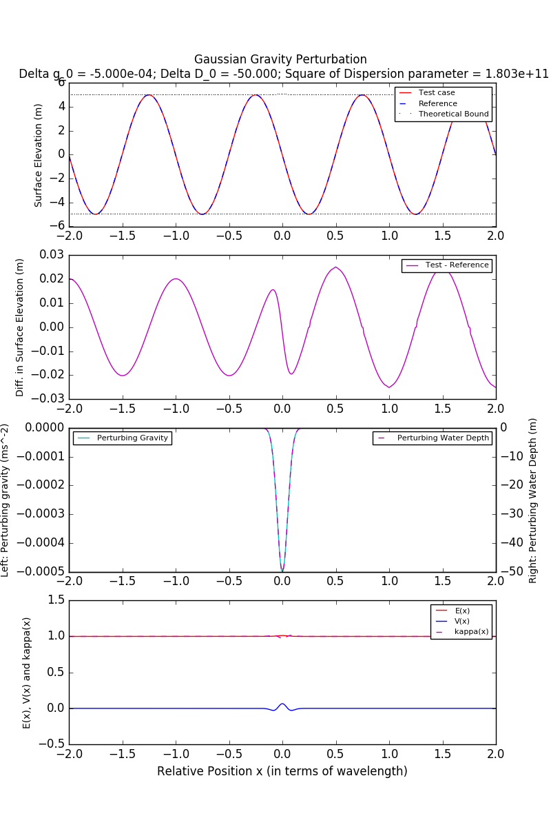
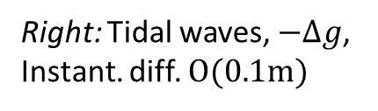

Adapted Shallow Water Waves:
Numerical Solutions (3)
Target: Waves on the Ocean
Test case: Physical – Gaussian Gravity & MSL Perturbation
Left: Tsunami waves, $+Δg$,
Instant. diff. $O(0.1m)$,
Right: Tidal waves, $−Δg$,
Instant. diff. $O(0.1m)$

Slide 27
Concluding Remarks
Gravity -> Wave amplitude and wavenumber field
In the actual ocean:
  Effect of gravity variation
    Unlikely measurable
  Effects of induced MSL variation
    Maybe measurable?

Slide 28


Adapted Shallow Water Waves:
Two-Dimensional
Two-Dimensional Wave Equations
Diagnostic formalism failed...
$η$: surface elevation;
$D_{0}$: water depth;
$c=\sqrt{g_{z}D_{0}}$: wave speed
$U=\left(U,V\right)$: mass flux

Slide 29


Adapted Shallow Water Waves:
Numerical Solutions (7)
Target: Find out the difference between Gravity and Depth perturbation
Test case: Hypothetical – Identical Size Gaussian Gravity Perturbation vs MSL Perturbation
Only gravity perturbation
Only MSL perturbation
Positive perturbation
Gravity:
Change wave amplitudes!
= Shoaling
Negative perturbation

Slide 30


Adapted Shallow Water Waves:
Numerical Solutions (4A)
Target: Waves on the Ocean
Test case: Physical – Gaussian Gravity Perturbation, Tidal waves
No perturbation
Positive perturbation
Spherical scattered waves
Negative perturbation

Slide 31


Adapted Shallow Water Waves:
Numerical Solutions (4B)
Target: Waves on the Ocean
Test case: Physical – Gaussian Gravity Perturbation, Tsunami waves
No perturbation
Positive perturbation
Plane-waves like scattered waves
Negative perturbation

Slide 32


Adapted Shallow Water Waves:
Numerical Solutions (5A)
Target: Waves on the Ocean
Test case: Physical – Gaussian Gravity & MSL Perturbations, Tidal waves
No perturbation
Positive perturbation
Negative perturbation
Minimal changes…

Slide 33


Adapted Shallow Water Waves:
Numerical Solutions (6A)
Target: Waves on the Ocean, filter out the effects of depth changes
Test case: Physical – Gaussian Gravity & MSL Perturbations, Tidal waves
Only MSL perturbation
Positive perturbation
Negative perturbation
Minimal changes again

Slide 34


Adapted Shallow Water Waves:
Numerical Solutions (5B)
Target: Waves on the Ocean
Test case: Physical – Gaussian Gravity & MSL Perturbation, Tsunami waves
No perturbation
Positive perturbation
Negative perturbation
Maybe observable!?

Slide 35


Adapted Shallow Water Waves:
Numerical Solutions (6B)
Target: Waves on the Ocean, filter out the effects of depth changes
Test case: Physical – Gaussian Gravity & MSL Perturbation, Tsunami waves
Only MSL perturbation
Positive perturbation
Negative perturbation
Minimal changes again

Slide 36



Short Conclusions
$g_{z}$:
Spatially dependent
Comparison between Standard and Adapted Shallow water waves
 | Standard Model | Adapted Model
Wave speed | $$c_{g}=\sqrt{g_{0}D}$$ | $$c_{g}=\sqrt{g_{z}D}$$
Adapting term | Absent | $$U∙∇ln⁡(\frac{g_{z}}{g_{0}})$$
Wave scattering | By wave speed | By wave speed
Wave Shoaling | By Depth | By both Depth and Gravity
Inference 1:
Theoretically distinguish waves scattered by Depth and Gravity
Inference 2:
In practice, it suffices to assume $g_{z}=g_{0}$ but take into account of change of static water depth $D$ due to gravity field

Slide 37
Content Page
1. Background - Gravitational Fields and Surface Fluid Waves
2. Waves in Shallow Water
  a. Standard Shallow Water Model
  b. Adapted Shallow Water Model
    i. One-Dimensional Waves
    ii. Two-Dimensional Waves
3. Airy’s Linear Wave Theory
  a. Standard Airy’s Linear Wave Theory
  b. Generalised Airy’s Linear Wave Theory
4. Further Discussions
5. Conclusions

Slide 38





Airy’s Linear Wave Theory: Standard
Wave Height 2a
Crest
Fluid surface
z=0
Water amplitude a
Water Depth h
Wavelength
z
No assumption of shallowness!
x
Continuity
$φ$: velocity potential;$\overset{⃑}{u}=∇φ$
(Linearised)
Governing Equations:
Momentum
$η$: surface elevation; $g_{0}$: uniform gravity
Boundary Conditions
Bottom: $z=−h\left(x\right)$
Surface: $z=η\left(x,t\right)$

Slide 39






Airy’s Linear Wave Theory: Standard
Analytical solution in uniformly deep ocean
  Bottom: $h\left(x\right)=h_{0}$ (const.)
Velocity Potential, $φ$
Surface Elevation, $η$
$η$: Surface elevation;
$a$: Wave amplitude;
$h_{0}$: Water depth (const.)
$ω$: Angular speed of waves
$k$: Wavenumber
Dispersion relation

Slide 40





Airy’s Linear Theory: Generalised, 2D
Generalised Airy’s Linear Theory
  Governing Equation:
Seemingly trivial?
  Justified by variational principle!
$Ψ$: Potential Field function
Continuity
$δm:$Mean-sea level
$φ$: velocity potential;$\overset{⃑}{u}=∇φ$
Momentum
Boundary Conditions
Bottom: $z=−h\left(x\right)$
Surface: $z=η\left(x,t\right)$
Question:
Can we derive some analytical solutions from it?

Slide 41





Airy’s Linear Theory: Generalised, 2D
Yes we can.
  Conservative force field provided a guide!
  Recall:
    Force potential $Ψ$ satisfies Laplace Equation in free space, i.e. $∇^{2}Ψ=0$
Consider 2D Laplace Equation
  Harmonic conjugates => Conformal coordinates
  Step 1:
  Define vertical coordinate q₂
  Step 2:
  Apply Cauchy-Riemann condition to determine q₁
  Step 3:
  Rewrite Laplacian operator in (q₁, q₂)

Slide 42
Airy’s Linear Theory: Generalised, 2D
Visualisation of Coordinates (q₁, q₂)
0
Conformal Coordinates, q₁
Equipotential Lines, q₂

Slide 43




Airy’s Linear Theory: Generalised, 2D
Governing equations of linear waves after transformation:
Continuity
$φ$: velocity potential;$\overset{⃑}{u}=∇φ$
Boundary Conditions
Bottom: $q_{2}=−\tilde{h}\left(q_{1}\right)$
Surface:$q_{2}=\tilde{η}\left(q_{1},t\right)$
Momentum
same as classical!

Slide 44






Airy’s Linear Theory: Generalised, 2D
Analytical solution in ‘uniformly deep’ fluid
  $\tilde{h}\left(q_{1}\right)={\tilde{h}}_{0}$: Standard result directly applicable
Surface Elevation, $η$
Velocity Potential, $φ$
subject to dispersion relation:
$η$: Surface elevation;
$a$: Wave amplitude;
${\tilde{h}}_{0}$: Water depth;
$ω$: Angular speed of waves
$k$: Wavenumber

Slide 45






Airy’s Linear Theory: Test Cases
Test case 1: Fluid Waves around circle
Potential
Orthogonal
coordinates
R_{s}
R_{c}
Surface elevation
in polar coordinates
(r, θ)
Solid Boundary
Equipotential Lines, q₂
$η_{r}$: Surface elevation;
$a$: Wave amplitude;
$R_{s}$: MSL;
$R_{c}$: Bottom boundary
$k$: Wavenumber
$g_{0}$: Reference gravity, const.
Hydrostatic Fluid Interface
Remark: Periodic B.C.

Slide 46






Airy’s Linear Theory: Test Cases
Test case 2: Fluid Waves in Decaying Perturbed Gravity Field
$d$: Depth of source;
$δm(x)$: MSL
$g_{0}$: Reference gravity, const.
$G_{ε}$: Reference const.
Potential
Orthogonal
coordinates
‘Perturbation’ coordinates to (x,z)
Example 2a: Linear waves at shorter wavelengths
Example 2b: Linear waves at longer wavelengths

Slide 47




Airy’s Linear Theory: Test Cases
Consistency with adapted shallow water model?
Adapted shallow water
Generalised Airy’s linear waves
Increasing wavelength
Step 1:
Increase wavelengths
(approach long-wave limit)
Step 2:
Compare amplitude field

Slide 48
Content Page
1. Background - Gravitational Fields and Surface Fluid Waves
2. Waves in Shallow Water
  a. Standard Shallow Water Model
  b. Adapted Shallow Water Model
    i. One-Dimensional Waves
    ii. Two-Dimensional Waves
3. Airy’s Linear Wave Theory
  a. Standard Airy’s Linear Wave Theory
  b. Generalised Airy’s Linear Wave Theory
4. Discussions
5. Conclusions

Slide 49

Discussion:
Small scattered wiggles
The small wiggles seen in positive gravity perturbation
Small wiggles
Instantaneous difference, 1D
Gravity perturbation vs no perturbation
Instantaneous difference, 2D
Gravity perturbation vs no perturbation
Possibly explained by the diagnostic formalism (Schrodinger question)?
Energy level; Wave trappings?

Slide 50


Discussion:
Experimental Validation of Adapted Shallow Water Model
Replacing Gravity by Electromagnetic force?
Direct Navier Stokes Simulation?

Slide 51
Discussion:
Airy’s Linear Waves in 3D Space
Three-Dimensional Gravity Field
  Conformal coordinates (q₁, q₂, q₃)?
Analytical solution?
Numerical simulation of governing equations?

Slide 52
Content Page
1. Background - Gravitational Fields and Surface Fluid Waves
2. Waves in Shallow Water
  a. Standard Shallow Water Model
  b. Adapted Shallow Water Model
    i. One-Dimensional Waves
    ii. Two-Dimensional Waves
3. Airy’s Linear Wave Theory
  a. Standard Airy’s Linear Wave Theory
  b. Generalised Airy’s Linear Wave Theory
4. Further Discussions
5. Conclusions

Slide 53
Conclusions
1. Adapted Shallow Water Model
  Gravity -> Amplitude, Wavenumber and Scattering
  In practice: effects on ocean surface waves by
    Gravity: Unobservable
    MSL: Observable, sufficient by standard model
2. Generalised Airy’s Linear Wave Theory
  Mapping of conservative gravity field into uniform field
    Redefine ‘depth’ and ‘horizontal’ coordinate
  Only valid for one-dimensional waves
  Consistent with Adapted Shallow Water Model

Slide 54
Things omitted…
Effective gravity field due to rotation
Detailed scale analysis in adapted shallow water model
Potential vorticity in adapted shallow water model
Length scales of perturbation on wave transmission and scattering
Limitations of 2D gravitational potential
Attempts on 3D generalised Airy’s linear wave theory
and many more…

Slide 55

Thank you!
Questions are welcome!

Slide 56

END

