Slide 1
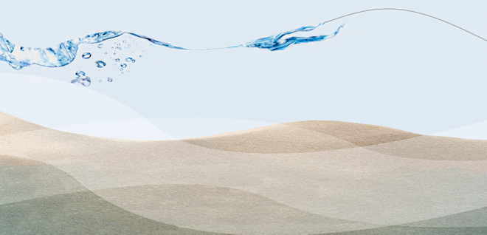





Ship Simulator
3TU.AMI
Applied Mathematics Institute
Kees Vuik
Delft University of Technology
www.3tu.nl/ami

Slide 2
Contents
Problem
Solution
Result
TU Delft: Elwin van ‘t Wout, Martijn de Jong, Martin van Gijzen
Marin: Auke Ditzel, Anneke Sicherer, Auke van der Ploeg

Slide 3
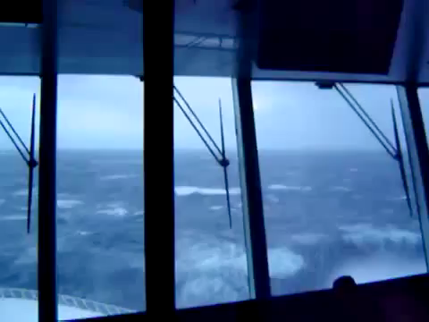
Rough seas

Slide 4
Problem: realistic simulator
Required area 5 km x 5 km
New screen every 0.05 seconds
Bound on the CPU time

Slide 5
How not to do it
Navier-Stokes equations
Multi-phase flow
Moving boundary problem

Slide 6
Boussinesq approach for water waves
(Gert Klopman, UT)
Approximation valid for weakly non-linear and fairly long waves
Takes into account the vertical structure of the horizontal and vertical flow velocity
Much cheaper in CPU time

Slide 7
Pressure system
Ax = b
Large linear system of equations
(ten million unknowns)
Schilders/Koren, TUe
Vuik/Oosterlee, TUD
Veldman/Van der Ploeg, UG

Slide 8
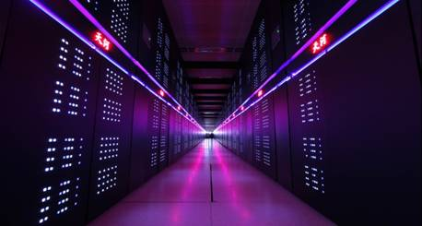
How not to do it
Compute the inverse of A
Work increases quadratically
Tianhe-2 Supercomputer
3 million parallel processors
20 MW energy consumption
40 petaflops (40 x 10¹⁵)
390 million USD

Slide 9
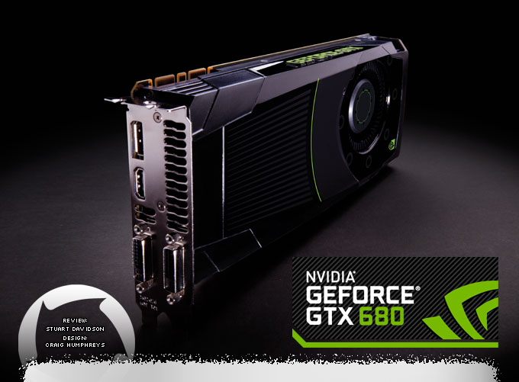
How to do it
Iterative solver (multigrid)
Linearly increasing
NVIDIA GeForce GTX 680 (Kepler)
1000 parallel processors
100 W energy consumption
1 teraflop (10¹²)
200 USD

Slide 10
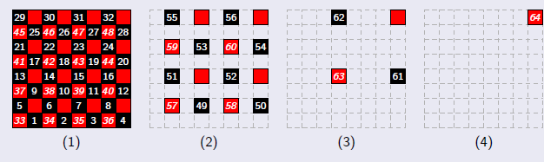
MSc Thesis of Martijn de Jong
RRB numbering
Example: 8 x 8 grid points

Slide 11
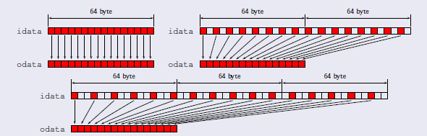
Problem with memory access

Slide 12
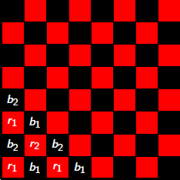
Good idea

Slide 13
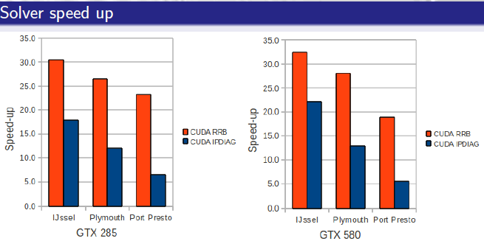
Results

Slide 14
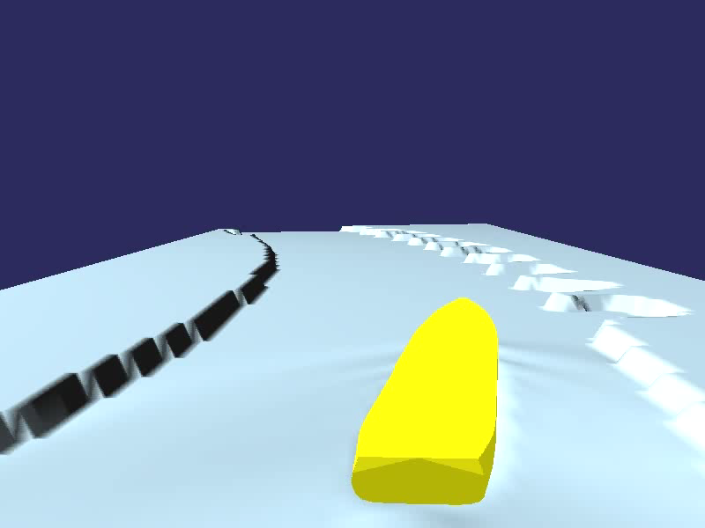

Slide 15
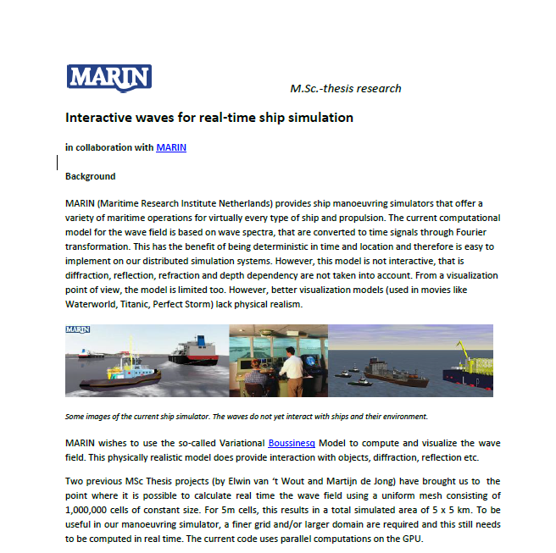
Future

