Slide 1

E-Learning in University
Math-Education
Experience and Perspectives in the Use of the Teaching and Learning Environment
Kees Vuik, TU Delft
March 21, 2013, 3TU HBO schakelprogramma

Slide 2
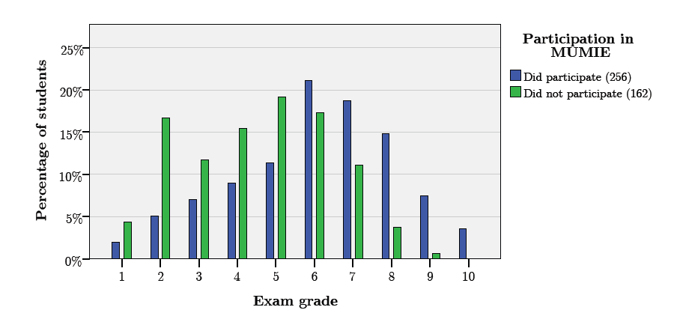
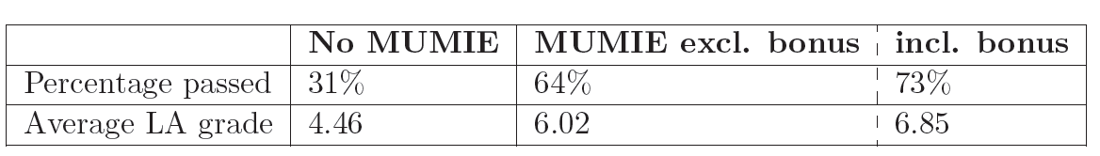
Results
March 21, 2013, 3TU HBO schakelprogramma

Slide 3
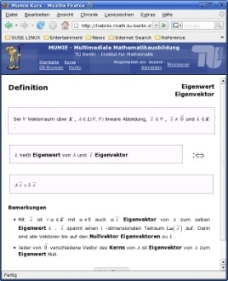
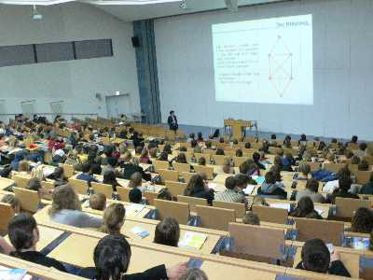
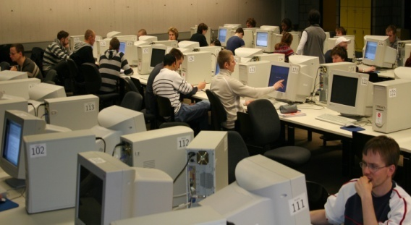
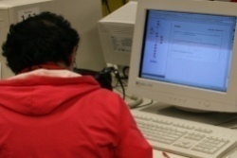
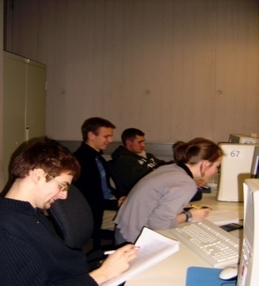
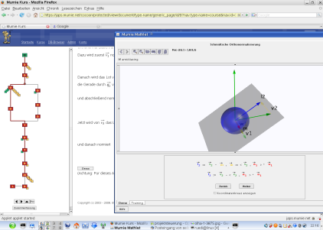
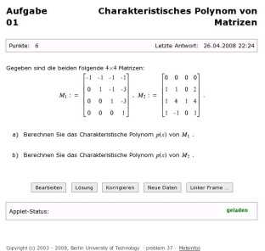
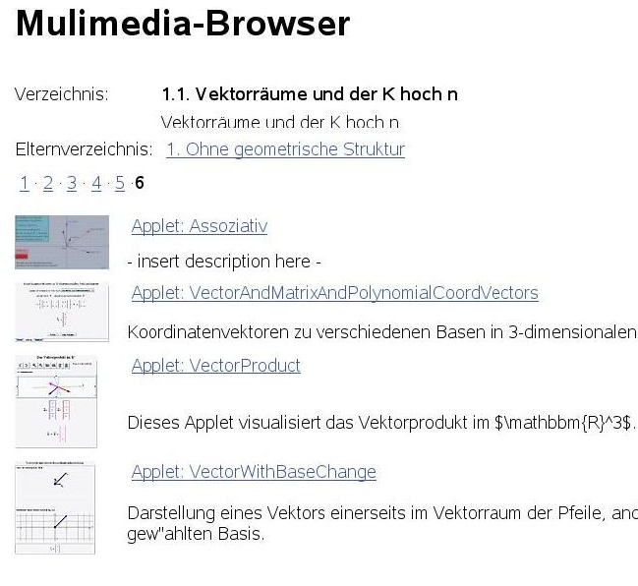
MUMIE supports a broad variety of pedagogical concepts
Blackboard + Multimedia
Interactive Script
Teamwork -
Tutor is Coach
Learner
Centred
Visualisation
personalized, automatically corrected home work with demo + training
Multimedia DB

Slide 4



MUMIE: Integrated in regular teaching
Linear Algebra for Engineers: Blended learning
COMA – Computer oriented Mathematics: Blended learning
GLET – Foundations of Electrical Engineering: Supplementary Material
Self Assessment Test
Linear Algebra
Analysis
Several other courses
Introductory Course
Complex Numbers
March 21, 2013, 3TU HBO schakelprogramma

Slide 5

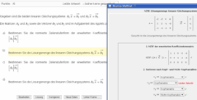
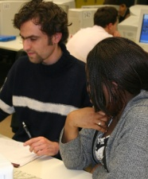
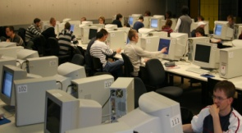
The pedagogical concept TuMult
interactive script
forum
preparation for the lecture:
personalized, automatic
correction, demo + training
self-
study
pre-
learning
to broaden competence,
to check achievement:
personalized, automatic correction , demo+training
home
work
blackboard + multimedia components from MUMIE- DB
lecture
math-
laboratory
learner centered work
supported by tutors
tutorial
work in groups
lead by tutor as coach
March 21, 2013, 3TU HBO schakelprogramma

Slide 6

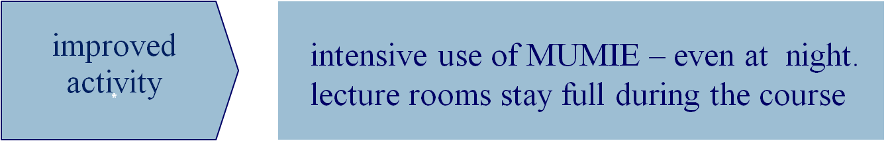

MUMIE proves: New pedagogical concepts like TuMult bring qualitative improvement of learning results.
March 21, 2013, 3TU HBO schakelprogramma

Slide 7
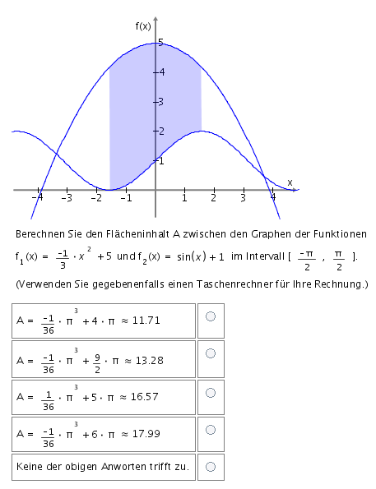
Online Self Assessment Test Elementary Mathematics
math competence among students differ a lot
students and teachers need to know: What are the prerequisites for the upcoming courses
Goals:
self assessment of missing pieces of knowledge and competences
first step towards: automated diagnostic testing
March 21, 2013, 3TU HBO schakelprogramma

Slide 8
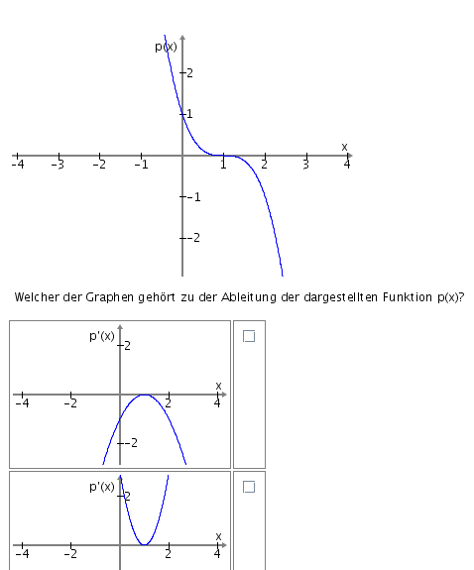
Online Self Assessment Test Elementary Mathematics
Questions from
school mathematics
for the understanding of freshmen courses
Multiple Choice
common mistakes among choices
variables randomized
pooled problems
can be repeated indefinitely at all times
immediate automatic feedback
March 21, 2013, 3TU HBO schakelprogramma

Slide 9
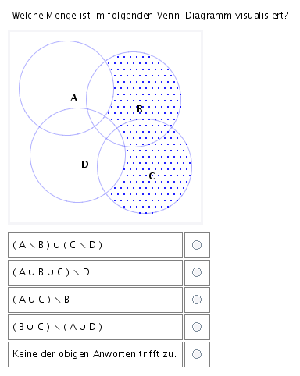
Online Self Assessment Test Elementary Mathematics
March 21, 2013, 3TU HBO schakelprogramma
presently
about 200 problems + variants
large part of syllabus covered
first launch: August 2008
more than 600 participants
perspective
improve feedback
more problems
automated diagnostic testing

Slide 10
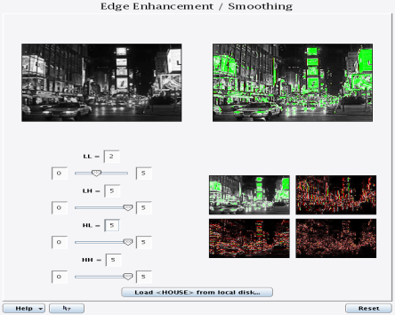
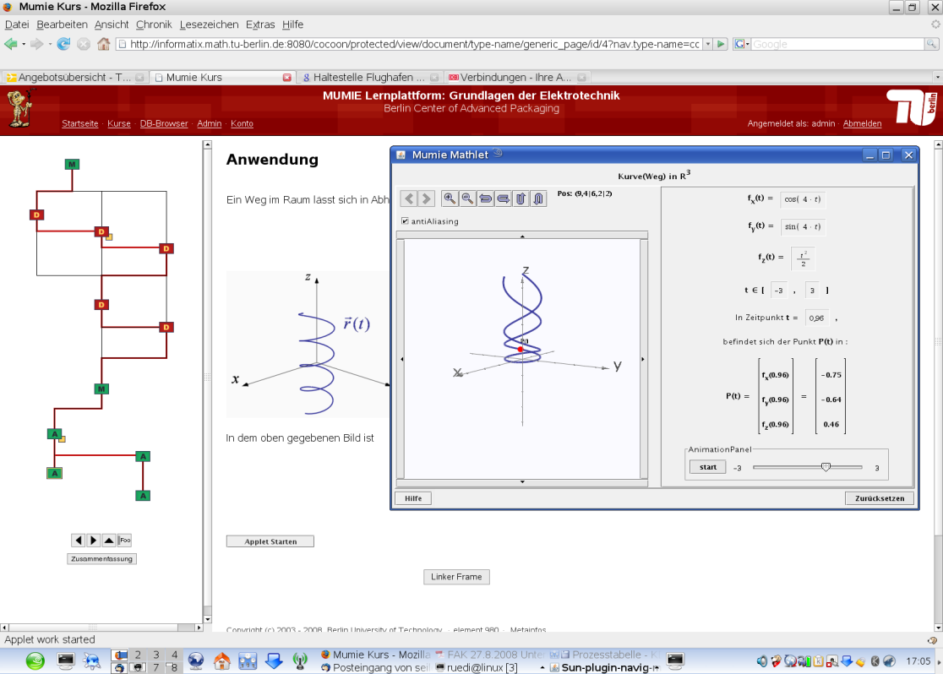
MUMIE based on modern Web-Technology
interactive, personalised, multi-linguale
dynamically generated web pages
JAVA- applets
forum
mathematically motivated taxonomy, semantic net
visualization of complex concepts
Text with math formulas
interactive, dynamic demos/training/problems
Communication between HTML-page and applet
multimedia data base
(XML, MathML, Latex, applets, images, Flash, Audio)‏
March 21, 2013, 3TU HBO schakelprogramma

Slide 11
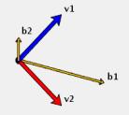
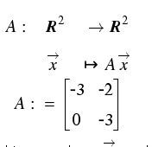
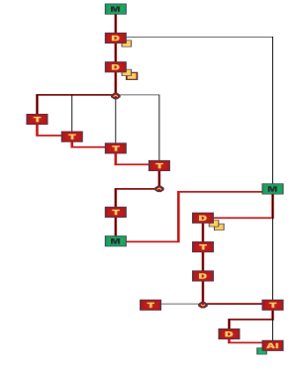
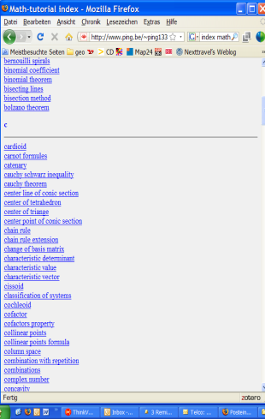
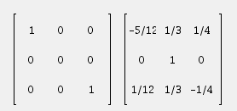
MUMIE content: flexible, reusable, sustainable
authors
lecturers
all users
applets
Latex
(MUMIE-Dialect)‏
editor for
semantic nets
data base
browser
MathletFactory
(ClassLib)‏
MathML
converter
XML
converter
multimedia data base
(XML, MathML, latex, applets, images, flash, audio)‏

Slide 12


Open Content – Open Platform
open licensing model
platform + applets:
content:
open, extendable system architecture
e.g. integration into Learning-Management-System Moodle (ETH-Zürich)
open content data base
integration of content from other projects‏
integration of MUMIE-content into other projects.
Open Source: optimal for academic environment
flexible, cheep but not for free!
LinAlg: MUMIE-corrections ~ 45 Teaching assistents (60h)
‏
March 21, 2013, 3TU HBO schakelprogramma

Slide 13




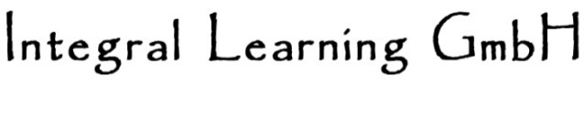
MUMIE Community
professional services for open
source community:
open source ommunity tools :
development repository
wiki and forum
March 21, 2013, 3TU HBO schakelprogramma

Slide 14

Support Successful Student Mobility with MUMIE (S3M2) an EU project using web-based bridge courses.
March 21, 2013, 3TU HBO schakelprogramma
Consortium:
Delft University of Technology
Kungliga Tekniska Högskolan
Aalto University http://www.s3m2.eu/
Technische Universität Berlin
integral-learning GmbH, Berlin

Slide 15
Questions
March 21, 2013, 3TU HBO schakelprogramma

