Slide 1
Numerical Methods for Power Networks
Kees Vuik, Scientific Computing
TU Delft
The mathematics of future energy systems
CWI, June 6, 2016

Slide 2
Content
Fast solvers for load flow problems
Robust transient simulators
Security assessment
Prediction of stresses in the network
Regional Energy Self-Sufficiency

Slide 3
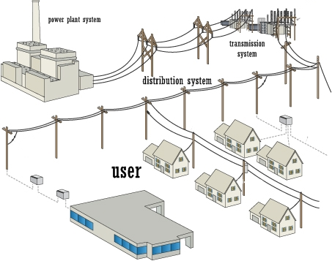
Motivation

Slide 4
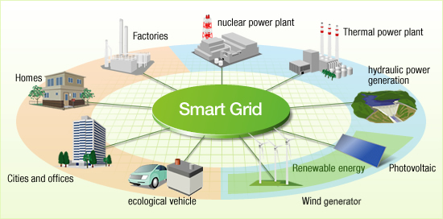
Future

Slide 5
What is a smart grid?
Energy flow in two directions
Information flow in two directions

Slide 6
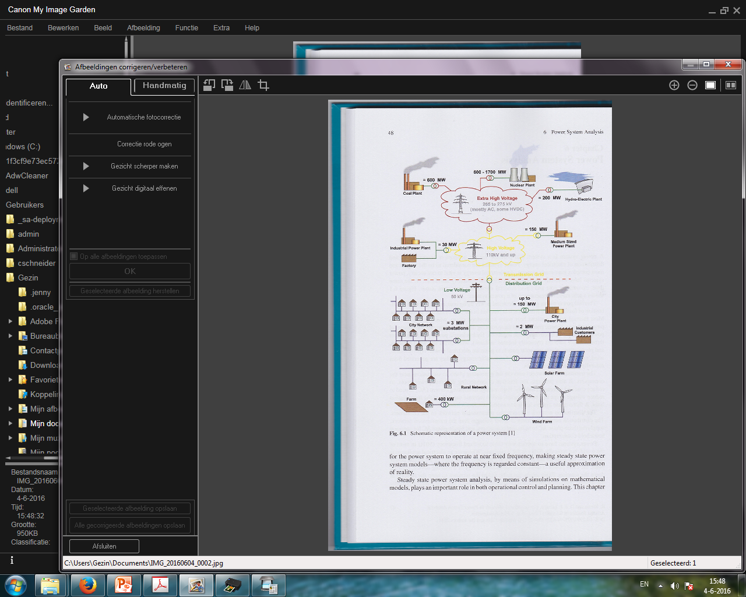
Transport grid

Slide 7
Distribution grid

Slide 8
Combined grid

Slide 9
Future system
large: European study (UCTE) model with 10,000+ nodes
bi-directional: market mechanisms
uncertainty: time-variable production by renewables
operated closer to limits: electrical vehicle charging

Slide 10
Fast solvers for load flow problems
Thesis Reijer Idema
Collaborators: Reijer Idema, Domenico Lahaye, Lou van der Sluis, Kees Vuik

Slide 11
Software used
Matlab
Matpower
PETSc (Portable, Extensible Toolkit for
Scientific Computation)

Slide 12
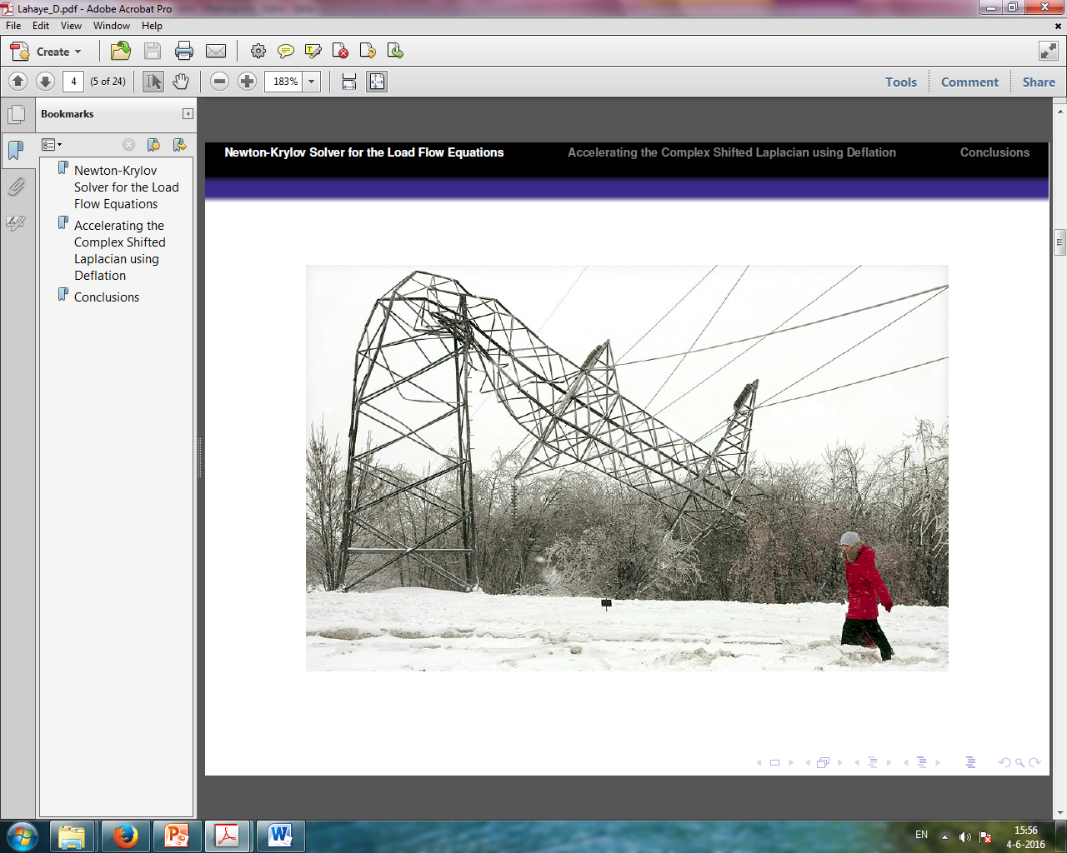
Power system failure

Slide 13
Load Flow Equations
x: voltage amplitude and phase at each node in network
F(x) = 0: non-linear system matching generation with demand
Jx= F : linear system at i-th Newton iteration
in the past solved by direct methods
currently solved approximately by ILU/GMRES
implemented in PETSc

Slide 14
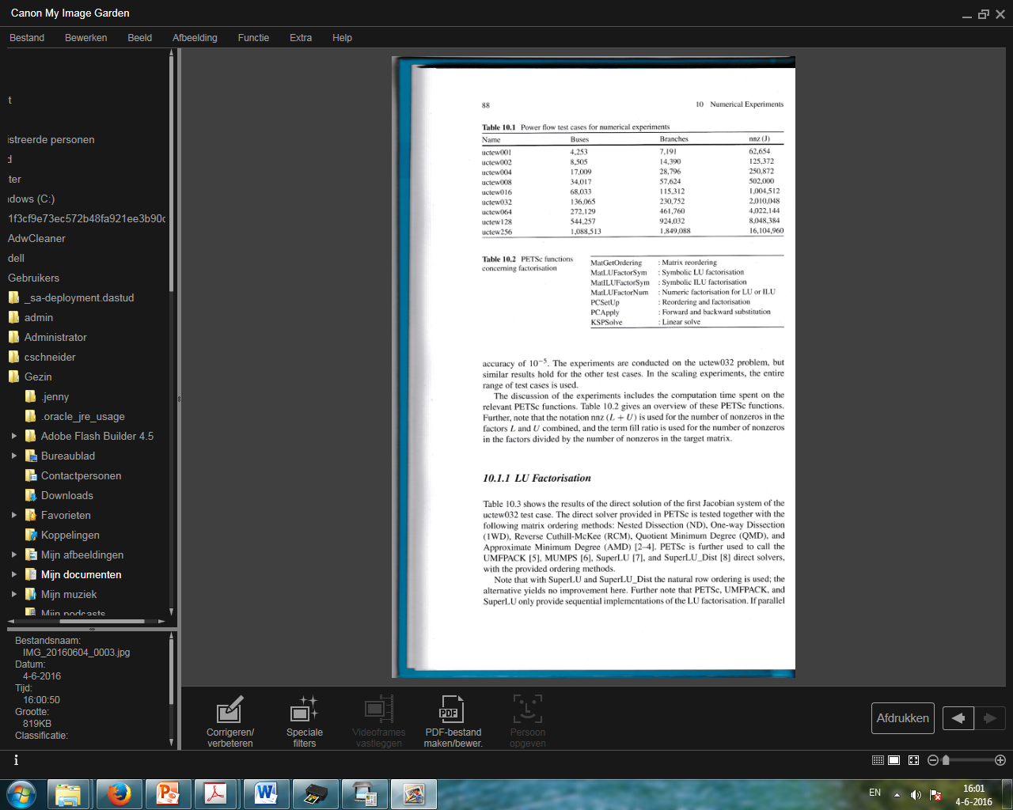
Power flow test cases

Slide 15
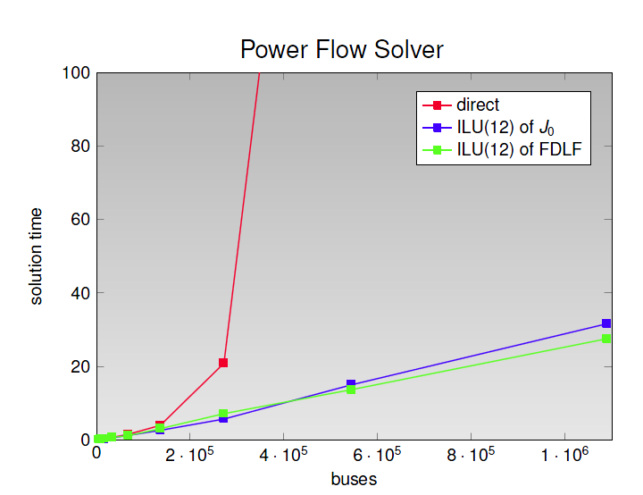
Results

Slide 16
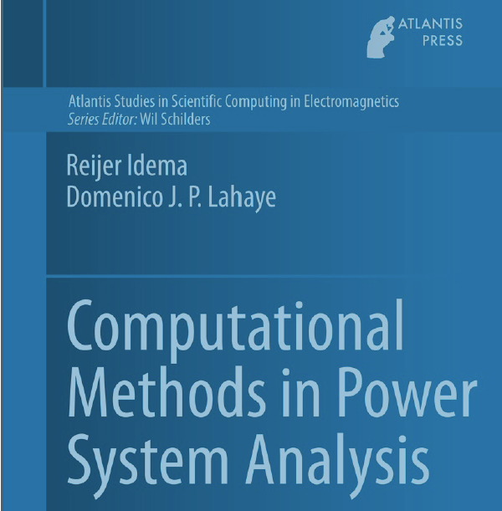
Monograph

Slide 17
Robust transient simulators
Thesis Romain Thomas
Collaborators: Romain Thomas, Domenico Lahaye, Lou van der Sluis, Kees Vuik

Slide 18
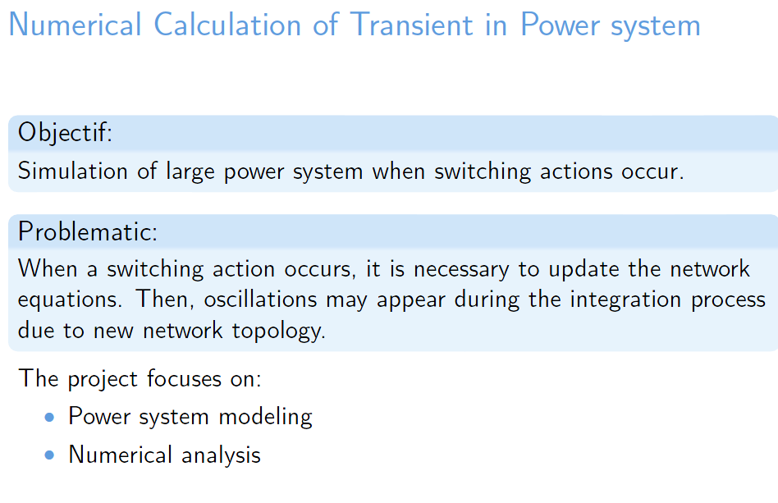

Slide 19
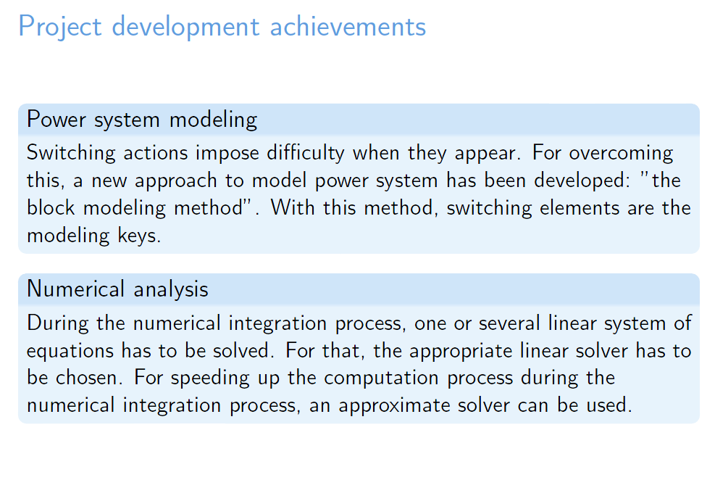

Slide 20
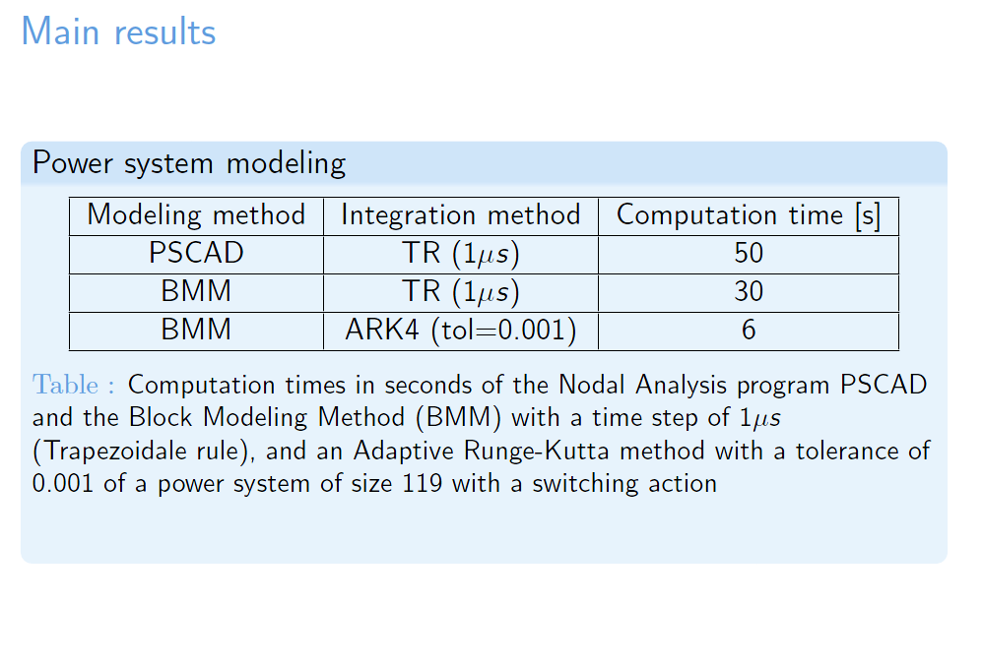

Slide 21
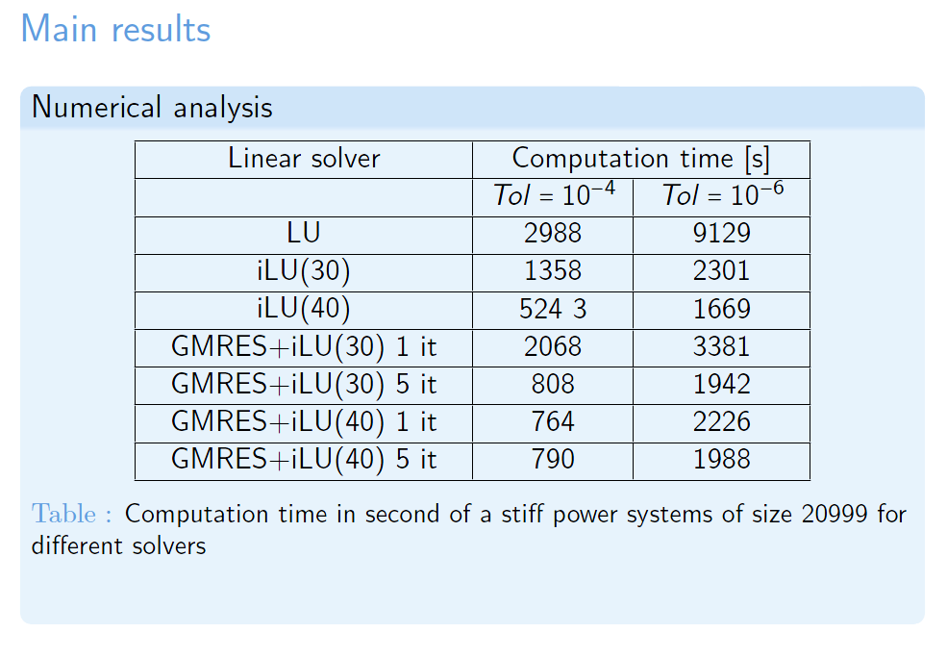

Slide 22
Security assessment
Thesis Martijn de Jong
Collaborators: Martijn de Jong, Domenico Lahaye, Lou van der Sluis, Kees Vuik

Slide 23
Introduction
Goal of our work: to develop tools for TSOs to assess the risk in the future power system (Umbrella Project).
At TU Delft we develop:
Accurate tools based on MC sampling, copula theory and
full AC power flow;
Robust and fast (parallel) iterative solvers.
We show:
A detailed modelling of both load forecast uncertainty and
correlation between system inputs is very important;
Voltage problems heavily contribute to the system risk;
tools that rely on DC computations are inaccurate;
Our tools are fast and can be used by TSOs for online (or
close-to-online) risk assessment.

Slide 24
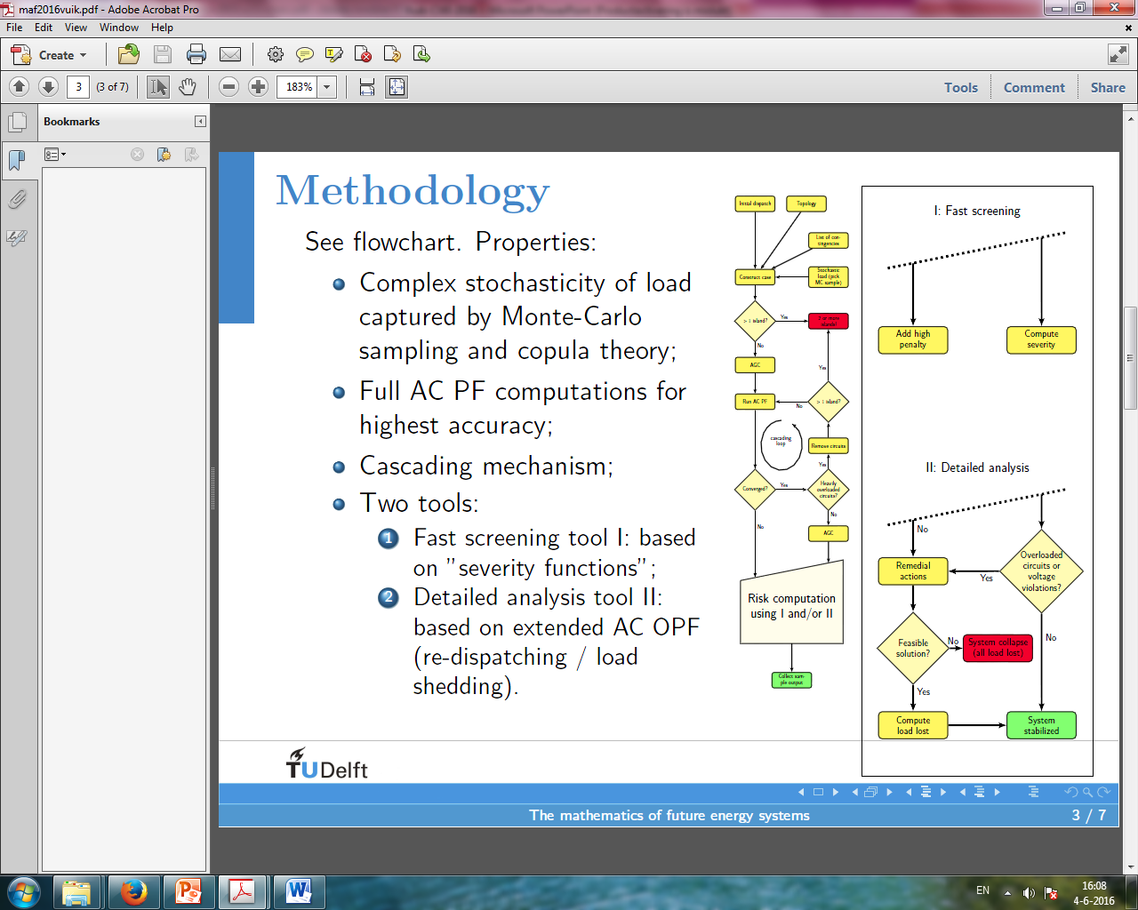
Methodology
See flowchart. Properties:
Complex stochasticity of load
captured by Monte-Carlo
sampling and copula theory;
Full AC PF computations for
highest accuracy;
Cascading mechanism;
Two tools:
1 Fast screening tool I: based
on "severity functions";
2 Detailed analysis tool II:
based on extended AC OPF
(re-dispatching / load
shedding).

Slide 25
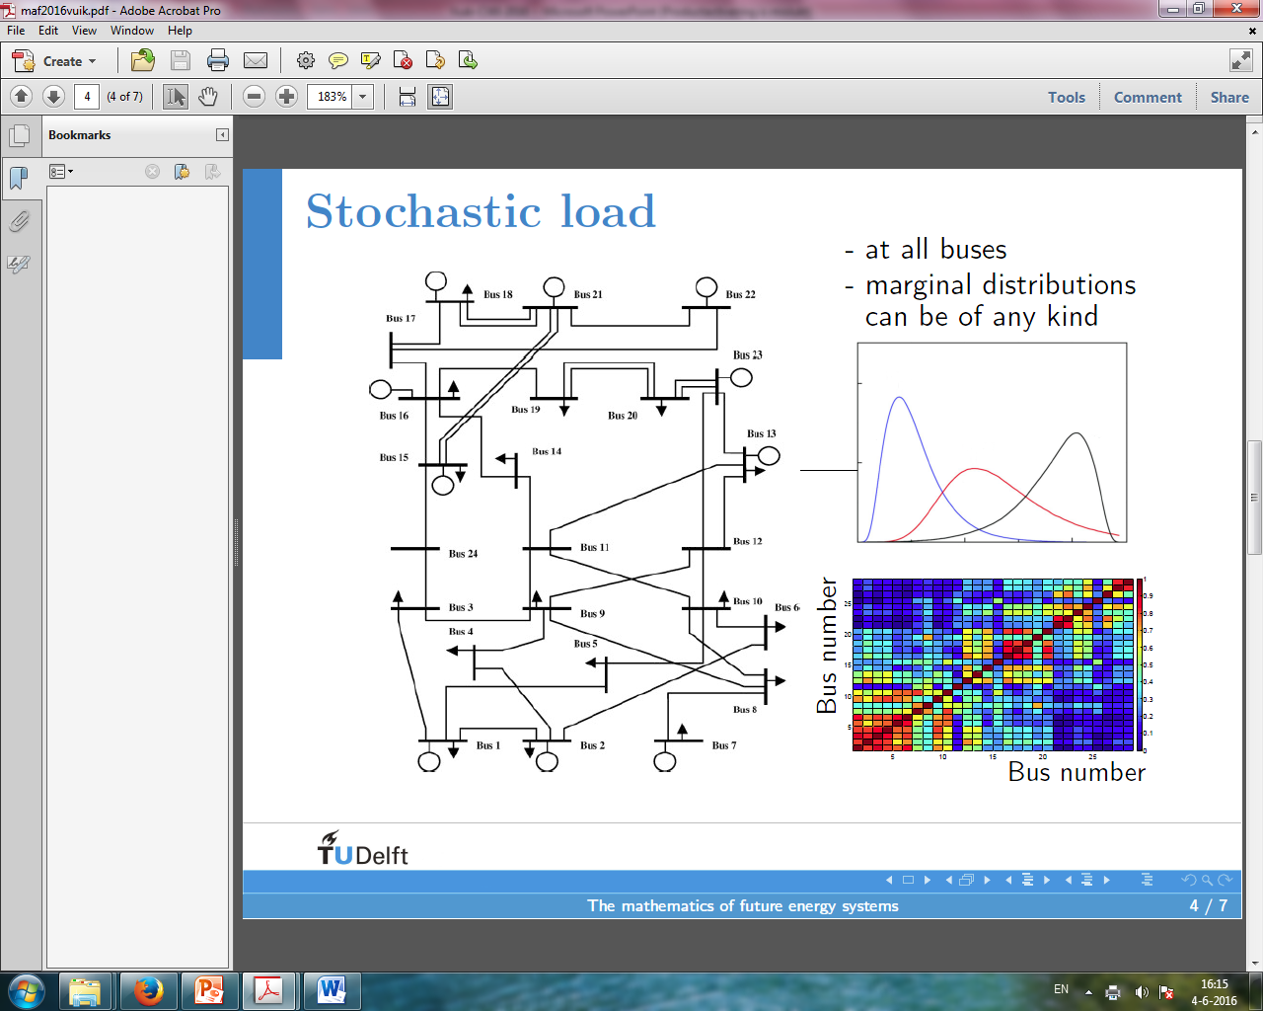

Slide 26
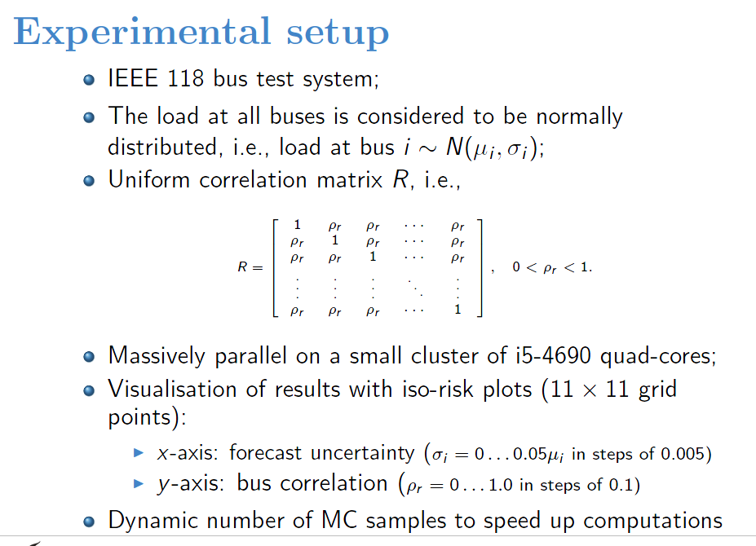

Slide 27
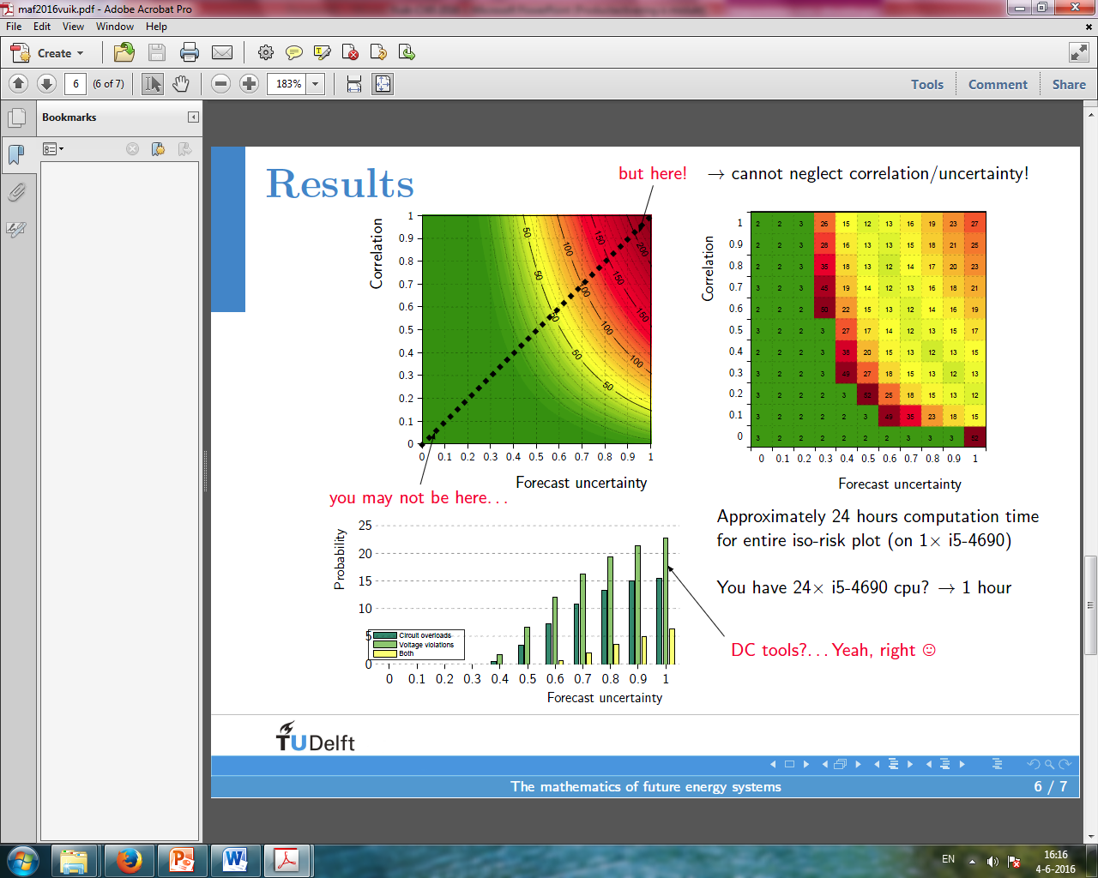

Slide 28
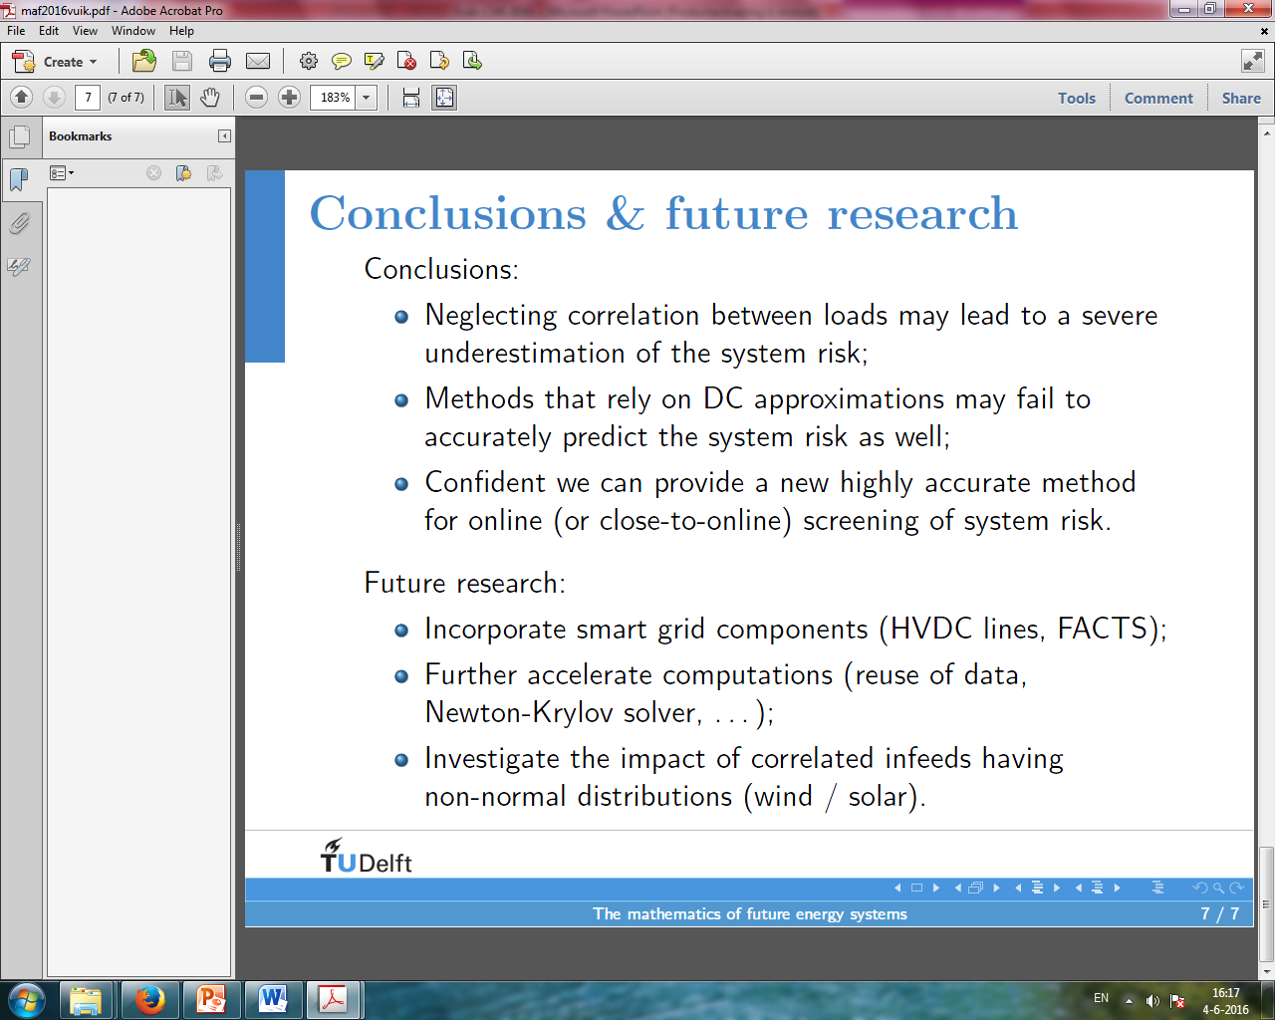

Slide 29
Prediction of stresses in the network
Thesis Balja Sereeter
Collaborators: Balja Sereeter, Cees Witteveen, Kees Vuik

Slide 30
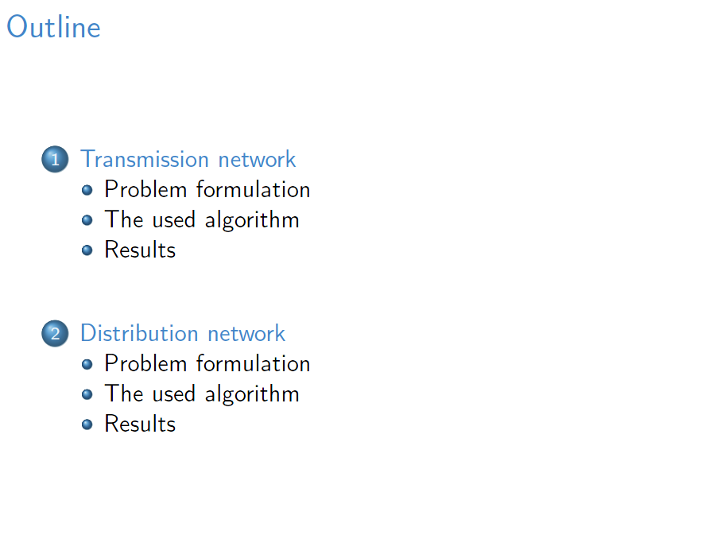

Slide 31
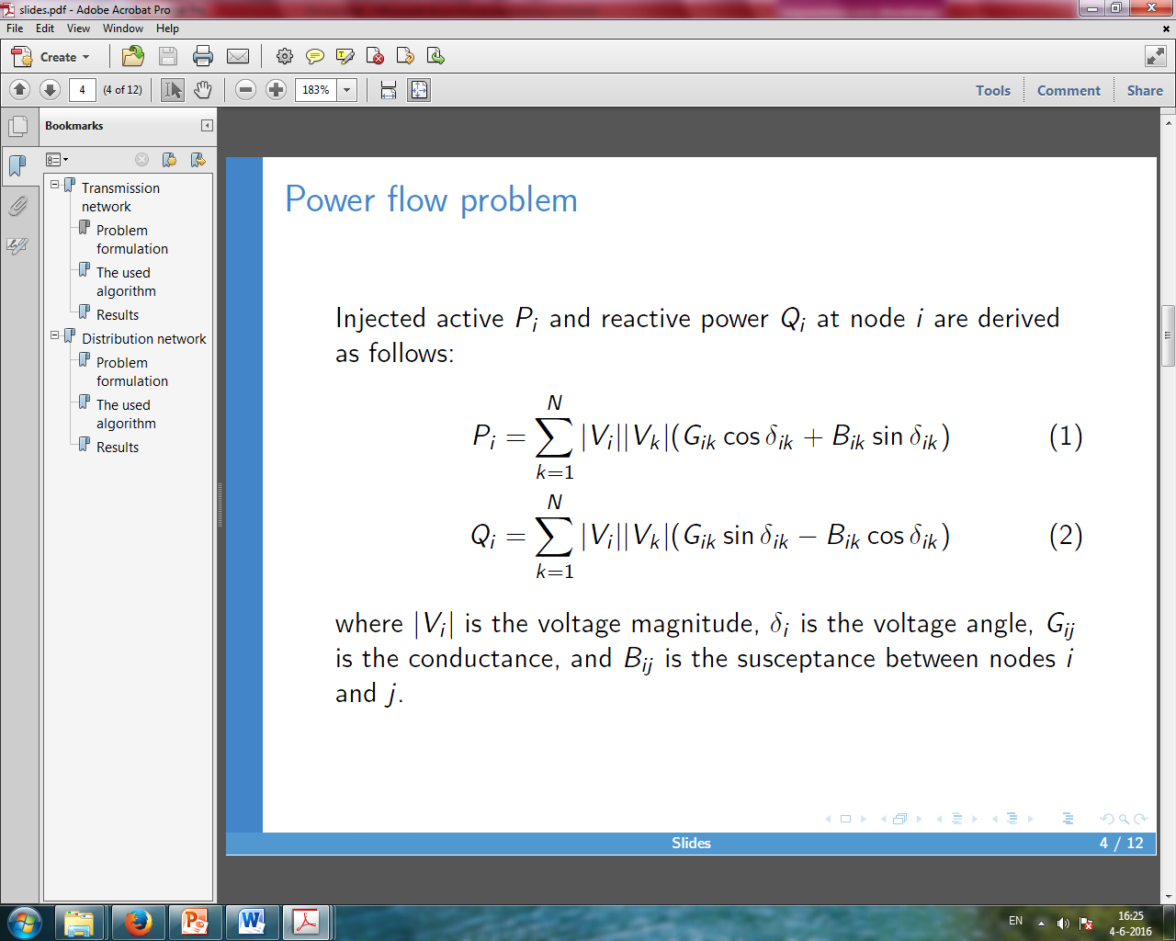
Transmission network

Slide 32
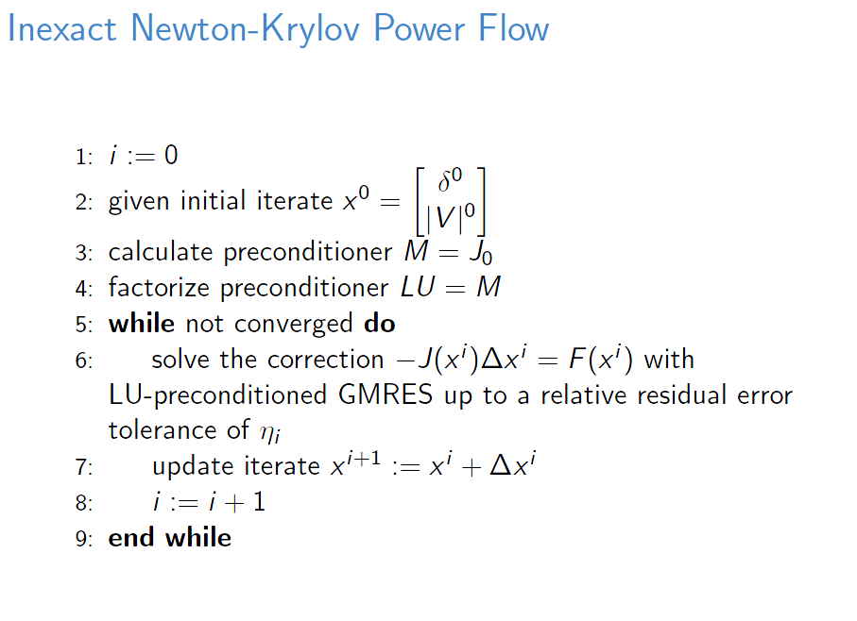

Slide 33
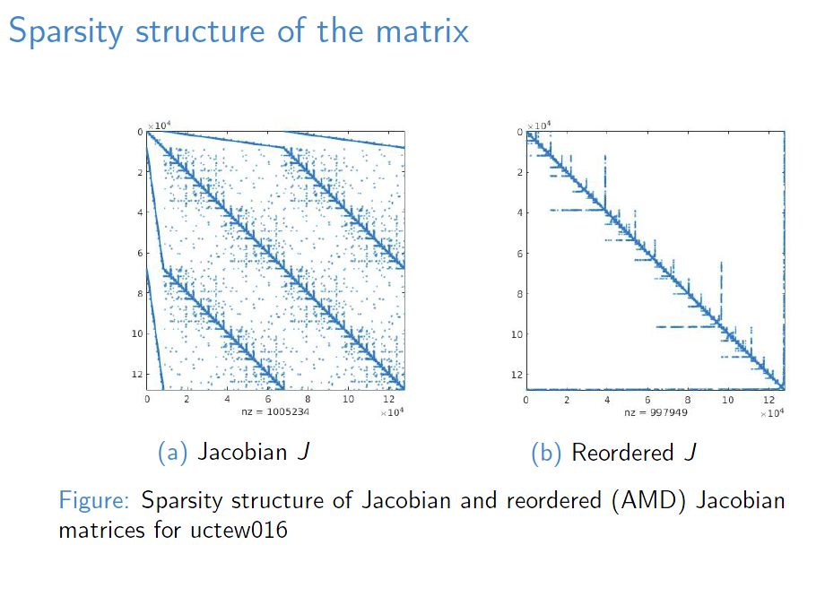

Slide 34
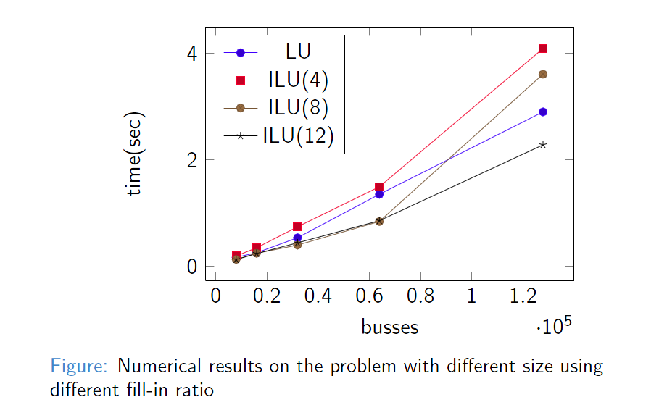
Results

Slide 35
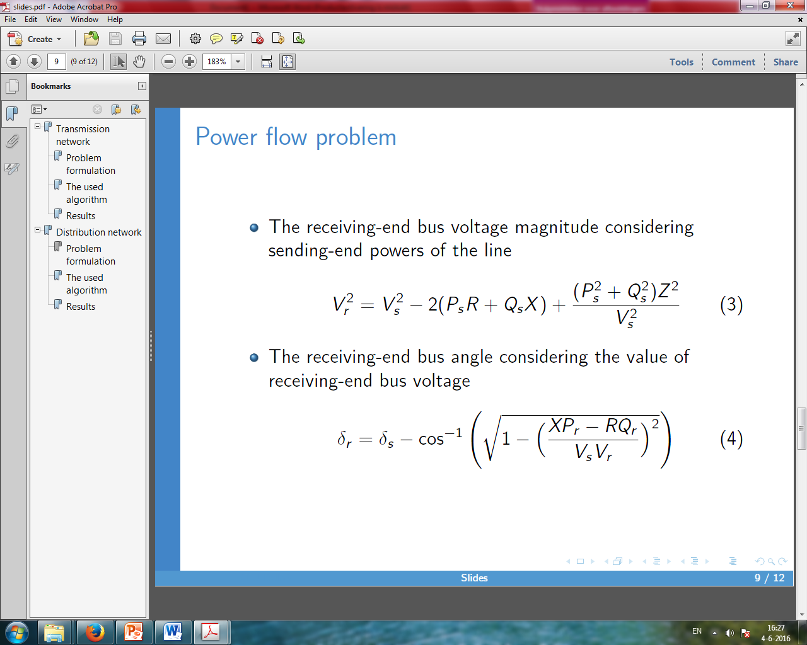
Distribution network

Slide 36


Slide 37
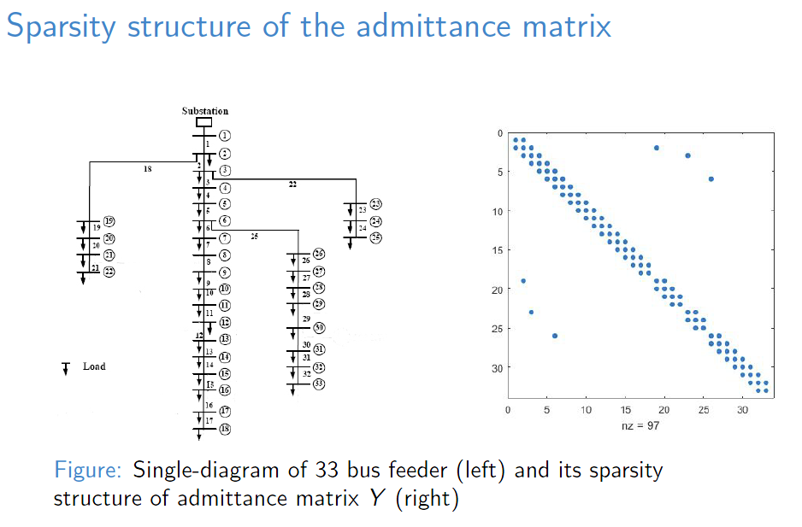

Slide 38
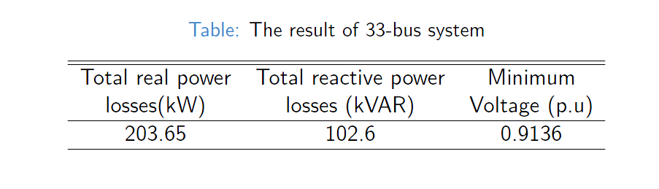
Results

Slide 39
Regional Energy Self-Sufficiency
Thesis ???
Collaborators: ??? , Johan Romate, Kees Vuik

Slide 40
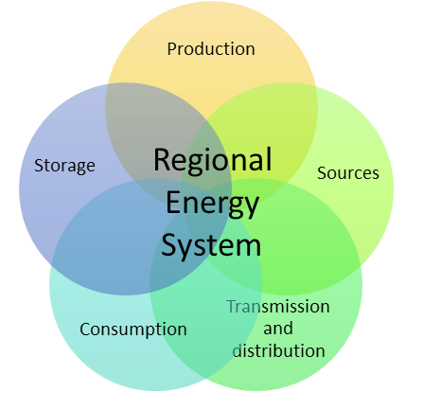

Slide 41
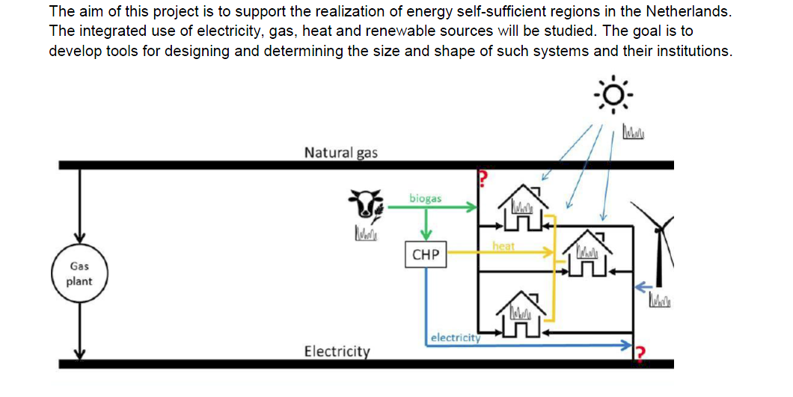
Formulation of the main goal(s) of the project

Slide 42
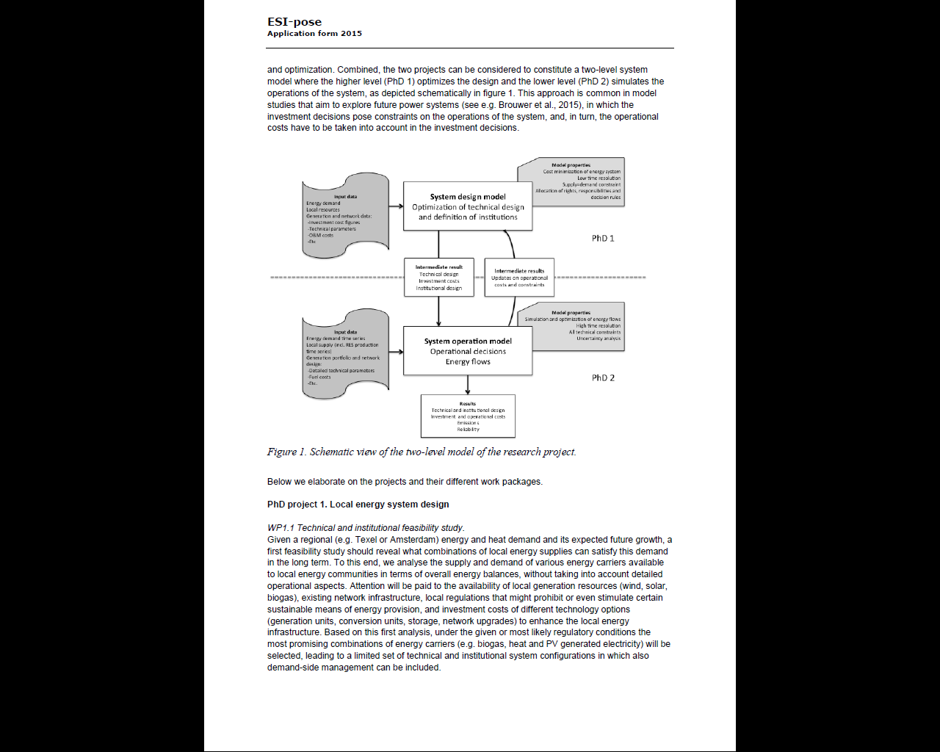

Slide 43
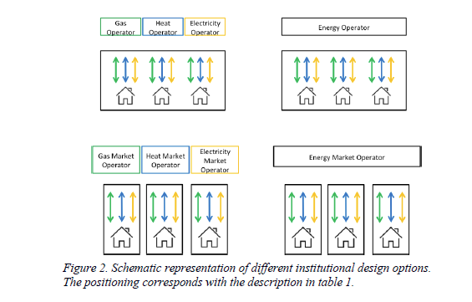

Slide 44
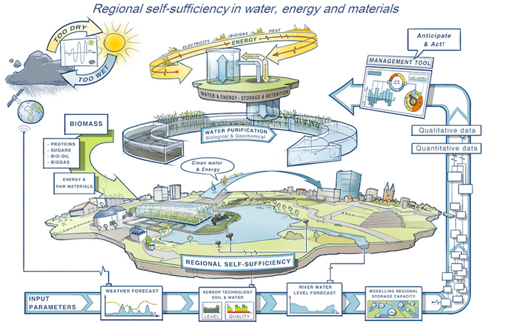

Slide 45
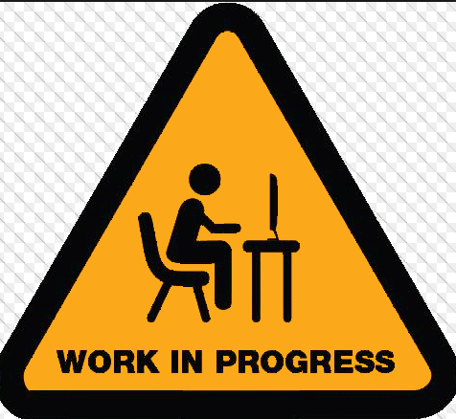
Questions

