Slide 1
Literature Review Presentation:
Physics-Informed Neural Networks and Topology Optimization for the Design of Flat Metamaterial
Space Optics
Dylan Everingham, 21-03-2022

Slide 2
Outline
Introduction
Background Material
Metamaterials
Rigorous Coupled-Wave Analysis
Algorithmic Differentiation
Previous Results
Scientific Machine Learning
Physics-Informed Neural Networks
Topology Optimization
Project Proposal

Slide 3
High-Level Project Goal
To find effective metamaterial lens designs for the CoPILOT high-altitude balloon project.
Essentially an inverse scattering problem.
What design techniques (from AI, optimization…) are both accurate and computationally efficient?
CoPILOT will observe the ionized carbon forbidden line in order to map star formation.

Slide 4
Background Material

Slide 5
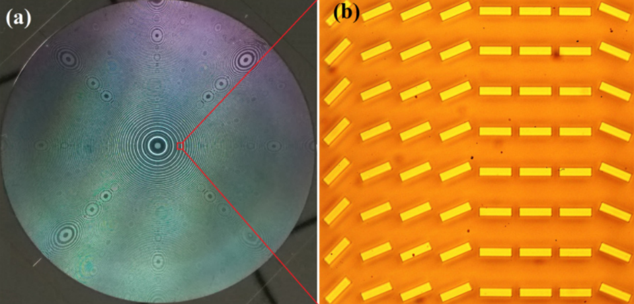
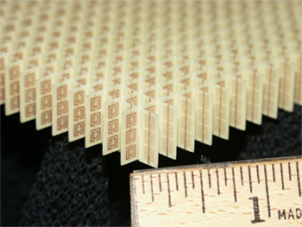
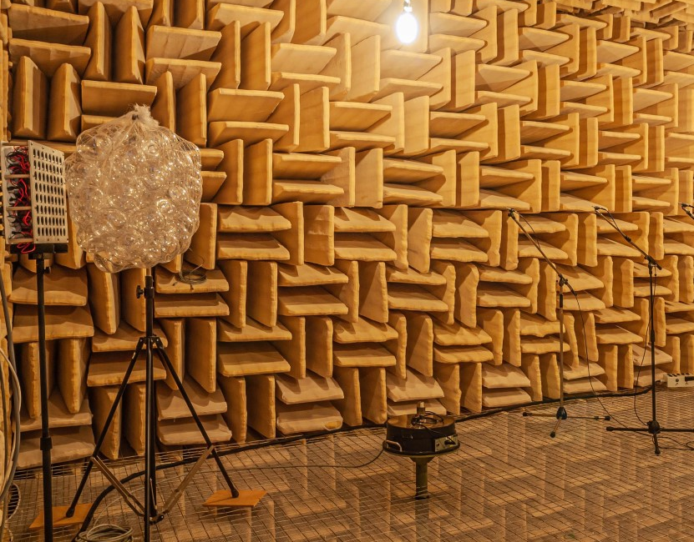
What are Metamaterials?
Engineered composite materials whose physical properties:
may not be observed in nature or in their constituent materials, and
arise due to some sub-wavelength lattice structure

Slide 6
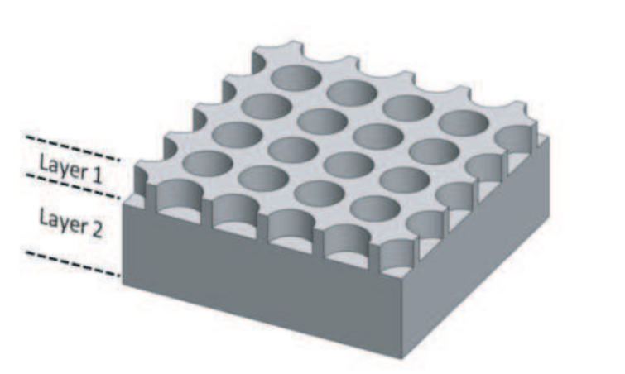
A fast forward solver method:
Rigorous Coupled-Wave Analysis (RCWA)
Semi-analytical solver for Maxwell’s equations in and around layered, periodic dielectric structures.
Fourier transform material properties and fields in x and y, leaving z unchanged.
Formulate result as a matrix equation.
Solvable via a complex-valued, degenerate eigenproblem.

Slide 7
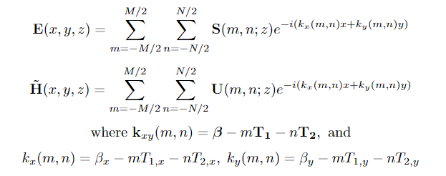
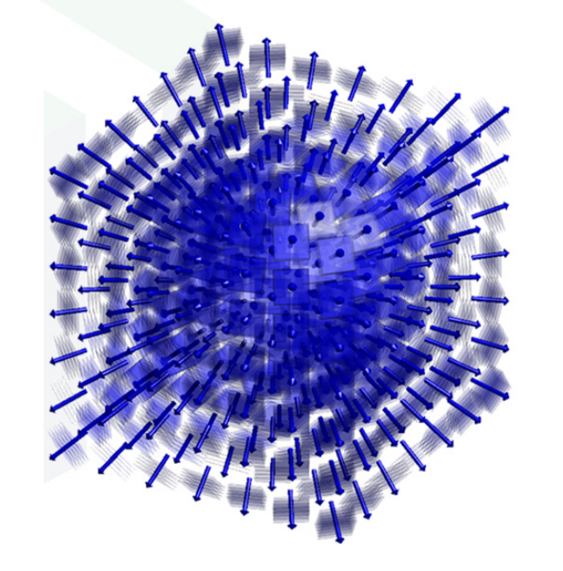
Formulation of RCWA - Transformation of Fields
Time-harmonic form of Ampere’s Law and Faraday’s Law
Fourier transform of fields in x,y

Slide 8
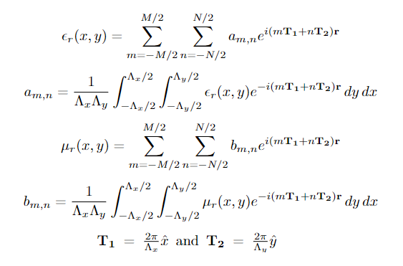
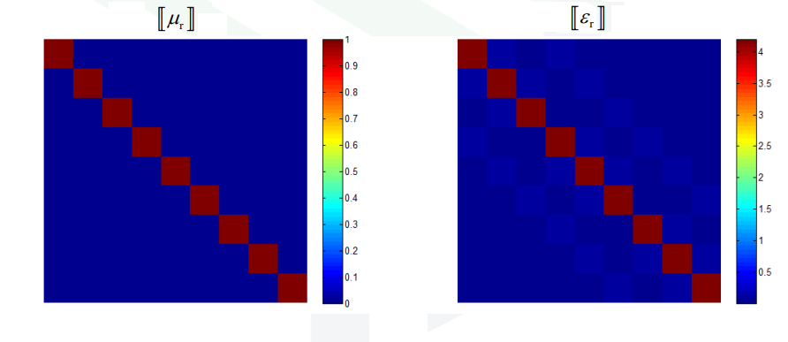
Formulation of RCWA - Transformation of Materials
Fourier transform of layer
material properties (permittivity, permeability)
Representation as
convolution matrices

Slide 9
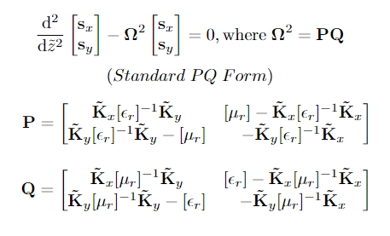
Formulation of RCWA - Matrix Wave Equation
Matrix wave equation for E field spatial harmonic complex amplitudes
Equation for all complex amplitudes, dependent on eigendecomposition
of 𝛀²

Slide 10
Formulation of RCWA - Scattering Matrices
Formulation of scattering matrix for one layer
Global scattering matrix for the entire device
Final solution for spatial harmonic amplitudes in reflection and transmission regions

Slide 11
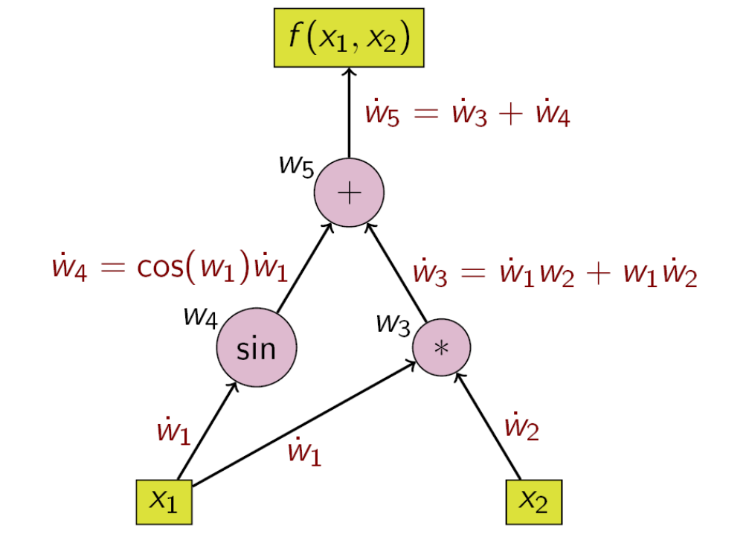
Differentiation of RCWA:
Algorithmic Differentiation
Any function implemented as a sequential computer program can be differentiated via the chain rule, given that we know the derivatives of each of the elementary operations.
Can be formulated as a
computational graph:

Slide 12
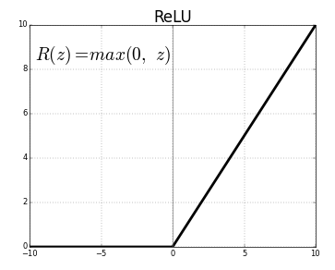
Correctness of Algorithmic Differentiation
Algorithmic differentiation systems
(i.e. TensorFlow, PyTorch,...)
can be shown to be correct if all elementary operations are PAP (piecewise analytic under analytic partition).
Example: ReLu activation function:

Slide 13
2. Previous Results

Slide 14
Approach 1:
Scientific Machine Learning
Standard deep learning techniques can be applied to solve any physics problem, including inverse scattering problems.
First train a forward network, and then an inverse network.
However, does not take advantage of physics-based information embedded in the data set.

Slide 15
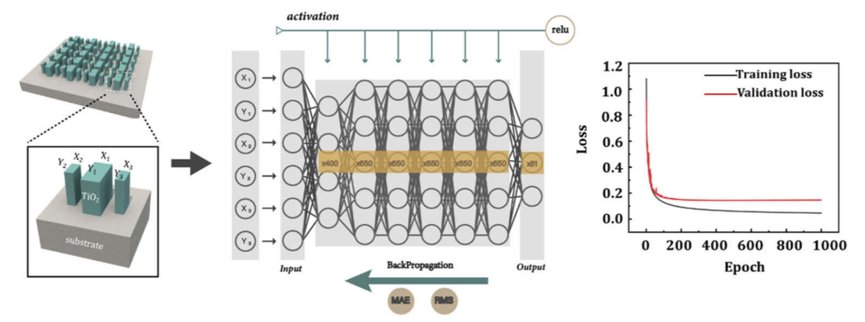
Jiang et al. 2021

Slide 16
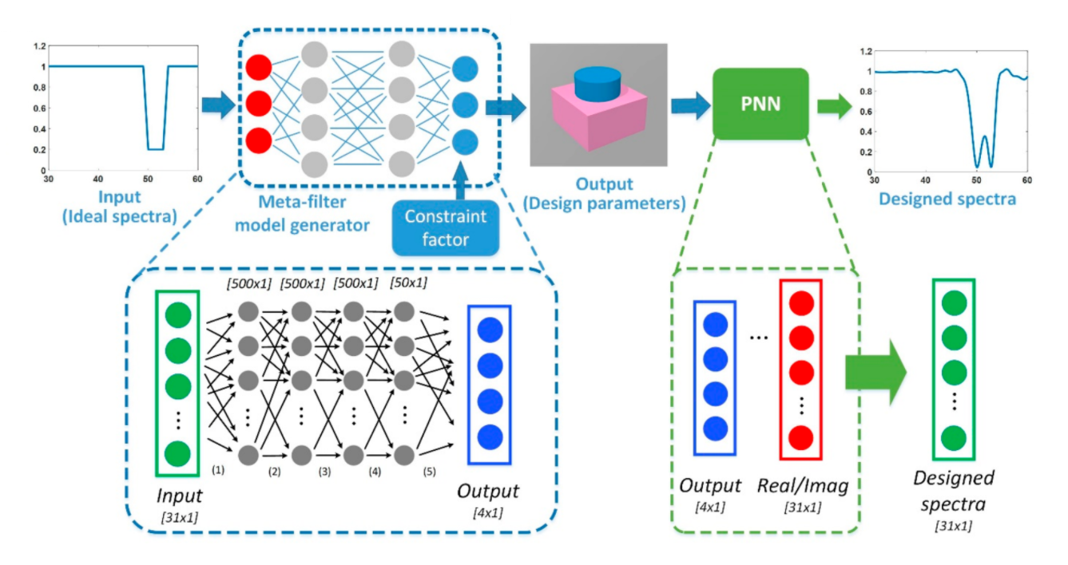
An et al. 2019

Slide 17
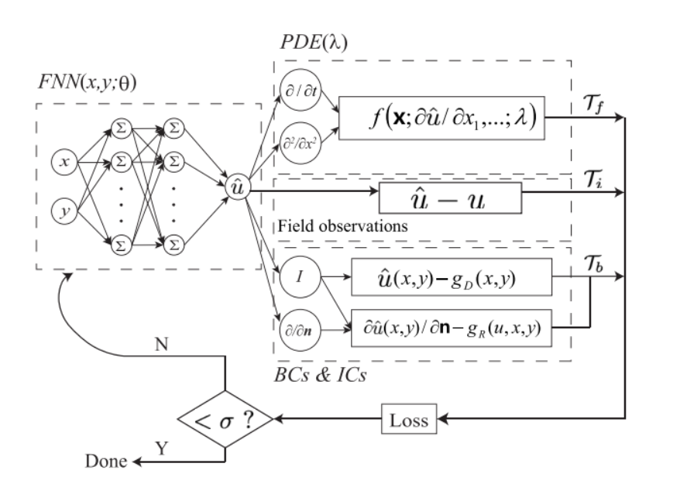
Approach 2:
Physics-Informed Neural Networks
Embed physical knowledge about the system (i.e. a governing PDE) in the loss function.
Increases information content of the data and restricts solution space.
In fact, belongs to unsupervised learning.

Slide 18
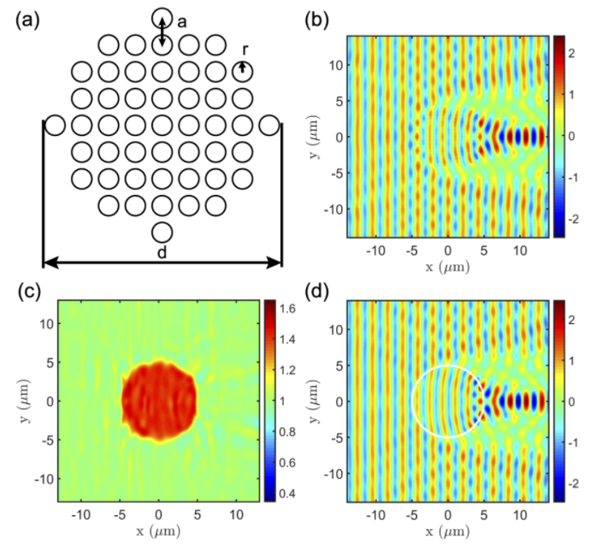
Chen et al. 2020

Slide 19
Approach 3:
Topology Optimization
Papers show that cleverly efficient direct or classical optimization strategies may also work well for the inverse scattering problem.
Able to determine unique shapes, beyond just parameters of simple shapes.
This includes common methods like the adjoint method as well as novel applications of AD.

Slide 20
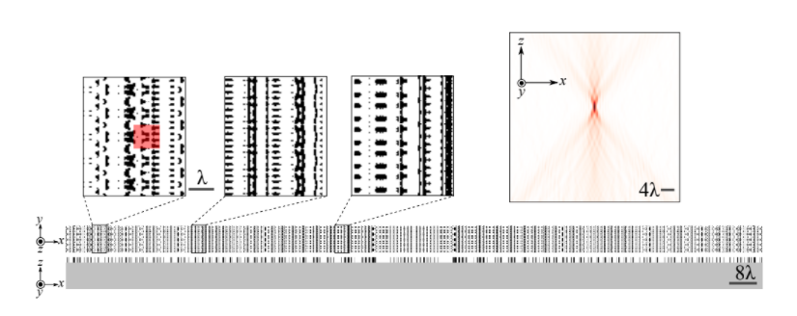
Lin et al. 2019

Slide 21
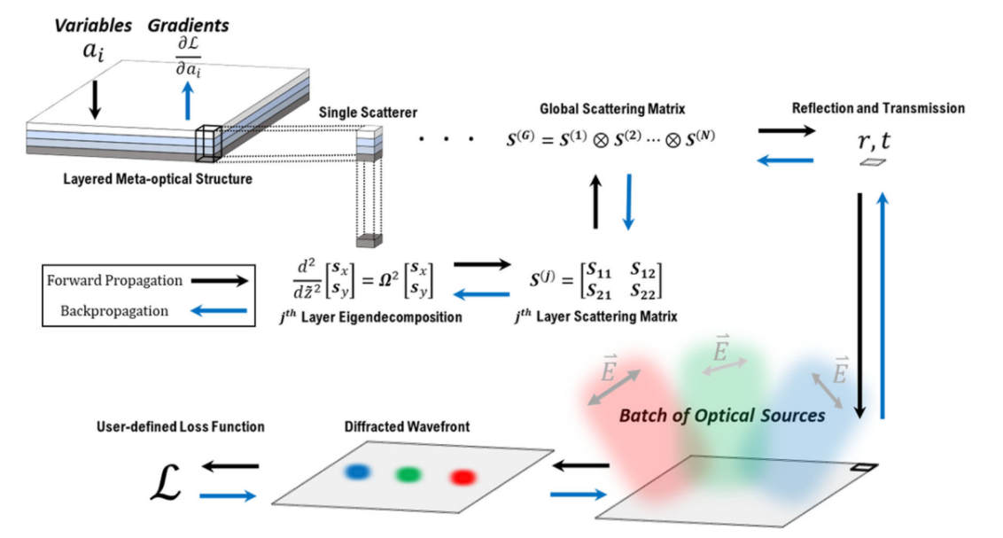
Colburn and Majumdar, 2021

Slide 22
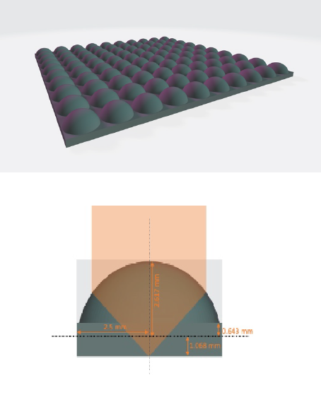
3. Project Proposal

Slide 23
Previous Design
An array of hemispherical silicon lenslets.
Primary downside for space optics applications is its bulkiness (in the longitudinal direction)

Slide 24
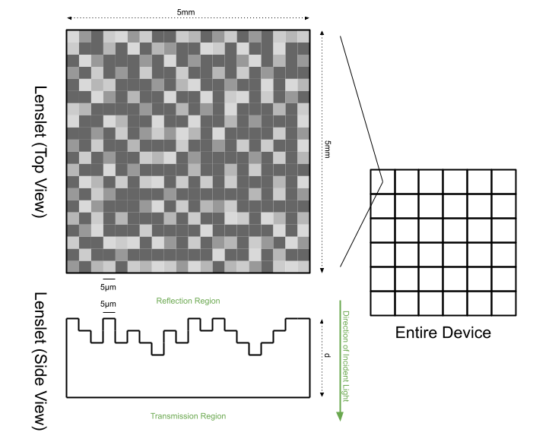
Design Overview
An array of flat metasurface lenslets, each composed of a square grid of pixels.
Each pixel has a discrete height. These heights are the primary geometrical metasurface parameters which we seek.

Slide 25
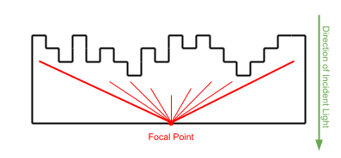
Near Field Case
Each lenslet is identical and focuses on the center of its transmission region side.
Makes application of RCWA trivial - entire device has a periodicity of 5mm.
Training goal formulated in terms of field intensity, not angle/phase.

Slide 26
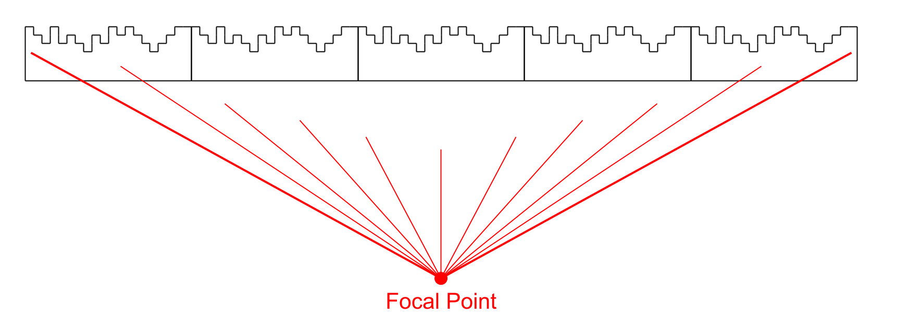
Far Field Case
All lenslets focus on a single point in the far field.
Lenslets are no longer identical. This will require a strategy to create periodicity in the design, so that RCWA is applicable…
Training goal can be formulated in the same way, but with further propagation from the device.

Slide 27
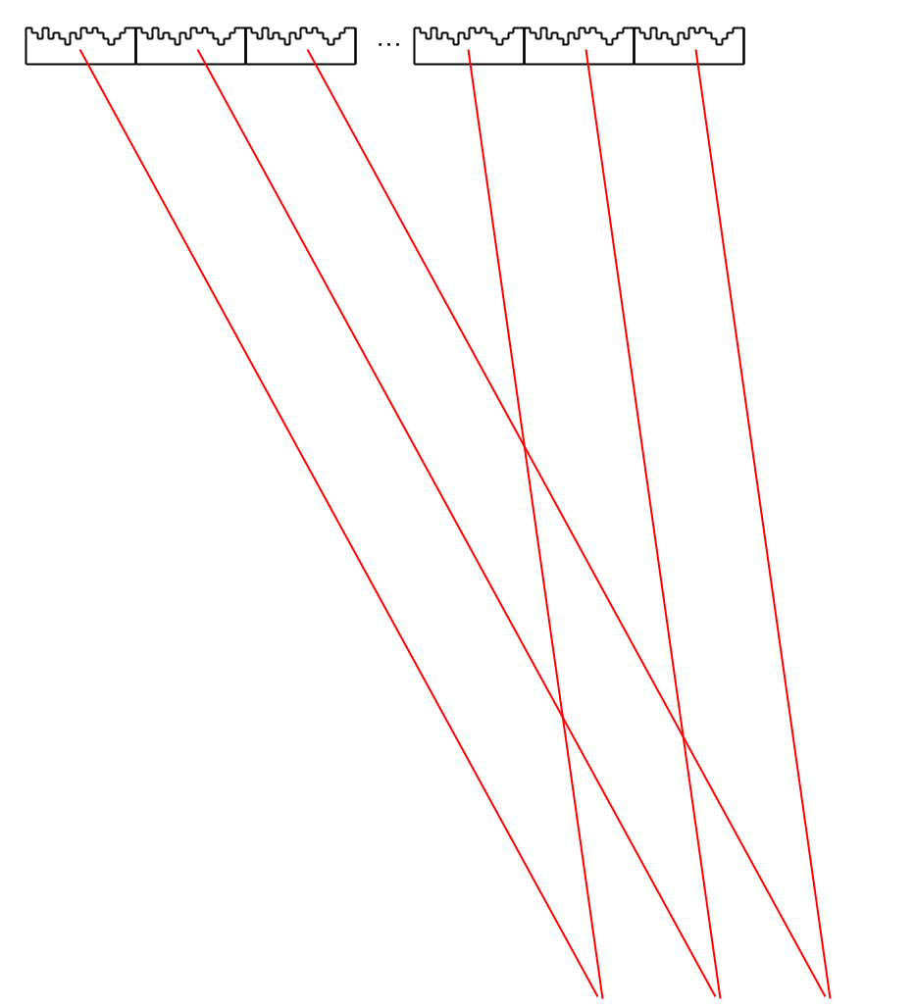
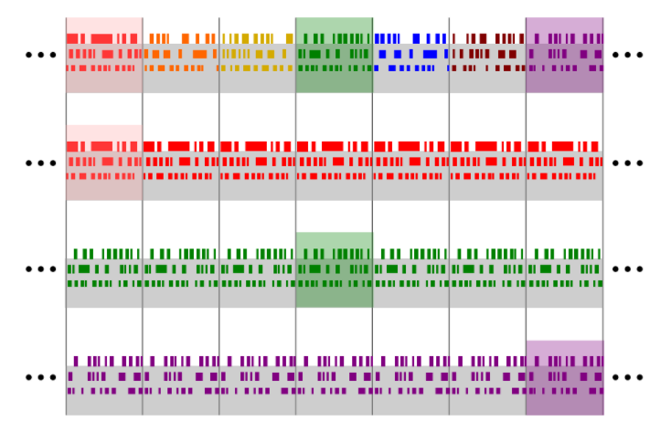
Options in the Far Field Case
09-10-2020

Slide 28
Research Questions
What technique is the most effective and computationally efficient for determining metasurface parameters in this application?
Leading choices are:
Topology Optimization with RCWA, AD
PINN
Which is able to perform better and handle more geometrical metasurface parameters is probably a matter of application.

Slide 29
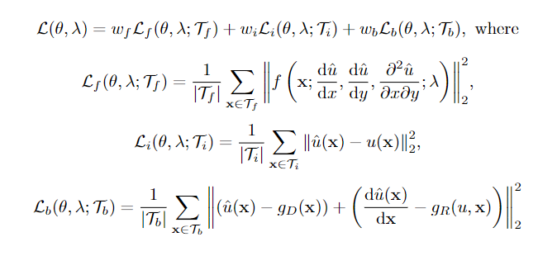
Research Questions
What technique is the most effective and computationally efficient for determining metasurface parameters in this application?
Loss function: three terms, as in general PINN framework.
Reward focal point, penalize stray light
Penalize differences between lenslets which should be identical

Slide 30
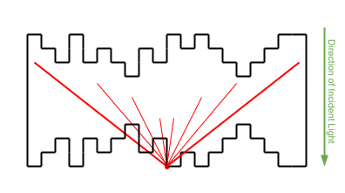
Research Questions
Which choice of design parameters admits the most effective metasurface designs while maintaining computational feasibility?
Lenslet Thickness
Single-sided vs. Double-sided Device
Anti-reflective Coating
Single or Multiple Materials
Size of Periodicity Groups
Most of these represent a tradeoff between expanded design space and complexity of optimization, making method efficiency even more important.

Slide 31
Research Questions
How sensitive are the resulting designs to manufacturing inaccuracies and to the angles of incidence of source waves, and can these sensitivities be minimized?
Because both the topology optimization and PINN will be implemented via TensorFlow, access to derivatives with respect to inputs can be made available.
Characterization. Which inputs are most sensitive?
Incorporation into loss function.

Slide 32
Thank you! Time for questions.
Dylan Everingham

