Slide 1
High Performance Solvers for Partial Differential Equations
Kees Vuik
Delft University of Technology
Institute of Computing Technology of the Chinese Academy of Sciences
April 3, 2019
Beijing, China
Notes:
DCSE was established 13 years ago. A collaboration and mutual exchange of knowledge between 16 research groups from different faculties and other universities. Acts also as a clearing-house for research queries from industry. There are 50 faculty members connected, more than 150 PhD students and several hundreds of MSc and BSc students are educated.

Slide 2
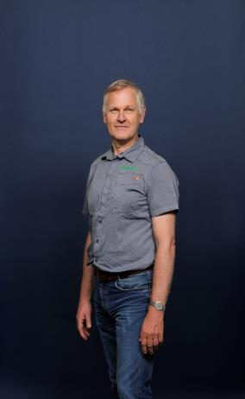
Affiliation Kees Vuik
Professor of Numerical Analysis
Director of the TU Delft Institute of Computational Science and Engineering
Scientific Director of 4TU.AMI Applied Mathematics Institute
Notes:
DCSE was established 13 years ago. A collaboration and mutual exchange of knowledge between 16 research groups from different faculties and other universities. Acts also as a clearing-house for research queries from industry. There are 50 faculty members connected, more than 150 PhD students and several hundreds of MSc and BSc students are educated.

Slide 3
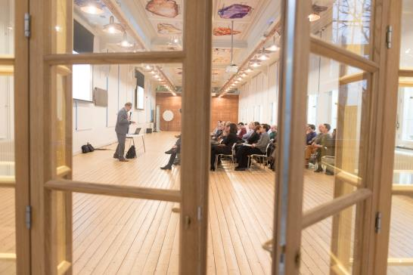
TU Delft Institute for Computational Science and Engineering

Slide 4
Content
Introduction
Problem and solution methods
Building blocks
Implementation on Modern Hardware
Conclusions
Collaboration with the group of Prof. Hai Xiang Lin
Notes:
DCSE was established 13 years ago. A collaboration and mutual exchange of knowledge between 16 research groups from different faculties and other universities. Acts also as a clearing-house for research queries from industry. There are 50 faculty members connected, more than 150 PhD students and several hundreds of MSc and BSc students are educated.

Slide 5
1. Introduction: discretized Partial Differential Equations
Applications
Computational Fluid Dynamics
Mechanical problems
Helmholtz problems (seismic, MRI)
Methods
Multigrid Methods
Krylov Subspace Methods
Domain Decomposition Methods
Notes:
DCSE was established 13 years ago. A collaboration and mutual exchange of knowledge between 16 research groups from different faculties and other universities. Acts also as a clearing-house for research queries from industry. There are 50 faculty members connected, more than 150 PhD students and several hundreds of MSc and BSc students are educated.

Slide 6
Example Linear Systems
Ruede et al, 2015
Notes:
DCSE was established 13 years ago. A collaboration and mutual exchange of knowledge between 16 research groups from different faculties and other universities. Acts also as a clearing-house for research queries from industry. There are 50 faculty members connected, more than 150 PhD students and several hundreds of MSc and BSc students are educated.

Slide 7
Introduction: Eigenvalue Problems
Applications
Stability of a structure
Resonance
Google PageRank
Methods
Power method (google)
Arnoldi
Jacobi Davidson
Notes:
DCSE was established 13 years ago. A collaboration and mutual exchange of knowledge between 16 research groups from different faculties and other universities. Acts also as a clearing-house for research queries from industry. There are 50 faculty members connected, more than 150 PhD students and several hundreds of MSc and BSc students are educated.

Slide 8
Example eigenvalues (Ipsen)
Notes:
DCSE was established 13 years ago. A collaboration and mutual exchange of knowledge between 16 research groups from different faculties and other universities. Acts also as a clearing-house for research queries from industry. There are 50 faculty members connected, more than 150 PhD students and several hundreds of MSc and BSc students are educated.

Slide 9
Example eigenvalues
Faster convergence of linear systems
Resonance of a bridge
Model order reduction
3D printing, ASML, Additive Industries,
Nexperia

Slide 10
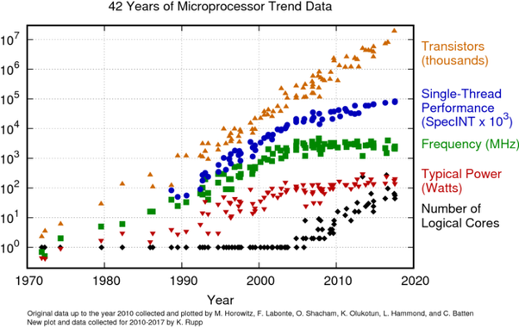
2. Problem and solution methods
Computational speed stagnates
Parallel computing
Fine grain
Coarse grain
Balance between flops and memory
Notes:
DCSE was established 13 years ago. A collaboration and mutual exchange of knowledge between 16 research groups from different faculties and other universities. Acts also as a clearing-house for research queries from industry. There are 50 faculty members connected, more than 150 PhD students and several hundreds of MSc and BSc students are educated.

Slide 11
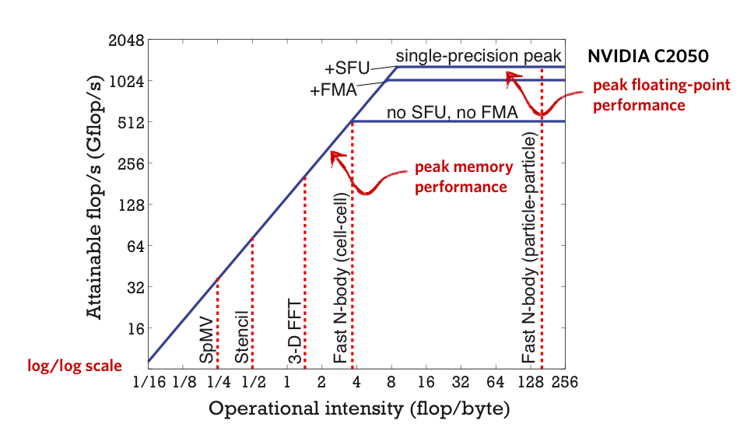
Roofline model
Notes:
DCSE was established 13 years ago. A collaboration and mutual exchange of knowledge between 16 research groups from different faculties and other universities. Acts also as a clearing-house for research queries from industry. There are 50 faculty members connected, more than 150 PhD students and several hundreds of MSc and BSc students are educated.

Slide 12
New Hardware
Multi-core CPU
Clusters of PC’s
GPU graphics processing unit
Xeon Phi
FPGA field-programable gate array
Quantum Computing
(TU Delft: QuTech https://qutech.nl/)
Notes:
DCSE was established 13 years ago. A collaboration and mutual exchange of knowledge between 16 research groups from different faculties and other universities. Acts also as a clearing-house for research queries from industry. There are 50 faculty members connected, more than 150 PhD students and several hundreds of MSc and BSc students are educated.

Slide 13
Data distribution
Domain decomposition
Data distribution
Parallel computation (load balancing)
Computation
Communication (local, global)
Scalability
Notes:
DCSE was established 13 years ago. A collaboration and mutual exchange of knowledge between 16 research groups from different faculties and other universities. Acts also as a clearing-house for research queries from industry. There are 50 faculty members connected, more than 150 PhD students and several hundreds of MSc and BSc students are educated.

Slide 14
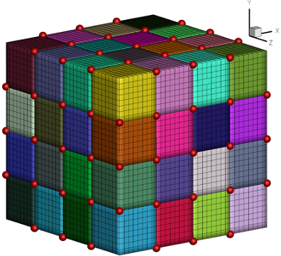
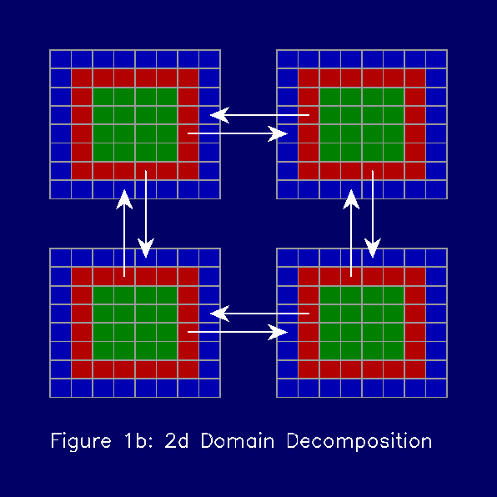
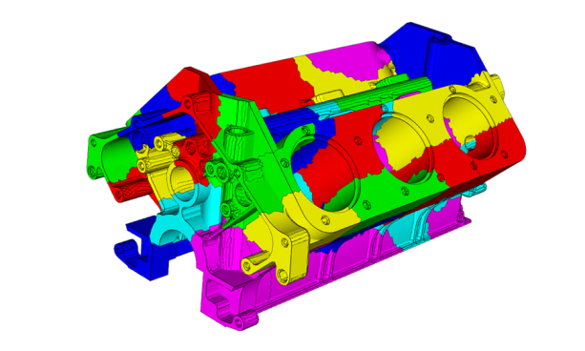
Domain decomposition
Notes:
DCSE was established 13 years ago. A collaboration and mutual exchange of knowledge between 16 research groups from different faculties and other universities. Acts also as a clearing-house for research queries from industry. There are 50 faculty members connected, more than 150 PhD students and several hundreds of MSc and BSc students are educated.

Slide 15
3. Building blocks
Iterative methods and eigenvalues
Vector update
Inner product
Matrix vector product
Preconditioner construction
Preconditioner vector product
Notes:
DCSE was established 13 years ago. A collaboration and mutual exchange of knowledge between 16 research groups from different faculties and other universities. Acts also as a clearing-house for research queries from industry. There are 50 faculty members connected, more than 150 PhD students and several hundreds of MSc and BSc students are educated.

Slide 16
Vector update
Embarrassingly parallel
for i= 1 : nblocks
x(1:n) = x(1:n) + $α ∗$y(1:n)
end
Notes:
DCSE was established 13 years ago. A collaboration and mutual exchange of knowledge between 16 research groups from different faculties and other universities. Acts also as a clearing-house for research queries from industry. There are 50 faculty members connected, more than 150 PhD students and several hundreds of MSc and BSc students are educated.

Slide 17
Inner product
Local inner products (fully parallel)
Global sum
Global communication
this can be a serious bottleneck
Notes:
DCSE was established 13 years ago. A collaboration and mutual exchange of knowledge between 16 research groups from different faculties and other universities. Acts also as a clearing-house for research queries from industry. There are 50 faculty members connected, more than 150 PhD students and several hundreds of MSc and BSc students are educated.

Slide 18
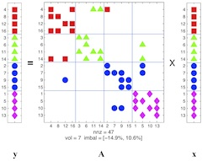
Matrix vector product
Structured
Unstructured
Nearest neighbour communication
Notes:
DCSE was established 13 years ago. A collaboration and mutual exchange of knowledge between 16 research groups from different faculties and other universities. Acts also as a clearing-house for research queries from industry. There are 50 faculty members connected, more than 150 PhD students and several hundreds of MSc and BSc students are educated.

Slide 19
Preconditioning
Diagonal preconditioning
Basic Iterative Method
ILU-type preconditioning
Multi-grid preconditioning
Block preconditioning
Operator preconditioning: SIMPLE preconditioning for Navier-Stokes, Complex Shifted Laplace for Helmholtz
Notes:
DCSE was established 13 years ago. A collaboration and mutual exchange of knowledge between 16 research groups from different faculties and other universities. Acts also as a clearing-house for research queries from industry. There are 50 faculty members connected, more than 150 PhD students and several hundreds of MSc and BSc students are educated.

Slide 20
Second level preconditioning
Due to parallel preconditioning the connection between the domains is lost.
Second level preconditioning repairs this.
Coarse Grid Correction
Multilevel preconditioning
Deflation
Balanced Neumann-Neumann
Notes:
DCSE was established 13 years ago. A collaboration and mutual exchange of knowledge between 16 research groups from different faculties and other universities. Acts also as a clearing-house for research queries from industry. There are 50 faculty members connected, more than 150 PhD students and several hundreds of MSc and BSc students are educated.

Slide 21
4. Implementation on Modern Hardware
Overview of techniques
Some additional remarks
Outlook to the future
Notes:
DCSE was established 13 years ago. A collaboration and mutual exchange of knowledge between 16 research groups from different faculties and other universities. Acts also as a clearing-house for research queries from industry. There are 50 faculty members connected, more than 150 PhD students and several hundreds of MSc and BSc students are educated.

Slide 22
Multi-core CPU
Staircase Incomplete Choleski Preconditioner
Notes:
DCSE was established 13 years ago. A collaboration and mutual exchange of knowledge between 16 research groups from different faculties and other universities. Acts also as a clearing-house for research queries from industry. There are 50 faculty members connected, more than 150 PhD students and several hundreds of MSc and BSc students are educated.

Slide 23
Multi-core CPU
Mechanical problem
Domain decomposition using physical properties into account
Good speedup on 8-16 cores
F.J. Lingen, P.G. Bonnier, R.B.J. Brinkgreve, M.B. van Gijzen, and C. Vuik
A parallel linear solver exploiting the physical properties of the
underlying mechanical problem
Computational Geosciences, 18, pp. 913-926, 2014
Notes:
DCSE was established 13 years ago. A collaboration and mutual exchange of knowledge between 16 research groups from different faculties and other universities. Acts also as a clearing-house for research queries from industry. There are 50 faculty members connected, more than 150 PhD students and several hundreds of MSc and BSc students are educated.

Slide 24
Clusters of PC’s
T.B. Jonsthovel, M.B. van Gijzen, C.Vuik, and A. Scarpas
On the Use of Rigid Body Modes in the Deflated Preconditioned Conjugate Gradient Method
SIAM Journal on Scientific Computing, 35, p.B207-B225, 2013
Notes:
DCSE was established 13 years ago. A collaboration and mutual exchange of knowledge between 16 research groups from different faculties and other universities. Acts also as a clearing-house for research queries from industry. There are 50 faculty members connected, more than 150 PhD students and several hundreds of MSc and BSc students are educated.

Slide 25
Clusters of PC’s

Slide 26
GPU Graphics Processing Unit
M. de Jong, A. van der Ploeg, A. Ditzel, and C. Vuik
Fine-grain parallel RRB-solver for 5-/9-point stencil problems suitable
for GPU-type processors
Electronic Transactions on Numerical Analysis, 46, pp. 375-393, 2017
Notes:
DCSE was established 13 years ago. A collaboration and mutual exchange of knowledge between 16 research groups from different faculties and other universities. Acts also as a clearing-house for research queries from industry. There are 50 faculty members connected, more than 150 PhD students and several hundreds of MSc and BSc students are educated.

Slide 27
Notes:
DCSE was established 13 years ago. A collaboration and mutual exchange of knowledge between 16 research groups from different faculties and other universities. Acts also as a clearing-house for research queries from industry. There are 50 faculty members connected, more than 150 PhD students and several hundreds of MSc and BSc students are educated.

Slide 28
GPU graphics processing unit
H. Knibbe, C. Vuik, and C.W. Oosterlee
Reduction of computing time for least-squares migration based on the Helmholtz equation by graphics processing units
Computational Geosciences, 20, pp. 297-315, 2016
Notes:
DCSE was established 13 years ago. A collaboration and mutual exchange of knowledge between 16 research groups from different faculties and other universities. Acts also as a clearing-house for research queries from industry. There are 50 faculty members connected, more than 150 PhD students and several hundreds of MSc and BSc students are educated.

Slide 29
GPU graphics processing unit
M.H. Aissa and T. Verstraete and C. Vuik
Toward a GPU-aware comparison of explicit and implicit CFD simulations on structured meshes
Computers and Mathematics with Applications, 74, pp. 201-217, 2017
R. Gupta, D. Lukarski, M.B. van Gijzen, and C. Vuik
Evaluation of the Deflated Preconditioned CG method to solve Bubbly and Porous Media Flow Problems on GPU and CPU
International Journal for Numerical Methods in Fluids, 80, pp. 666-683, 2016
Notes:
DCSE was established 13 years ago. A collaboration and mutual exchange of knowledge between 16 research groups from different faculties and other universities. Acts also as a clearing-house for research queries from industry. There are 50 faculty members connected, more than 150 PhD students and several hundreds of MSc and BSc students are educated.

Slide 30
FPGA field-programable gate array
Data flow machine
Hard and software programming
Maxeler
Altera
Xilinx
Notes:
DCSE was established 13 years ago. A collaboration and mutual exchange of knowledge between 16 research groups from different faculties and other universities. Acts also as a clearing-house for research queries from industry. There are 50 faculty members connected, more than 150 PhD students and several hundreds of MSc and BSc students are educated.

Slide 31
FPGA field-programmable gate array
Implementation of the BiCGSTAB Method for the Helmholtz Equation on a Maxeler Data Flow Machine
Onno Meijers
MSc Thesis, TU Delft, 2017
http://ta.twi.tudelft.nl/nw/users/vuik/numanal/meijers_afst.pdf
Notes:
DCSE was established 13 years ago. A collaboration and mutual exchange of knowledge between 16 research groups from different faculties and other universities. Acts also as a clearing-house for research queries from industry. There are 50 faculty members connected, more than 150 PhD students and several hundreds of MSc and BSc students are educated.

Slide 32
FPGA field-programmable gate array
Notes:
DCSE was established 13 years ago. A collaboration and mutual exchange of knowledge between 16 research groups from different faculties and other universities. Acts also as a clearing-house for research queries from industry. There are 50 faculty members connected, more than 150 PhD students and several hundreds of MSc and BSc students are educated.

Slide 33
FPGA field-programmable gate array
Notes:
DCSE was established 13 years ago. A collaboration and mutual exchange of knowledge between 16 research groups from different faculties and other universities. Acts also as a clearing-house for research queries from industry. There are 50 faculty members connected, more than 150 PhD students and several hundreds of MSc and BSc students are educated.

Slide 34
Notes:
DCSE was established 13 years ago. A collaboration and mutual exchange of knowledge between 16 research groups from different faculties and other universities. Acts also as a clearing-house for research queries from industry. There are 50 faculty members connected, more than 150 PhD students and several hundreds of MSc and BSc students are educated.

Slide 35
Quantum Computing
M. Moeller and C. Vuik
On the impact of quantum computing technology on future developments in high- performance scientific computing
Ethics and Information Technology, 19, pp. 253-269, 2017
M. Moeller and C. Vuik
A conceptual framework for quantum accelerated automated design optimization
Microprocessors and Microsystems, 66, pp. 67-71, 2019
Notes:
DCSE was established 13 years ago. A collaboration and mutual exchange of knowledge between 16 research groups from different faculties and other universities. Acts also as a clearing-house for research queries from industry. There are 50 faculty members connected, more than 150 PhD students and several hundreds of MSc and BSc students are educated.

Slide 36
Conclusions
CPU’s will not be faster
Heterogeneous computing is the future
More parallelism
Various precisions used
Special algorithms needed
Optimization of code is important
Decrease memory access
http://homepage.tudelft.nl/d2b4e/
Notes:
DCSE was established 13 years ago. A collaboration and mutual exchange of knowledge between 16 research groups from different faculties and other universities. Acts also as a clearing-house for research queries from industry. There are 50 faculty members connected, more than 150 PhD students and several hundreds of MSc and BSc students are educated.

